Slide 1
Speaker notes
Purpose:
Utilize this deck with executive leaders in your organization.
Outcomes:
Identify executive sponsorship or talent gaps ahead of implementation kick off.
Set context for detailed framework materials in the full Copilot Success Kit.
Highlight the resources and support options available for customers to accelerate their adoption, such as Microsoft Partners, Microsoft Unified, and Microsoft FastTrack.
v2; Mar 2024

Slide 2
Microsoft 365 Copilot implementation framework
Overview guidance
Jan 2025

Slide 3
Copilot is the UI for AI
Copilot
Agents
Copilot Control System
Notes:
At Ignite, we introduced our vision and strategy for Copilot + Agents.
It all starts with people and human ingenuity.
We envision every employee having a Copilot – their trusted AI assistant. Copilot understands you and your work context, and it provides a consistent user experience to interact with AI.
Agents augment Copilot by adding skills and knowledge to automate tasks and business processes.
Our ambition is to empower every employee with a Copilot and to transform every process with agents.
Importantly, we provide governance and controls for data protection, agent management, and the reporting needed to measure business outcomes. This is what we announced at Ignite as the “Copilot Control System”.

Slide 4

Microsoft 365 Copilot
1
Consistent UI for AI
2
Integrated in the tools millions use every day
3
Platform for agents and extensibility
Enterprise-grade security, privacy, and compliance
4
5
Flexible purchasing and deployment options
6
Measure AI impact and business value
Notes:
Copilot is a comprehensive solution for AI transformation.
Engage with Copilot chat with a standardized user experience across web, desktop, and mobile
Copilot is integrated in the tools millions use every day, including Word, Excel, PowerPoint, Outlook, and Teams. Copilot provides a unified AI experience that works seamlessly across apps and experiences throughout your workday. ​It is grounded in Microsoft Graph, which provides trillions of signals from productivity and work data, which enables Copilot to provide more personalized and relevant responses.​
In addition to the productivity signals in Microsoft 365, you can also connect to additional business data sources, such as ERP, CRM, HCM, and custom applications, which allows Copilot to reason over all your enterprise data. You can choose from over 1800+ pre-built connectors to get started.​ We recognize that every business is different and so we offer no-code and low-code tools build custom Copilot agents. Copilot agents give Copilot new ways to access data and take actions. to customize the topics, knowledge, and actions available to Copilot agents so that they can meet the needs of specialized functions and tasks.​
Copilot inherits Microsoft 365 security, permissions, policies, and admin controls. There’s also built-in data governance with advanced enterprise data protection. All of this is done with our comprehensive approach to Responsible AI.​
Provides flexibility and choice to enable all employees with AI and access to agents as needed with subscription or pay as you go options
And finally, we provide tools to help you accelerate adoption and measure AI impact and business value. This includes tools like Copilot Lab and the Learning Academy to drive skilling and adoption, and the Copilot Dashboard to help you quantify the benefits. ​

Slide 5
The AI Adoption Curve
Access
ROI
Governance
Provide broad access to AI within budget constraints
Redesign business process
to realize value of AI
Deliver secure and compliant AI while managing agents
Notes:
We’ve been working closely with our customers and are seeing a clear pattern emerge. We call it the AI Adoption Curve.
It begins with access. Leaders need to decide how to provide broad access to cutting edge AI, all while navigating limited budgets.
Next is ROI. This is where organizations use AI to redesign processes and demonstrate measurable business value.
Last is governance. It’s building AI tools that are secure and compliant, and ensuring IT can easily and effectively manage the constellation of agents that will be the new drivers of business process.
Customers are looking for a unified solution that can meet the varying needs of employees across the organization, offer a consistent user experience, and standardized governance and controls.
And they want more flexible purchasing and deployment options.

Slide 6

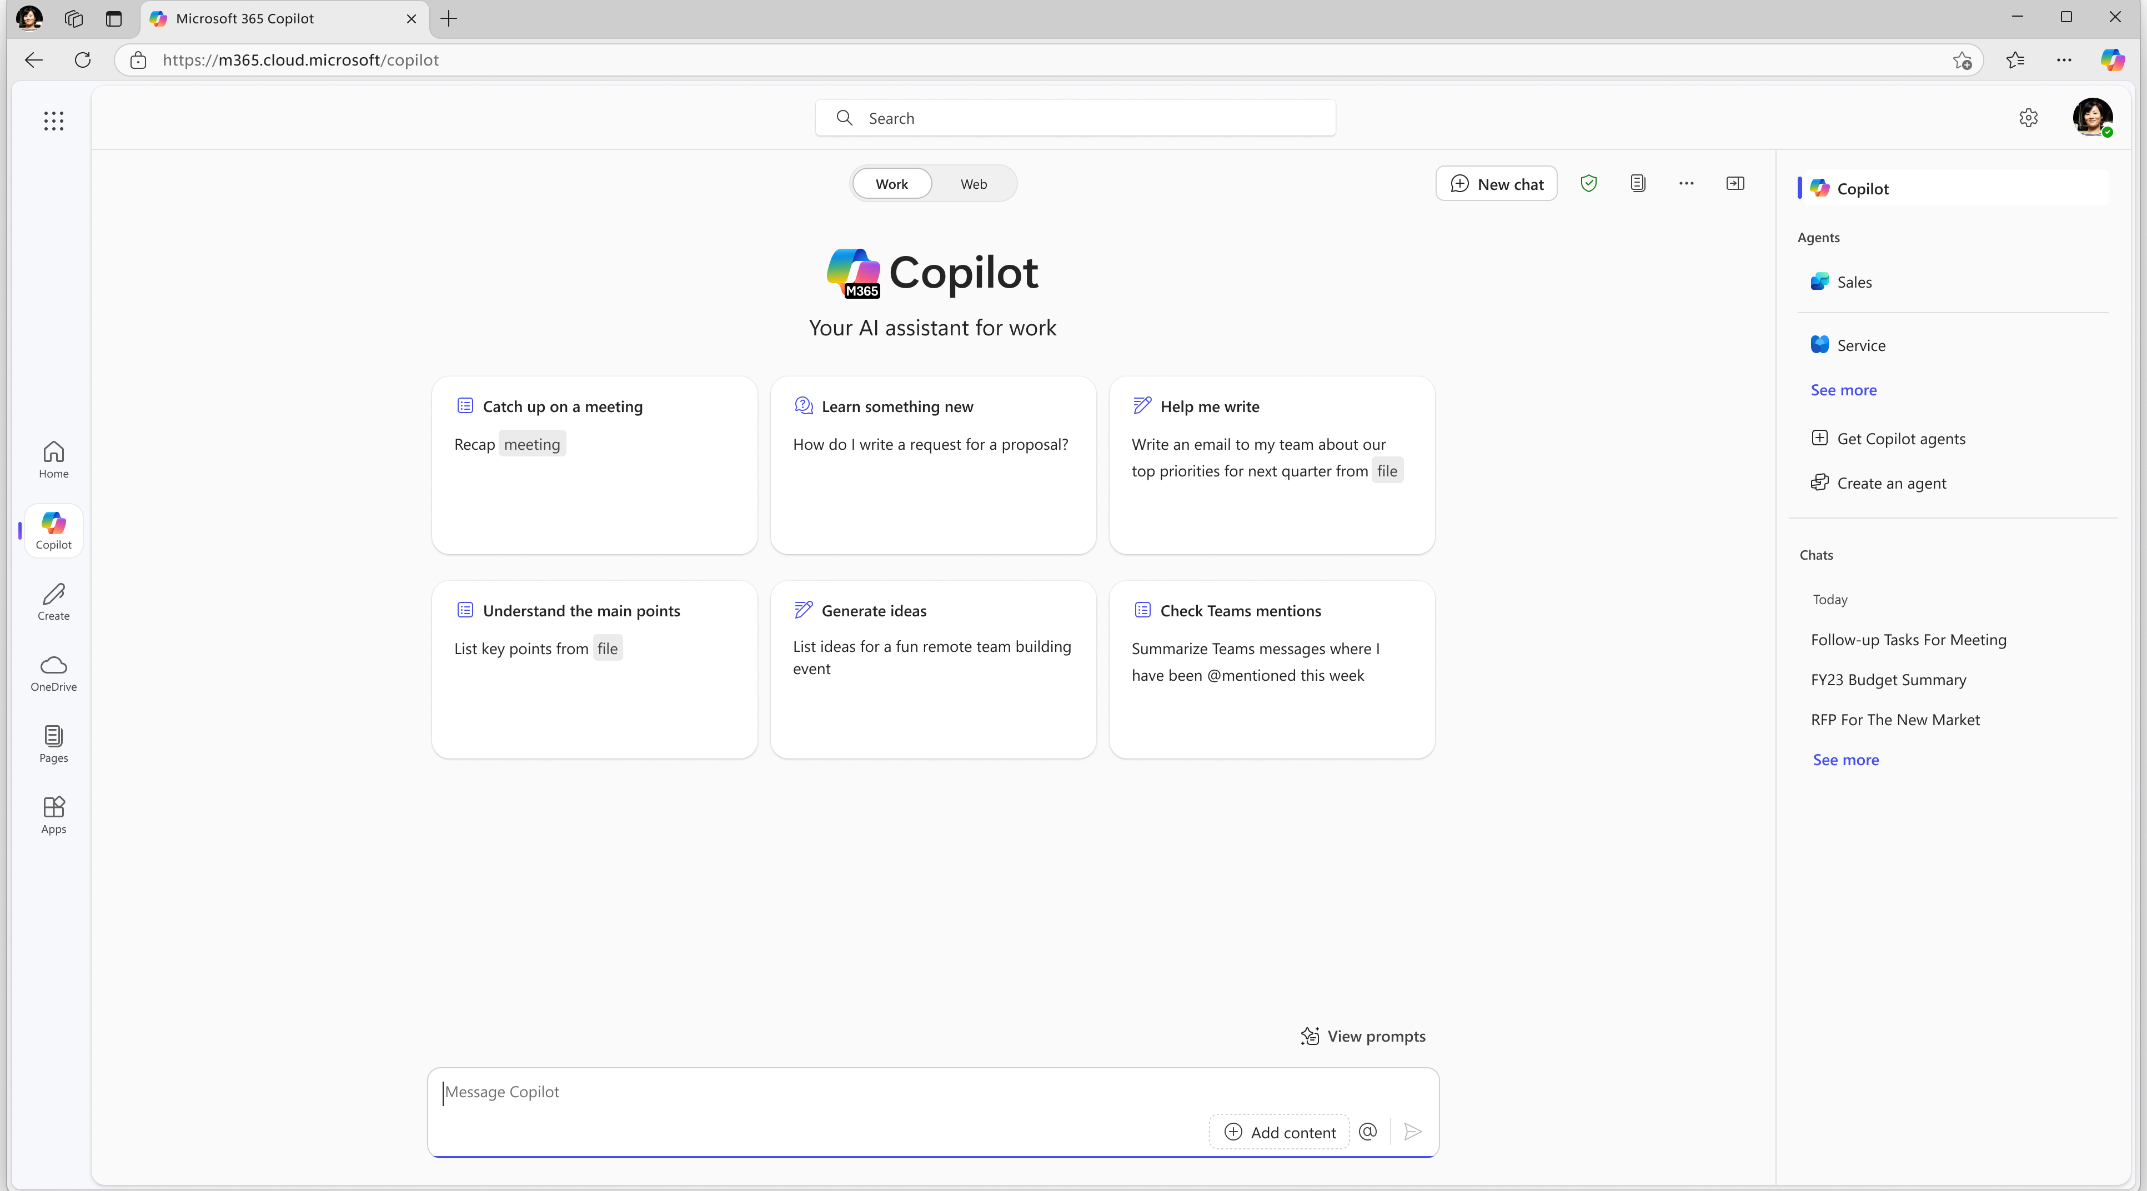
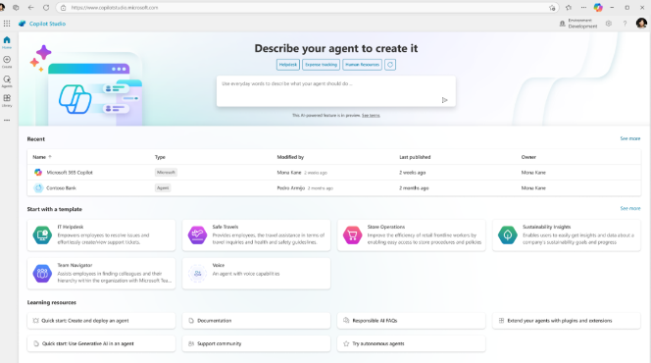
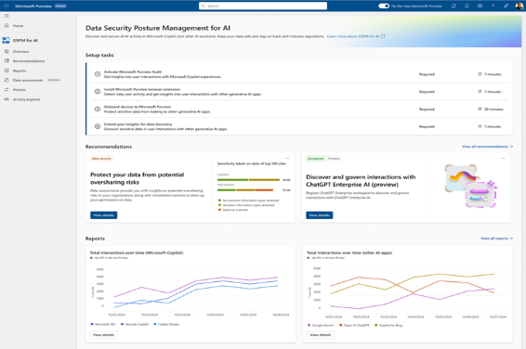
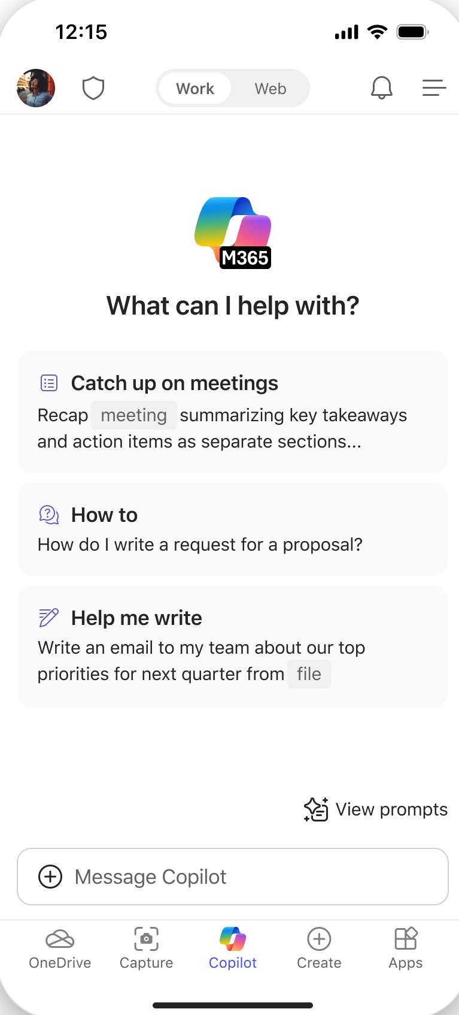
Introducing Microsoft 365 Copilot Chat
Chat
Agents
IT Controls
Free AI chat -- powered by GPT 4o and grounded in the web
Integrated into the chat experience and paid for on a consumption basis
Enterprise Data Protection and management
Notes:
That’s why we introduced Microsoft 365 Copilot Chat. A new way for EVERY organization to quickly and securely scale AI adoption so no employee is left behind.
Copilot Chat combines three powerful capabilities into one integrated product to unlock the measurable value of AI at work…
First is free, secure enterprise-ready AI chat that’s powered by GPT 4o and grounded in the web. This chat experience is going to become an essential, day-to-day tool for everyone in your organization. None of your employees are going to want to work without it.
Second – agents that will enable you to reimagine business process and realize real cost savings and revenue generation. These agents are integrated into the chat experience and paid for on a metered consumption basis, so you only pay for what you use.
And third, robust IT controls that ensure enterprise-grade security, privacy, compliance, and management.

Slide 7

Microsoft 365 Copilot
Copilot Chat
Chat
Free, secure AI chat
Chat Work scope
Copilot in Microsoft 365 apps Teams, Outlook, Word, Excel, PowerPoint
Your personal AI assistant
Agents
$30
Copilot Control System
Copilot Analytics
Notes:
Copilot Chat provides free and secure AI chat as a foundational and standardized user experience.
There’s no shortage of AI solutions out there, but Copilot Chat is the only one that’s free and secured by the same organization you already trust with all your emails and files. AND it gives you access to pay-as-you-go agents that will be critical to transforming business process.
Microsoft 365 Copilot remains our best-in-class personal AI assistant. It offers the best value, and we’re continually adding new features and functionality. Microsoft 365 Copilot includes all the capabilities of Copilot Chat and more.
It includes chat that’s grounded in your tenant work data, access to and usage of agents, and all the productivity capabilities within the Microsoft 365 apps your employees use every day, like Teams, Outlook, Word, Excel, and PowerPoint.
And Microsoft 365 Copilot comes with advanced management capabilities and Copilot Analytics – a new set of advanced analytics to measure Copilot-driven business outcomes.

Slide 8
3 essentials for Copilot success
Leadership
Human change
Technical readiness
Develop leadership capabilities to leverage AI for business outcomes
Manage the human transformation with robust user enablement programs
Build and iterate technical skills to deliver on business results
Executive sponsorship
Align AI to business strategy
Providing clarity and prioritization
Best practice: AI Council
User enablement program
Communications and community
Skilling and training
Best practice: Community of Practice and Copilot Dashboard
Secure your data infrastructure
Policy review
Extend to new high value line of business scenarios
Best practice: Optimization Assessment
Responsible AI principles
Notes:
There are three fundamental components to Copilot success.
1st is leadership. It's important that your business leaders are sponsoring and championing this change as well as driving the strategy throughout the rollout.
There's also an element of human change including re-skilling and new ways to work, new ways to do the same processes that people have been using for a long time.
The third piece includes technical skills and transformation that will be important for your leaders to invest in throughout the journey.
Through all these components, you will want to keep Responsible AI principles at the forefront of what you’re doing.
You will see these again as we move forward.
__________________________________________________________________
1) Leadership and sponsorship are critical for aligning AI investments to business priorities, and defining high value scenarios
Best practice: create an AI Council from representative across the organization to help guide and measure adoption
2) Human change requires a dedicated workstream: User enablement program, communications and community, skilling and training, as well as authentically getting and acting on feedback
Best practice: Get and respond authentically to user feedback
3) Technical readiness includes things like securing your data infrastructure, risk management, and technical skilling (especially for customization and extensibility).
Best practice: is to create an AI Center of Excellence with skilled resources that can act as a shared service and drive knowledge transfer throughout the organization.

Slide 9

Microsoft 365 Copilot implementation
Human change
Prepare organization and employees for the AI transformation journey through user enablement programs
Copilot
readiness checklist
You are here
Workstreams support each other for maximum value and ROI
Copilot implementation
Sponsor
Scenarios
Security
Get ready > Onboard & engage > Deliver impact > Extend & optimize
Technical readiness
Address technical deployment and optimization, including governance, security, compliance, and management
Leadership journey
Notes:
If we step back at the highest level, this is the end-to-end implementation journey that you’ll go through.
It's important that you start thinking about the three Ss in the Copilot readiness checklist as early as possible.
First is the sponsor. It's important to have leadership, if possible, C-suite level sponsorship, whenever there are blockers or challenges that are faced across the rollout.
2nd is scenarios. It is important early on that business leaders get a sense of where they want to start their Copilot innovation. Many have had success with a functional approach, deciding if it's HR, Finance, Marketing, or another area of the business, and what Key Performance Indicators (KPIs) they want to see Copilot impact and improve.
And then finally security. You want to start the security, data, and privacy conversation as early as possible to make sure you know what your path and journey is going to look like.
It's important that the Human change (user enablement) and Technical readiness workstreams start at the same time and that they work hand in hand. This is where your sponsor and your change management team will really serve as the glue to help these workstreams support each other, and that is how customers are seeing the highest Return On Investment (ROI) value and are delighting their business users with Copilot.
Of course, the leadership workstream cuts across the entire journey, and we want to make sure that we're keeping our business leaders and sponsors engaged.

Slide 10
3 essentials for Copilot success
You are here
Leadership
Human change
Technical readiness
Develop leadership capabilities to leverage AI for business outcomes
Manage the human transformation with robust user enablement programs
Build and iterate technical skills to deliver on business results
Executive sponsorship
Align AI to business strategy
Providing clarity and prioritization
Best practice: AI Council
Secure your data infrastructure
Policy review
Extend to new high value line of business scenarios
Best practice: Optimization Assessment
User enablement program
Communications and community
Skilling and training
Best practice: Community of Practice and Copilot Dashboard
Responsible AI principles
Notes:
We begin with leadership.
1) Leadership and executive sponsorship are critical for aligning AI investments to business priorities and defining high value scenarios
Best practice: create an AI Council with representatives from across the organization to help guide and measure adoption.

Slide 11
Secure exec sponsorship
Leadership
Ensure they understand the ABCs:
Executive Sponsors should:
Executive Sponsors may:
Help the project team identify and prioritize their top business needs.
Encourage shared planning between user enablement and technical teams.
Play a role in communicating the vision to leaders across the organization.
Actively participate in and use Copilot to help drive and reinforce enablement.
Promote the enablement program. Studies show engaged employees are 2.6x¹ more likely to fully support a successful AI transformation.
Lead or participate in the organizational AI Council.
Have purchasing authority for licenses or services from supporting suppliers.
Be directly accountable for Microsoft 365 or broader digital workplace initiatives.
A
Active, visible, and consistent participation
B
Build a coalition with their executive peers
C
Communicate directly with employees to support landing the change
¹The state of AI change readiness eBook, Microsoft Viva People Science
Notes:
For Copilot success, again you will want to ensure your sponsors are engaged. Ensure they understand the ABCs:
They should be active, visible, and have consistent participation.
They should build a coalition with their executive peers.
They should communicate directly with employees to support landing the change.
The active involvement of executive sponsors is a key factor in the success of any implementation. This slide gives a good delineation of what executive sponsors should be doing and what they may do to go the extra mile. You’ll see this broken down more in the User Enablement Guide.

Slide 12
Clarify AI value drivers
Leadership
Organization and culture
Business strategy
Applied AI experience
AI
governance
Technology strategy
Do you have an operating model to enable the adoption and use of AI?
Do you have top-down support?
What business outcomes are you driving?
How can AI help you achieve those outcomes?
Do your people have diverse experiences and skills with AI?
Is your organization collaborating to build experience?
Are you implementing processes and controls that are transparent?
Are you governing data privacy and security?
Do you have access to quality data?
Is your infrastructure set up to help you scale?
Notes:
Across each of these value driver areas, there are key questions you can and should ask yourselves to determine if your organization is focusing on the right things to allow for accelerated AI transformation with clarification:
When it comes to organization and culture – do you have an established operating model to industrialize and enable the adoption and use of AI, and has your leadership clearly communicated that model and vision from top-down?
For business strategy – what types of business outcomes are you focused on driving, and have you determined how AI can help you achieve those outcomes?
For applied AI experience – have you examined how diverse and skilled your organization possesses with AI? Also, are you actively encouraging cross-team collaboration so that everyone can build experience with using AI and what it looks like to realize value from AI?
For AI governance – are you implementing processes and controls and responsible AI practices, and making those transparent? Are you governing data privacy and security?
Lastly – when it comes to technology strategy, have you enabled your organization to have access to quality and comprehensive data given that AI experiences are only as good as the data is? Are you equipped to scale from an infrastructure standpoint as the potential demand for your AI experiences and solutions increase?

Slide 13
Create an AI Council
Leadership
A cross-functional body unique to your needs
Oversees and guides the development, deployment and evaluation of AI capabilities
IT enablement team
Responsible for technical preparedness and rollout, providing onboarding support, as well as managing feedback and compliance.
Executive sponsor
Drives adoption and infuses confidence in the technology. Active champion that encourages integrating AI into day-to-day processes.
Change management team Bridge between the AI council and employees, helping to monitor adoption progress, gather feedback, and foster a collaborative environment.
Risk management
Ensures compliance to AI regulations and ethical standards. Ensure organization’s AI initiatives are transparent, accountable, and trustworthy.
Notes:
It is essential for organizations to establish a governance framework that ensures the responsible and ethical use of AI across their operations and stakeholders. This is where creating an AI Council comes in.
The AI Council should have representatives in each of these four roles:
-IT enablement team
-Executive sponsor
-Change management team
-Risk management team
This collaborative council allows everyone to be “in the know” at every step in the Copilot implementation journey.

Slide 14
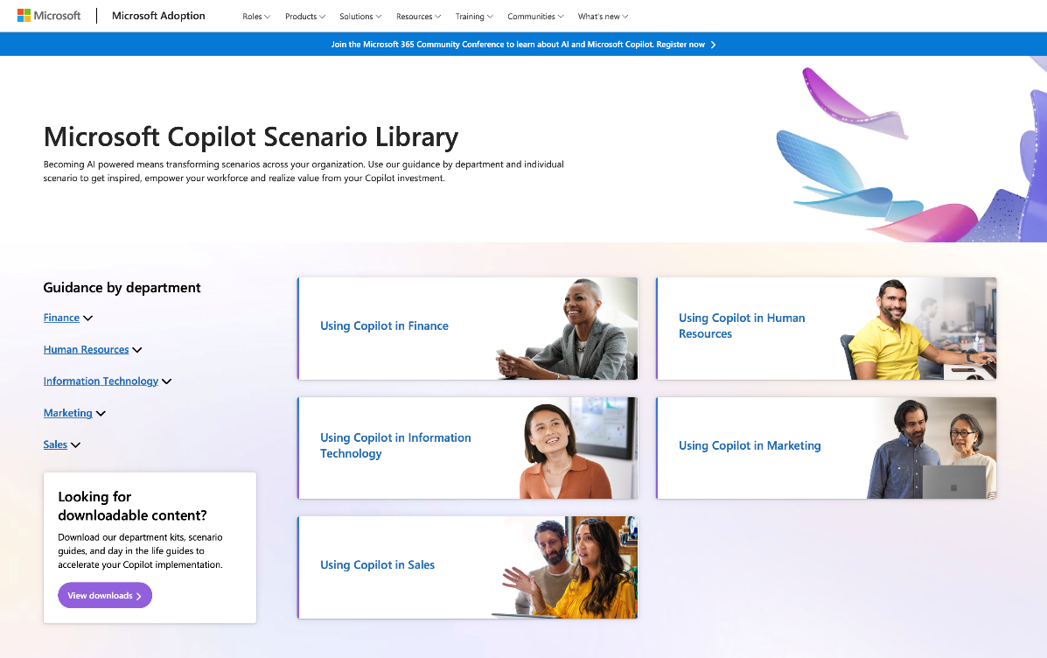

Identify initial high-value Copilot scenarios
Leadership
Copilot brings AI value across lines of business
Use the Scenario Library to identify top use cases and business metrics you would like to improve in that functional area.
Library PPT deck: https://aka.ms/CopilotScenarioLibrarySlides
All roles & execs
HR
Marketing
Operations
IT
Sales
Finance
Improve meetings
Content creation
Manage daily agenda
Cost per hire
Employee turnover
Compliance risk reduction
Leads created
Brand value
Cost per lead
Customer retention
Product time to market
Supply chain efficiencies
Outstanding support tickets Application downtime Departmental spending
Number of opportunities
Close rate
Revenue per sale
Accelerate cash flow
Spend on ERP system
Risk reduction
https://aka.ms/Copilot/ScenarioLibrary
Notes:
The Copilot Scenario Library offers examples of the top use cases by functions and metrics to help you measure areas you'd like to improve.
It maps the scenarios to Copilot product capabilities which provide a blueprint for functions of specific roles within your organization.
You can check these out at https://aka.ms/Copilot/ScenarioLibrary.

Slide 15
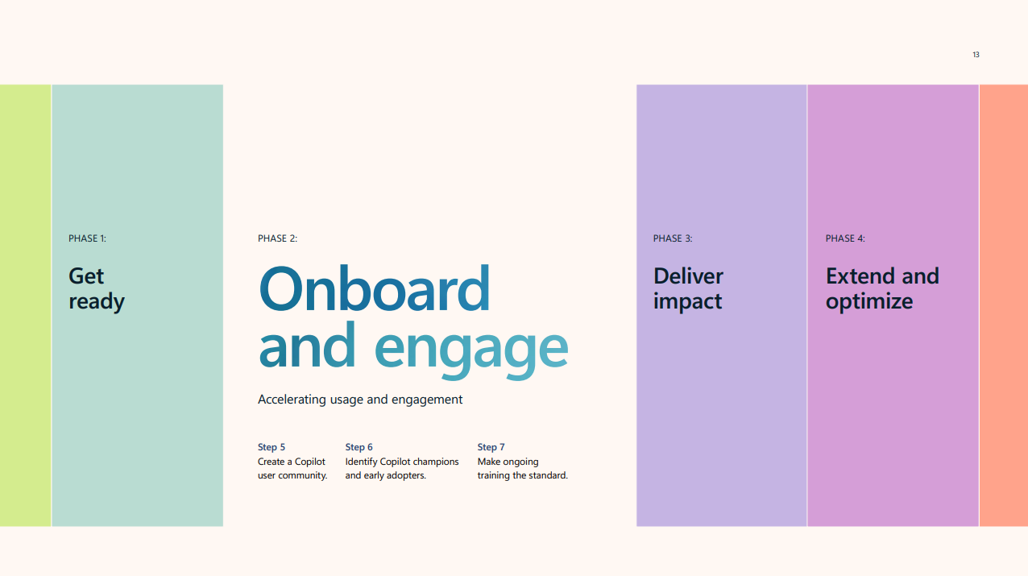
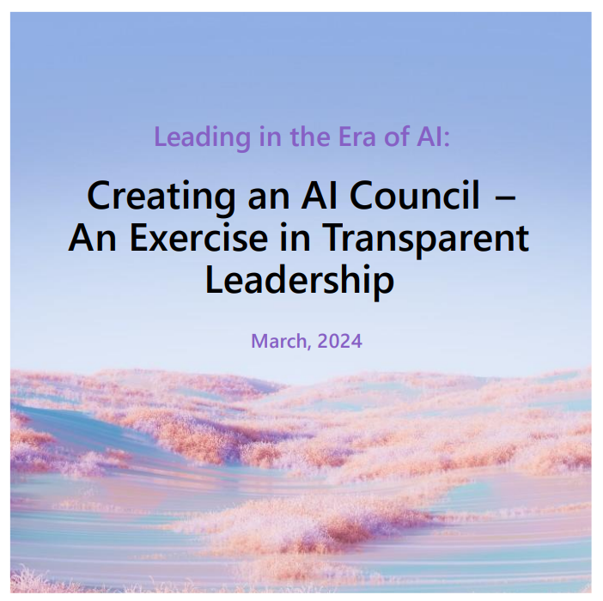

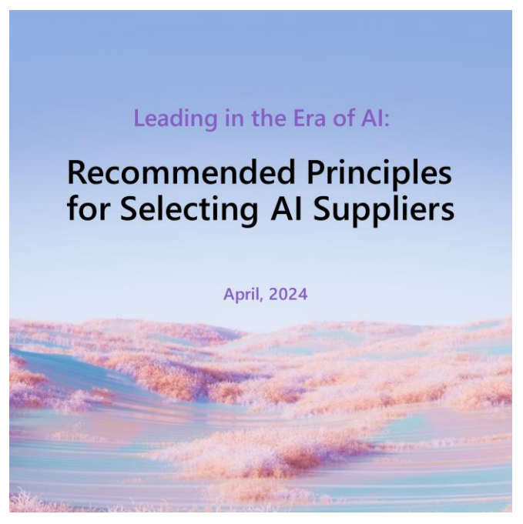
Leverage AI for business outcomes
Leadership
Get tips for your AI journey with actionable guidance from early adopters with the Business Leader’s guide for AI adoption.
Explore practical guidance for aligning AI strategy with business goals and mitigating risk with the Leading in the Era of AI: Creating an AI Council - An Exercise in Transparent Leadership whitepaper.
Learn about building trust and putting human connections first to get the most from AI with the whitepaper, Leading in the Era of AI: It's not about AI - It's about trust.
Read how those you enlist to support your success will guide it to the next horizon of business expansion with the Leading in the Era of AI: Recommended Principles for Selecting AI Suppliers whitepaper.
Notes:
There are several assets available to help you learn how to leverage AI for business outcomes.
The Business Leader’s guide for AI adoption is a step-by-step implementation guide for leaders. Built off the learnings from customer insights, this playbook provides actionable guidance to business leaders on how they can begin to adopt Copilot within their organization. This eBook explores:
how to prioritize licenses and capitalize on early productivity gains
how to get up and running quickly and build momentum
when you can expect so see and how to quantify business results
The whitepaper series, Leading in the Era of AI:
Creating an AI council - An exercise in transparent leadership: Explore practical guidance for aligning AI strategy with business goals and mitigating risk
It's not about AI, it's about trust: Learn about building trust and putting human connections first to get the most from AI
Recommended principles for selecting AI suppliers: Read how those you enlist to support your success will guide it to the next horizon of business expansion

Slide 16
3 essentials for Copilot success
You are here
Leadership
Human change
Technical readiness
Develop leadership capabilities to leverage AI for business outcomes
Manage the human transformation with robust user enablement programs
Build and iterate technical skills to deliver on business results
Executive sponsorship
Align AI to business strategy
Providing clarity and prioritization
Best practice: AI Council
Secure your data infrastructure
Policy review
Extend to new high value line of business scenarios
Best practice: Optimization Assessment
User enablement program
Communications and community
Skilling and training
Best practice: Community of Practice and Copilot Dashboard
Responsible AI principles
Notes:
The next fundamental components to Copilot success is human change.
2) Human change requires a dedicated workstream: User enablement program, communications and community, and skilling and training
Best practice: create a Community of Practice for your users to share their success stories, ask questions, and learn from each other, and leverage the Copilot Dashboard to gain insights on usage

Slide 17
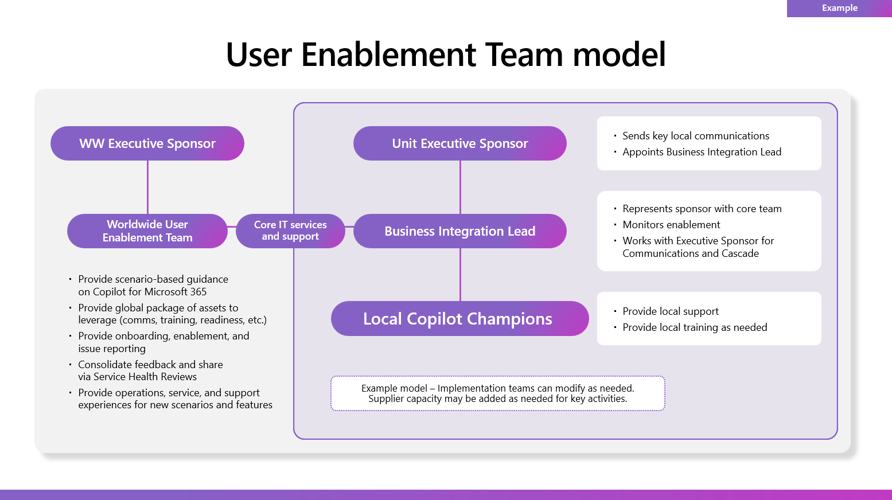
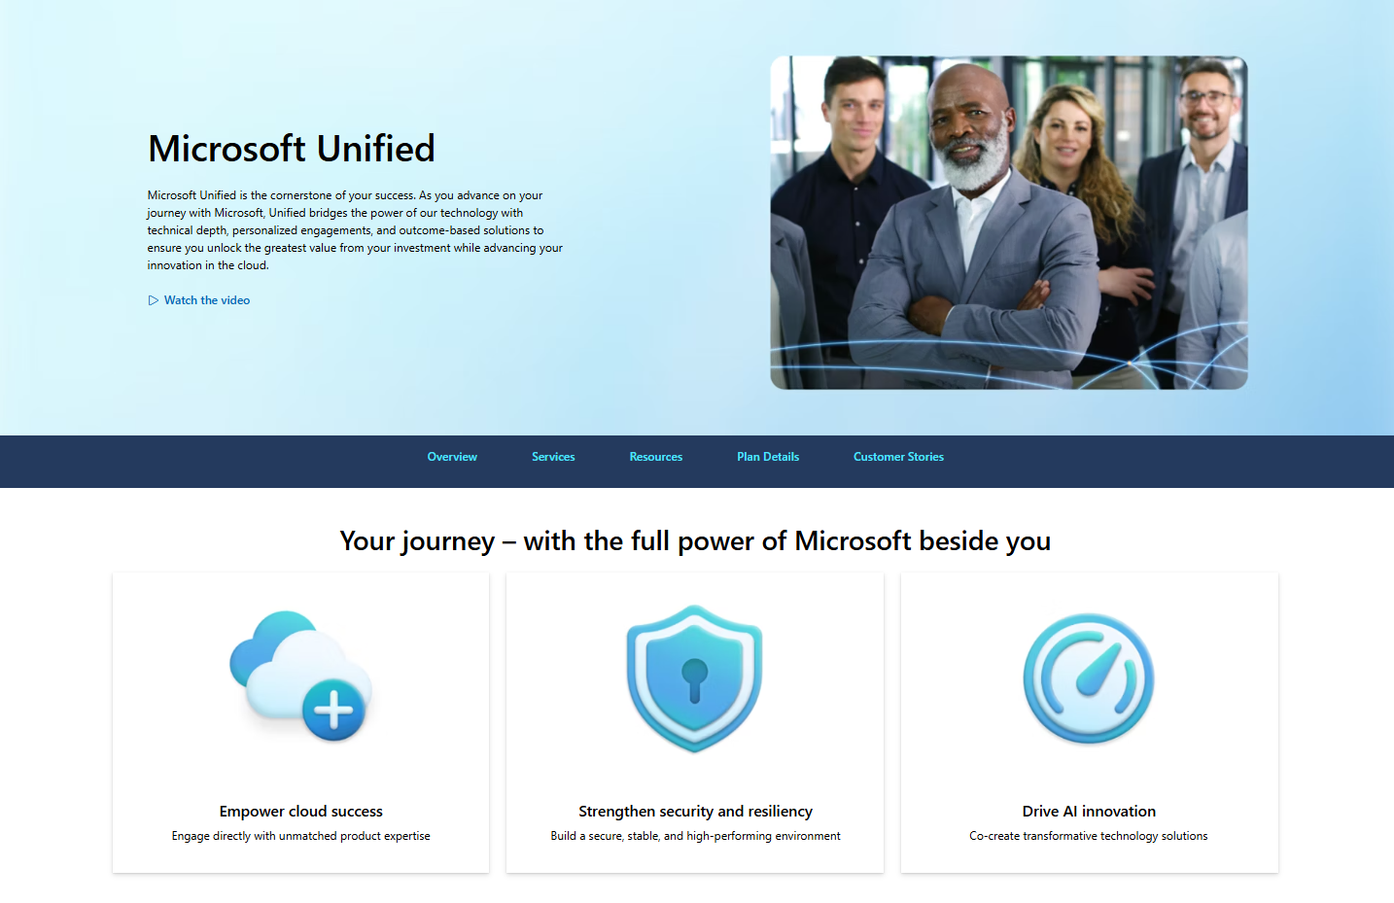
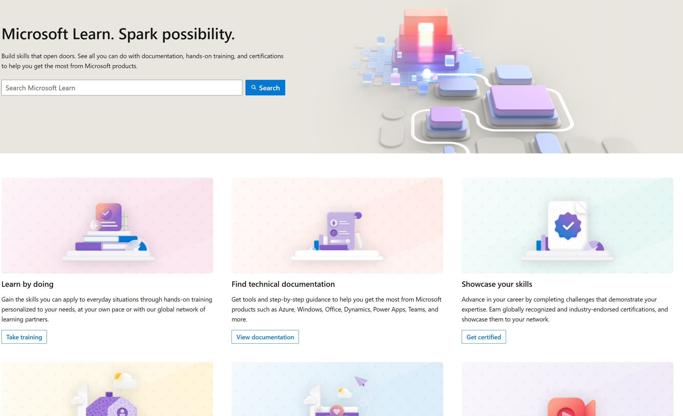
Microsoft 365 Copilot Implementation executive summary
Human change
Get ready
Onboard & engage
Deliver impact
Extend & optimize
1
2
3
4
Select initial departments for rollout with the Scenario Library. Target a critical mass of users for rapid impact.
Lay the foundation for an intelligent progression of AI skills with Copilot Prompt Gallery.
Review success measures with the Copilot Dashboard and the User survey kit.
Extend to new scenarios and transform business processes.
Copilot readiness checklist
Human CHANGE
Identify your success team
Be intentional with assignment and concentrate seats
Deploy training and Champion programs, engagement community
Make ongoing training the standard
Quantify of your investments and understand how employees are benefiting
Build momentum with success stories and knowledge sharing
Identify new high value functional and line of business scenarios
Recognize and reward success
Support continuous learning and optimization
User Enablement Guide
Prepare your organization and employees for AI transformation journey with the User Enablement Guide.
Microsoft Unified
Unified unlocks the greatest value from
your investment.
Copilot learning hub
Build your skills across Microsoft Copilot with industry leading online training and certification programs.
Microsoft resources
Notes:
The Microsoft 365 Copilot implementation framework is broken out into these four phases across both the human change and technical readiness workstreams: get ready, onboard and engage, deliver impact, and extend and optimize.
It's important that the two workstreams work hand in hand and stay connected throughout these milestones on the journey.
Let’s first focus on human change.
To get ready for human change, you're deciding which department(s) you're going to rollout Copilot to first based on the Scenario Library and who your success team is. You will want to be intentional with license assignments and concentrate them for better evaluation.
Onboard and engage is where you rollout training for your users and set up your Champion program. The Copilot Prompt Gallery is ideal for users to discover prompts to get the started with their AI skills.
Delivering impact is where you measure success and understand how Copilot is impacting your business. User surveys and the Copilot Dashboard give insight on usage and where they are with the pre-defined success measures.
Finally extend and optimize is where you want to start thinking about new, high-value business scenarios and the next functional areas to roll out Copilot. This is also where you should also recognize and reward success for Champions and users who have been part of the implementation.
Throughout all phases, it is important for leaders to support continuous learning and optimization.

Slide 18
Drive human change with best practices
Human change
Change ‘adopted’
Sufficient benefits realized
Benefits outlined in the business case
Future state
With change management
Proficiency
Higher likelihood of Copilot adoption and benefits realization.
Organizational performance/
value realization
Copilot readiness complete
Licenses assigned
Adoption
Deep, habitual usage that delivers measurable value to the employees, a line of business, and the organization.
Without change management
More challenging transition, fewer employees ‘on board,’ and
more resistance. Longer time to
benefits realization.
Transition state
Deployment
Technology implementation including design, development, addressing technical prerequisites or controls, and making the solution available for use.
7x
More likely to meet or exceed project objectives when have excellent change management practices, compared to poor change management practices (Prosci, 2024)
Usage
Employees consume the service as available through user enablement alone.
Current State
Time
Notes:
Here we can see the importance of driving human change with change management and adoption vs without.
When you deploy Microsoft 365 Copilot with the minimum user enablement, usage has a slower and lower rate of proficiency.
When you add in change management, be it in-house, with a Unified Cloud Solution Architect, or with a Microsoft Partner, you will move to adoption and a higher level of proficiency than without.

Slide 19
Lay the foundation for continuous learning and an intelligent progression of AI skills
Human change
3
Advanced
skills
Generate synergies across departments with extensibility
Streamline and automate cross-business process flows
Org value
Start here
2
Departmental skills
Departmental value
Use role-specific and multi-step prompts
Extend usage to role-based processes
1
Foundational skills
Inspire quick wins to reach value tipping point
Master basic prompts (e.g., summarization, revision)
Individual value
1
Start with top 10 generic skills from Copilot Prompt Gallery that deliver immediate success (e.g., summarize a meeting, email thread)​.
2
Use the Copilot Scenario Library to train users on new departmental use cases and process improvement to impact departmental KPIs.
3
Extend to line of business systems to streamline and automate for organizational level impacts on revenue and costs.
Prioritize peer-to-peer learning through community engagement and knowledge sharing.
Notes:
It's important to set the right foundation for driving value and setting expectations because your users are going to want to understand, “What is the impact? What is the ROI?”
We all start with Copilot value at this first level – what we call individual value or foundational skills. These are the skills such as summarizing your meetings, revising your Word drafts, etc. – things that help all users, regardless of what their job or function is.
Once you get pretty good at that, you move to the next level where you start digging into departmental or job-specific prompts, such as multi-step or multi-turn. This is where users start to feel like they're really getting high value out of Copilot.
Finally, there's the org value, or advanced skills, where people start to streamline and automate some of those business flows. There are huge gains here and by the time you get to the third level here, the ROI is very apparent about the value and the gains that you’re seeing.
Make sure that you're setting the right expectations for this journey of intelligent progression of AI skills.

Slide 20
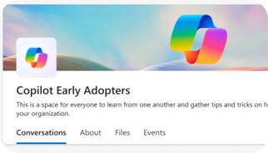
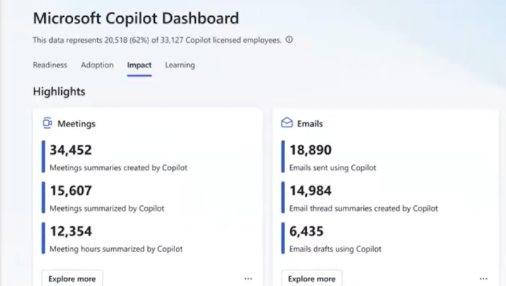
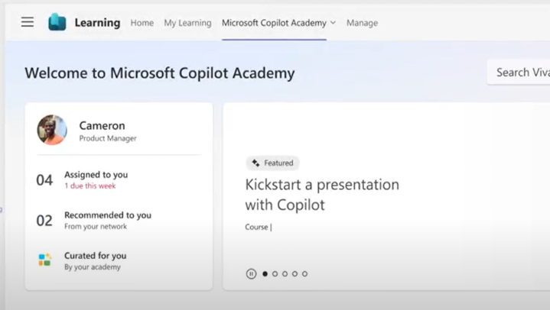

Accelerate your AI workforce transformation
Communications
Measurement
Skilling
Copilot Communities to facilitate user enablement
Share best practices
Access company announcements
Seek support from peers and IT
Copilot Analytics for ROI and impact assessment
Copilot Dashboard for leaders
Viva Insights for customizable analysis
Copilot business impact reports
Copilot Academy for user skill development
Curated learning paths
Hands-on prompt guidance
Content created by Microsoft experts
aka.ms/CopilotCommunities
aka.ms/CopilotAnalytics
aka.ms/CopilotDashboard
aka.ms/CopilotAcademy
Powered by Microsoft Viva
Notes:
Microsoft Viva can help accelerate your AI transformation in three areas:
Copilot communities, powered by Microsoft Viva Engage, facilitate user enablement, providing a Community of Practice for users to share their success stories and celebrate others’, ask questions, and find more training.
The Copilot Dashboard, powered by Microsoft Viva Insights, provides analytics and data on usage, as well as impact reports.
The Copilot Academy from Microsoft Viva Learning can be accessed in Teams, right in the flow of work, for user skill development and training.

Slide 21
3 essentials for Copilot success
You are here
Leadership
Human change
Technical readiness
Develop leadership capabilities to leverage AI for business outcomes
Manage the human transformation with robust user enablement programs
Build and iterate technical skills to deliver on business results
Executive sponsorship
Align AI to business strategy
Providing clarity and prioritization
Best practice: AI Council
Secure your data infrastructure
Policy review
Extend to new high value line of business scenarios
Best practice: Optimization Assessment
User enablement program
Communications and community
Skilling and training
Best practice: Community of Practice and Copilot Dashboard
Responsible AI principles
Notes:
The next fundamental components to Copilot success is technical readiness.
3) Technical readiness includes things like securing your data infrastructure, risk management, and technical skilling (especially for customization and extensibility).
Best practice: perform the Microsoft 365 Copilot Optimization Assessment.

Slide 22
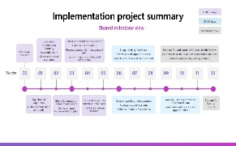
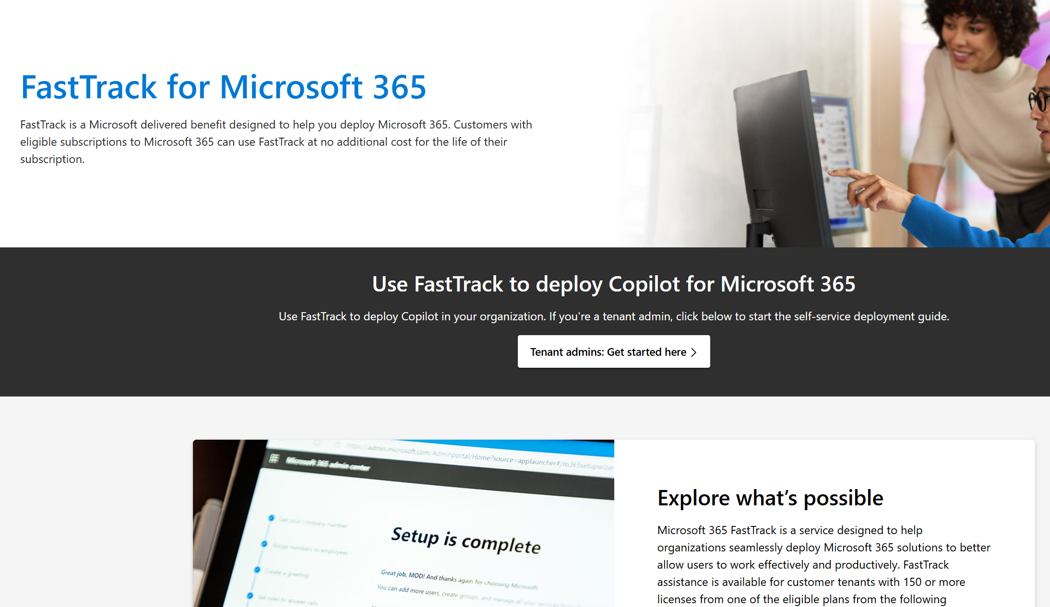
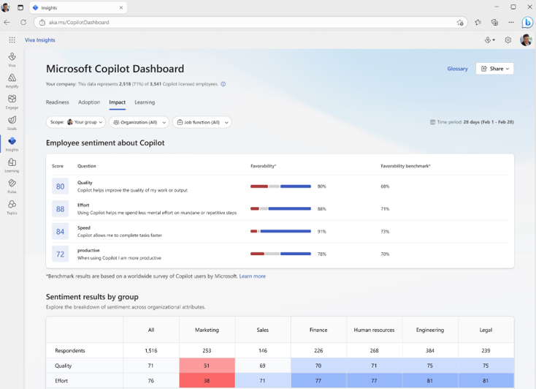
Microsoft 365 Copilot Implementation executive summary
Technical readiness
Get ready
Onboard & engage
Deliver impact
Extend & optimize
1
2
3
4
Perform the Microsoft 365 Copilot Optimization Assessment
Prepare Microsoft 365 for AI deployment with the Setup Guide
Mature AI management skills through improved IT service delivery
Provide insights on service health and optimization opportunities
Copilot readiness checklist
Address data security, governance, and data access questions
Build shared Copilot implementation plan with User Enablement team
Technical Readiness
Ensure appropriate Data Security controls are in place
If needed, deploy additional Microsoft 365 apps
Establish service management plan
Review Admin usage reports and the Copilot Dashboard to analyze user adoption and usage patterns
Design, build, and publish plugins to deliver unique experiences
Build your own custom agents
Support continuous learning and optimization
Technical Readiness Guide
Get up and running quickly with proper security and governance controls using our Technical Readiness Guide.
Microsoft FastTrack
FastTrack is a Microsoft delivered benefit to help you deploy Microsoft 365.
Copilot Dashboard
Measure the impact of your Copilot investment with the Copilot Dashboard.
Microsoft resources
Notes:
Once again, it's important that technical readiness works hand in hand with human change, and these teams stay connected throughout these milestones on the journey.
Let’s focus on the technical readiness recommendations for deployment.
In the get ready stage, perform the Optimization Assessment to analyze your current security and compliance posture.
In onboard and engage, we recommend using the Copilot setup guide to ensure you have proper data security controls in place and to determine if you need to deploy additional Microsoft 365 apps.
In deliver impact, establish a service management plan and enable the Copilot Dashboard to analyze user adoption and usage patterns.
Finally, extend and optimize to take insights on optimization opportunities and service health and consider how the technical team can start to customize and build internal agents, use extensibility plugins, and start to drive the next level of AI value.
Again, this whole journey works best if leadership supports continuous learning and optimization of Microsoft 365 Copilot.

Slide 23
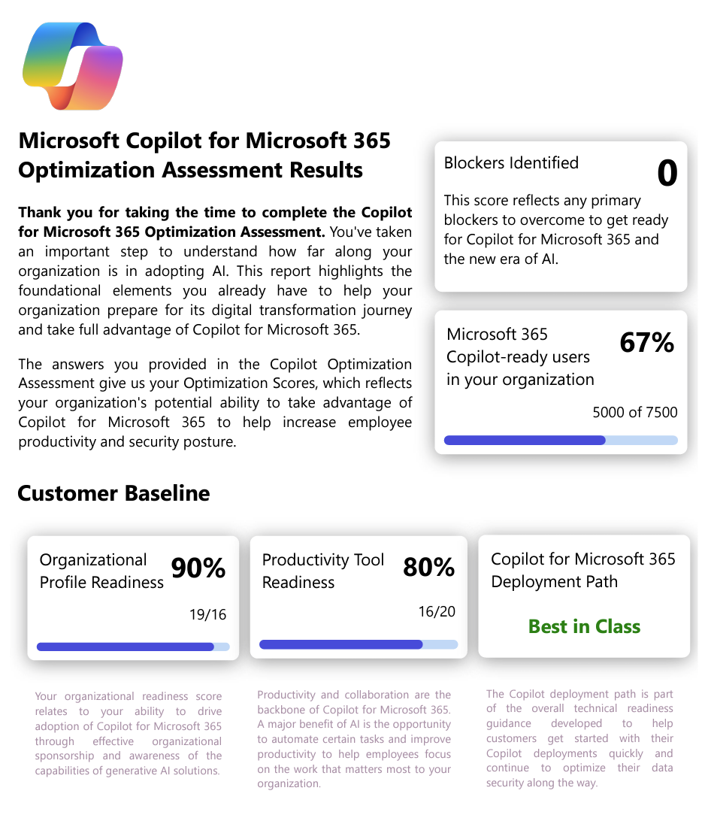
Perform the Microsoft 365 Copilot Optimization Assessment
Technical readiness
Get ready
Optimization Assessment
The assessment is designed to understand your current licensing profile, your collaboration tools, sensitive data handling, and security controls implemented today in your organization, helping you identify a clear path to deploying Microsoft 365 Copilot. The assessment consists of 26 questions and takes about 30 minutes to complete.
Complete the Microsoft 365 Copilot Optimization Assessment
Understand current licensing
Understand identity management
Understand current collaboration tools
Understand current data locations
Uncover opportunities to implement data security measures and improve data security posture to optimize user experience with Microsoft 365 Copilot
Notes:
The Microsoft 365 Optimization Assessment tool is designed to help organizations analyze their computing environment and provide recommendations for optimization Copilot.
The assessment aims to enhance productivity, streamline workflows, and drive digital transformation.
Once you have completed the Optimization Assessment, you should understand your current licensing, identity management, current collaboration tools, and current data locations.
This will uncover opportunities to implement important data security measures and improve security posture to optimize the Copilot experience while protecting your data.

Slide 24
Extend & optimize
Technical readiness
Explore
Expand
Extend
Identify new high value scenarios
Understand Copilot Studio capabilities
Scale Copilot users and skills
Gather data from service health reviews
Prioritize via AI Council and leadership engagement
Skill/acquire talent for extensibility opportunities
Build, automate, and administer agents
Select extensibility scenarios
Extend throughout organization
Identify high value user cohorts for advanced skill building
Optimize usage patterns
Notes:
Once you get to extend and optimize, it's really about exploring new scenarios and where you want to go next, expanding those capabilities with Copilot Studio and agents, and extending to new use cases, new departments, and new functional areas across your organization.

Slide 25
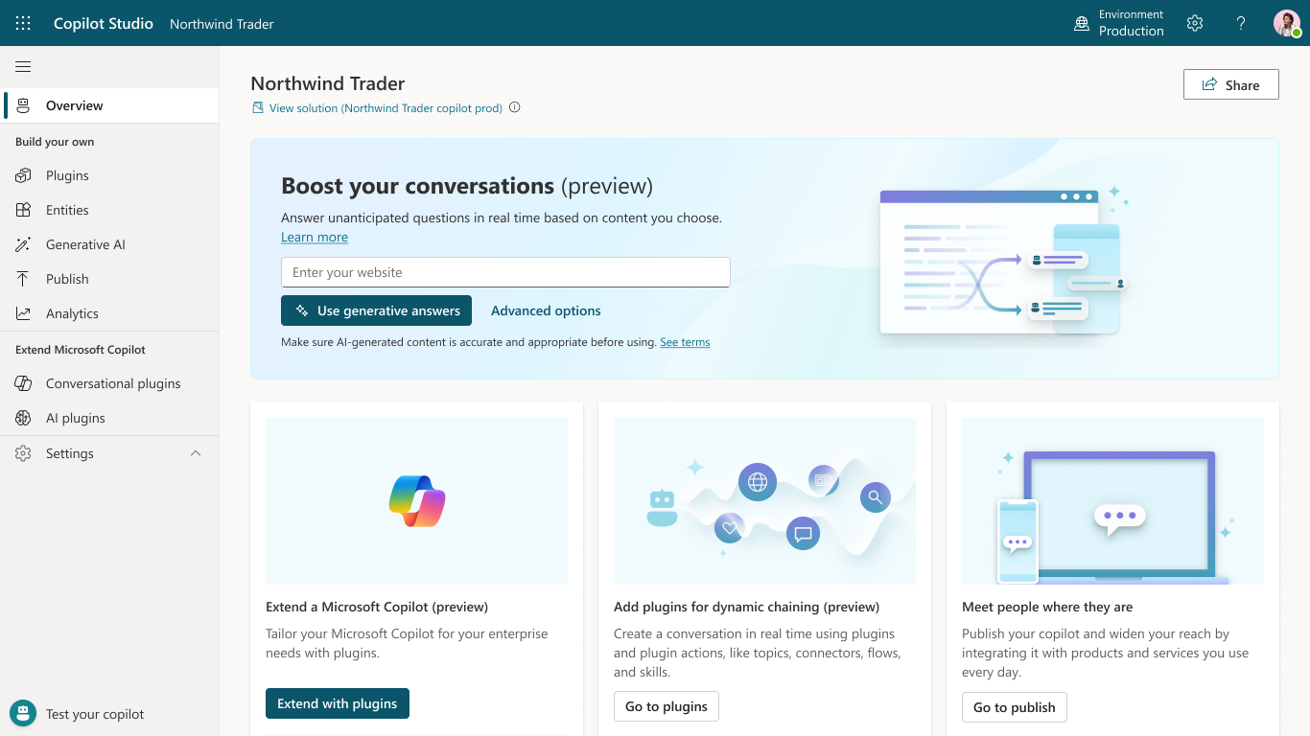
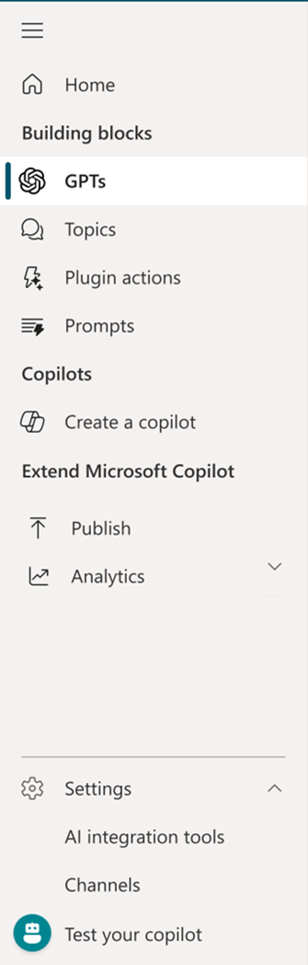

Microsoft Copilot Studio
Build your own agents
Create and publish a custom agent for your organization using the intuitive building experience enhanced with large language models and generative AI
Customize Microsoft Copilot
Extend and customize 1st party agents with your own enterprise scenarios. Copilot Studio will be included with the Microsoft 365 Copilot SKU.
Connected platform
Integrates and exposes various Microsoft’s conversational AI technology stacks – integrated with Azure AI Studio, Azure Cognitive Services, Azure Bot Framework, Power Platforms AI models, and more
Manage experiences
Governance and control features to monitor usage with full visibility of customizations, standalone agents as well as who is building and customizing them.
Notes:
Copilot Studio is an end-to-end conversational AI platform that empowers you to create and customize copilots with a low-code graphical interface.
With Copilot Studio, you can easily design, test, and publish agents that suit your specific needs for internal or external scenarios across industry, department, or role.
It allows you to connect Copilot to other data sources using either pre-built or custom agents, create and orchestrate sophisticated logic, and manage your experiences with ease.
Whether you’re looking to customize an existing agent or build your own from scratch, Copilot Studio provides an intuitive, low-code experience that puts the power of AI at your fingertips.

Slide 26
Microsoft investments to accelerate your time to value
Customers that buy more than 150 Copilot seats are eligible for Microsoft co-investment in partner deployment and adoption services through eligible Microsoft Partners.
Eligible customers can request technical and deployment assistance from Microsoft FastTrack.
Get started on your Copilot journey with expert-led services through Microsoft Unified.
Notes:
REMEMBER: you don't have to do this on your own. Microsoft has great resources for deployment and adoption services available through our Microsoft Partners, and FastTrack is a free service that can help if you have questions about technical security and compliance deployment elements.
Finally, we have our flagship Microsoft Unified services with top experts ready to help through the user enablement components and the technical readiness pieces to help you get started and loving Copilot.

Slide 27







Industry leaders gaining business value with Copilot
70%
Marketing team’s time to create new content reduced by 67%
7 months of work completed in 7 weeks
68,000 users with 90% praising the benefits
Saving 3 hours savings per week per person
of the Fortune 500 use Microsoft 365 Copilot
Sellers increased outbound call by 40% due to process efficiencies
Projected $50M annual revenue gains
L&D organization creates training materials and speaking notes in minutes instead of hours
92 minutes saved per week per person
Nearly 2 weeks per person annually
Clinicians saving 4 hours per week on admin tasks
More time spent focused on patients
20,000 users across functions accelerate rare disease research.
Notes:
…and this is why 70% of the Fortune 500 trust Microsoft 365 Copilot.
Our journey has been guided by our amazing customers. Our customers, along with product telemetry, provide an incredible feedback loop to continuously improve the product, and to help customers apply AI to real world business problems.
These are a few examples:
Finastra’s marketing team is creating assets in 7 weeks that used to take 7 months.
Lumen’s sales organization has connected Copilot to SFDC and NOW, saving their employees 10 hours per week, resulting in a 40% increase in outbound calls, and leading to a projected $50 million in annual revenue gains.
Honeywell employees are saving 92 minutes per week, which adds up to 74 hours in one year!
Oxford University Hospital's staff are saving 4 hours per week on administrative tasks, allowing more time to focus on patients.
Amgen’s 20,000 employees are using Copilot to boost productivity and accelerate drug development for rare diseases.
Bank of Queensland employees are using Copilot to create memos, training materials, and speaking notes in minutes instead of hours.
Vodafone rolled out Copilot to 68,000 employees after seeing an average time savings of 3 hours a week per person, with 90% of users praising the benefits.

