Slide 1
Accelerate Copilot enablement with Microsoft Viva
Creating the AI powered organization
Jan 2025

Slide 2

Implementation overview
Microsoft 365 Copilot
Get ready
Onboard & engage
Deliver impact
Extend & optimize
User Enablement Workstream
Complete User Enablement Strategy training
Define user experience and feedback strategy
Design and deploy training and engagement community (Community of Practice/Champion Platform)
Launch employee communications and Champion program
Onboard executives and user cohorts
Deliver user Champions and support staff training
Review success measures and user survey results
Conduct feedback and reporting analysis
Deliver extended training and adoption support
Identify additional optimization scenarios
Iterate user experience strategy
Gather and amplify success stories
Extend to new high value scenarios
Deliver business process transformation with Copilot Studio, plugins, and connectors
Drive group and cross-organizational productivity and innovation
Understand custom line of business opportunities
Secure exec sponsorship, create AI Council, and define RAI principles
Identify success owners, Champions, and early adopter cohorts
Detail high value scenarios and personas
Be intentional with assignment and concentrate seats
Define success criteria, KPIs, and success measurement plan
User
Enablement
Technical Readiness Workstream
Ensure appropriate Data Security controls are in place
Prepare your organization for Microsoft 365 Copilot with setup guide: deploy Microsoft 365 apps, if needed; assign licenses
Assign permissions by role to provide access to the Microsoft 365 Copilot usage report
Establish service management plan
Analyze Microsoft 365 Copilot usage reports and the Microsoft Copilot Dashboard to observe user adoption, retention, and engagement
Design, build, and publish plugins to deliver unique experiences
Build your own custom agents
Perform the Microsoft 365 Copilot Optimization Assessment
Address data security, governance, and data access questions
Build shared Microsoft 365 Copilot implementation plan with User Enablement team
Technical Readiness

Slide 3
Accelerate AI workforce transformation with Microsoft Viva
Get ready
Onboard & engage
Deliver impact
Extend & optimize
Use the Copilot Dashboard to prepare for Copilot rollout
Use Copilot Dashboard to understand usage and adoption
Use Copilot Academy to train employees on critical AI skills
Develop communities to promote peer-to-peer best practice sharing and support your Copilot champions.
Use Copilot Dashboard to measure Copilot impact on workplace behaviors
Develop an employee app to connect your workforce to the information, resources, and tasks they need to succeed with Copilot
Get started with included capabilities
(Available with your Microsoft 365 Copilot license)
Use templatized survey tools to gather feedback and identify obstacles to adoption
Create and track goals for Copilot deployment and adoption
Run iterative AI communication campaigns on Copilot launch and use cases
Advanced Copilot reports with data beyond 28 days and more customization options to track adoption and usage
Measure business value of Copilot with pre-built templates and ability to connect third party data (e.g CRM, Finance)*
Gather survey feedback, insights, and user sentiment throughout the AI journey
Update progress against goals and inform all stakeholders with one-click broadcast
Share success stories and visualize communication campaign performance across channels
Capture Q&A and connect employees to solutions and experts
Employee survey tools to understand feedback and sentiment on Copilot impact and use cases
Accelerate with premium features
(Available with a Viva license)
* Currently in private preview

Slide 4
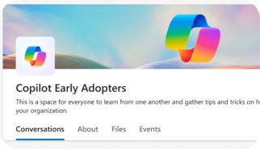
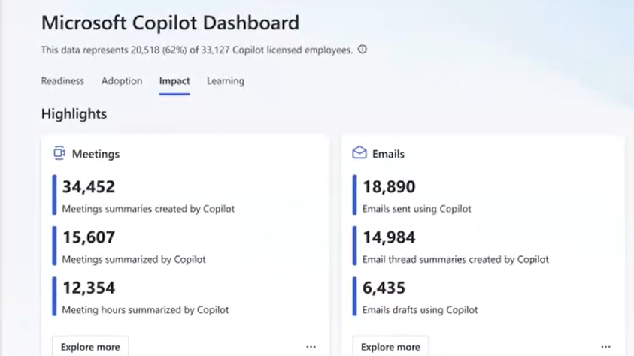
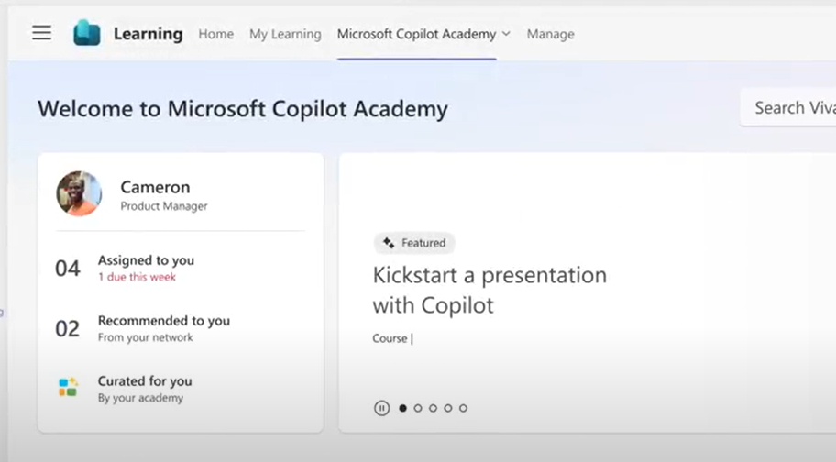

Accelerate your AI workforce transformation
Communications
Measurement
Skilling
Copilot Communities to facilitate user enablement
Share best practices
Access company announcements
Seek support from peers and IT
Copilot Analytics for ROI and impact assessment
Copilot Dashboard for leaders
Viva Insights for customizable analysis
Copilot business impact reports
Copilot Academy for user skill development
Curated learning paths
Hands-on prompt guidance
Content created by Microsoft experts
aka.ms/CopilotCommunities
aka.ms/CopilotAnalytics
aka.ms/CopilotDashboard
aka.ms/CopilotAcademy
Powered by Microsoft Viva
Notes:
Microsoft Viva can help accelerate your AI transformation in three areas:
Copilot communities, powered by Microsoft Viva Engage, facilitate user enablement, providing a Community of Practice for users to share their success stories and celebrate others’, ask questions, and find more training.
The Copilot Dashboard, powered by Microsoft Viva Insights, provides analytics and data on usage, as well as impact reports.
The Copilot Academy from Microsoft Viva Learning can be accessed in Teams, right in the flow of work, for user skill development and training.

Slide 5
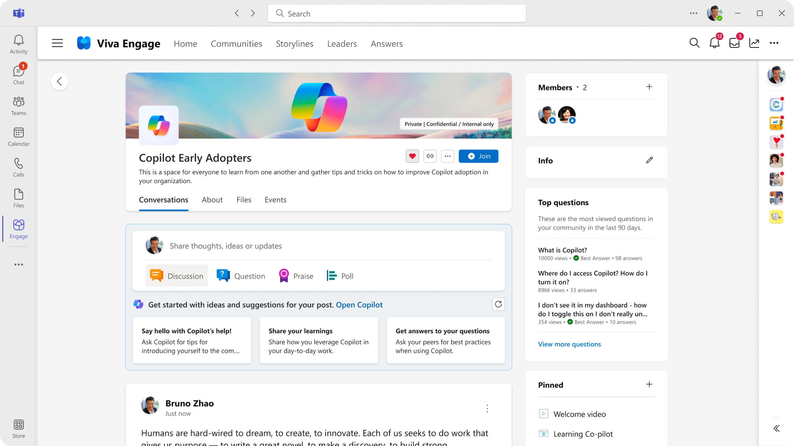


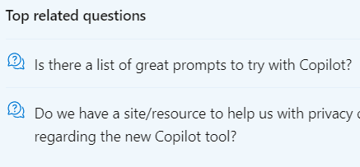

Get your culture AI ready, and leaders engaged
Communications
1
AI colleagues assemble
Lead your AI journey
Deliver planned & effective comms
Support AI enabled colleagues
Gather everyone together
Identify Leaders
Get the message out
Answer questions
Deploy Copilot community
Users automatically join
Share ideas & successes
One place to find answers
Who will drive your AI journey?
Create Leaders in Viva Engage
Amplify leader messages
Drive engagement
Pre-built AI comms kit (Amplify)
Use #hashtags (Engage)
Host AskMeAnything events
Promote purpose & timings
AI powered answers engine
Pre-load FAQs
Crowd-sourced Q&A
Amplify early adopters' voices
Viva Amplify
Micrsooft 365 Copilot
Viva Engage Premium
Viva Engage Premium
Answers in Viva
Available with your Microsoft 365 Copilot license
Available with Microsoft Viva licences

Slide 6
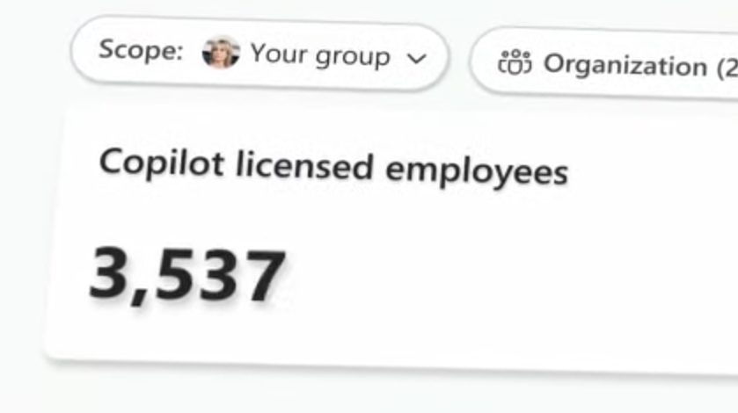
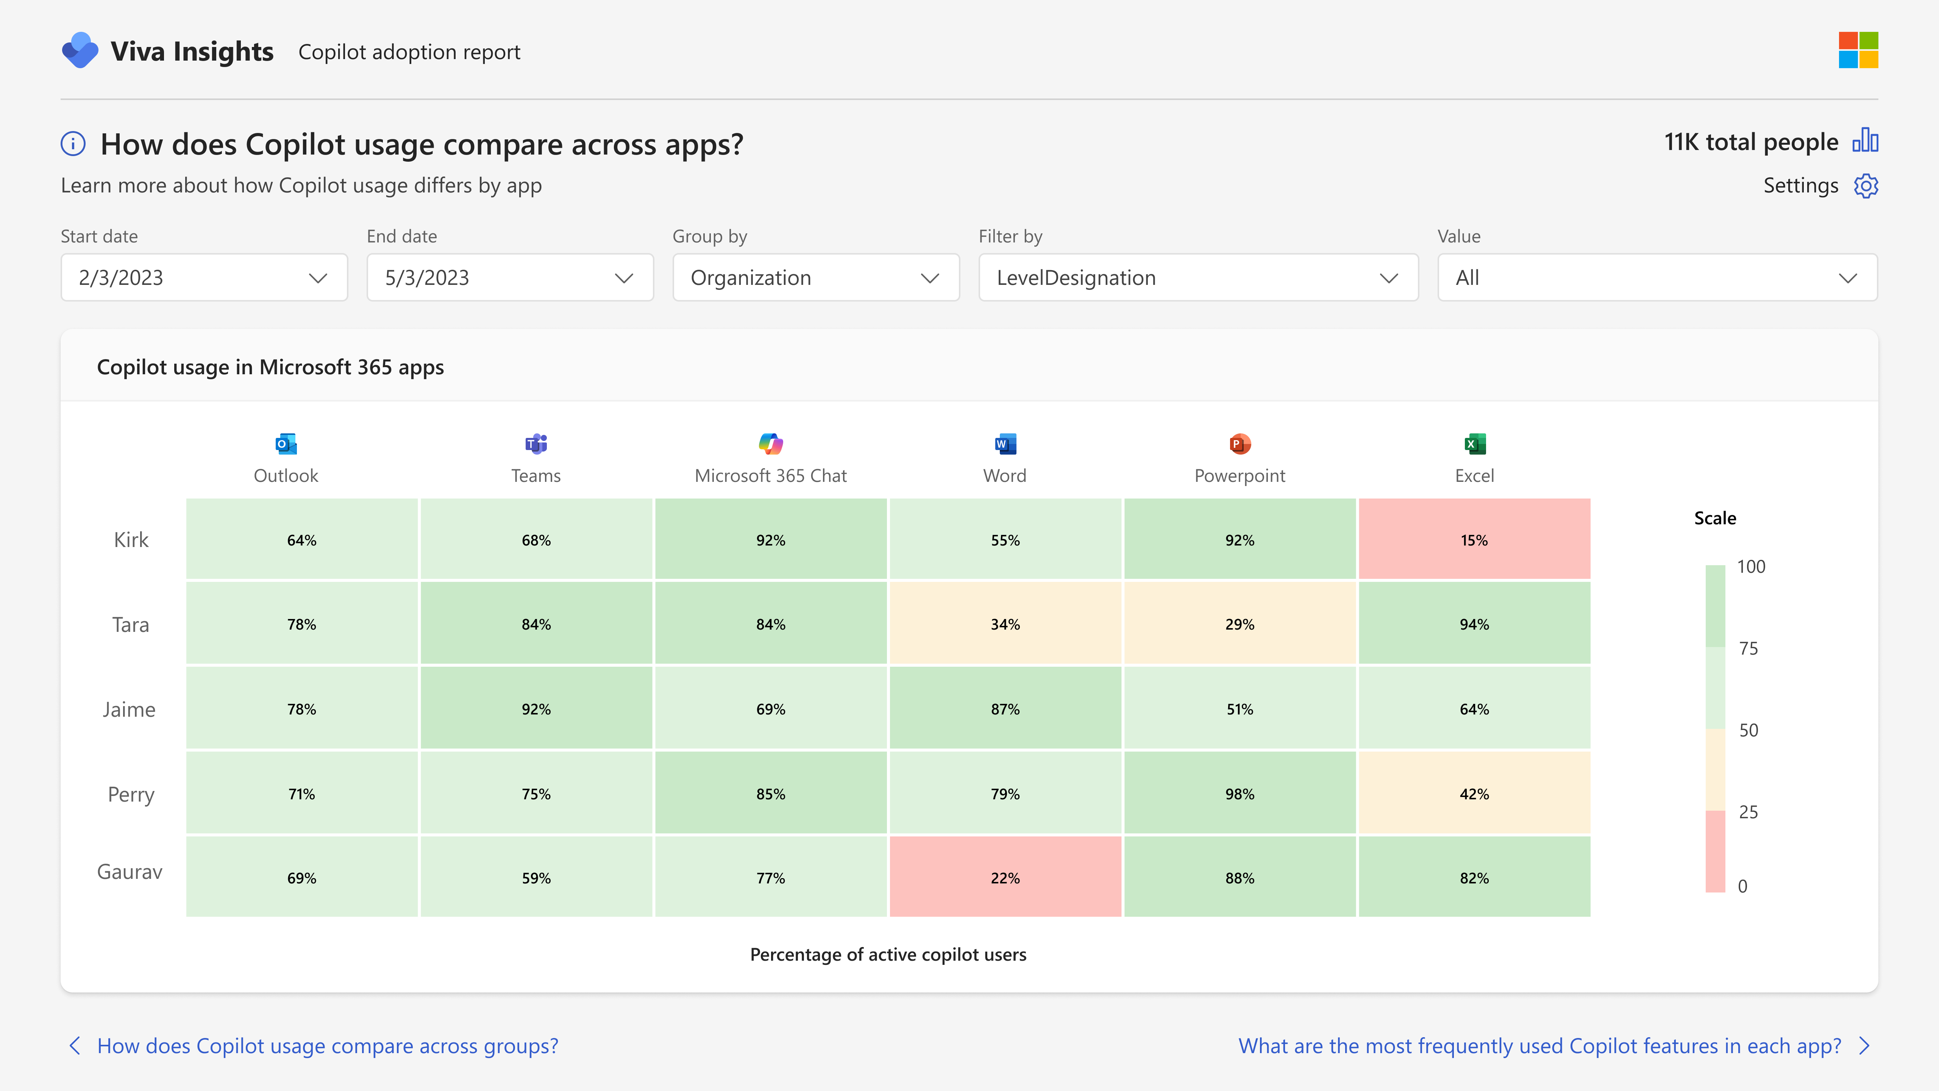
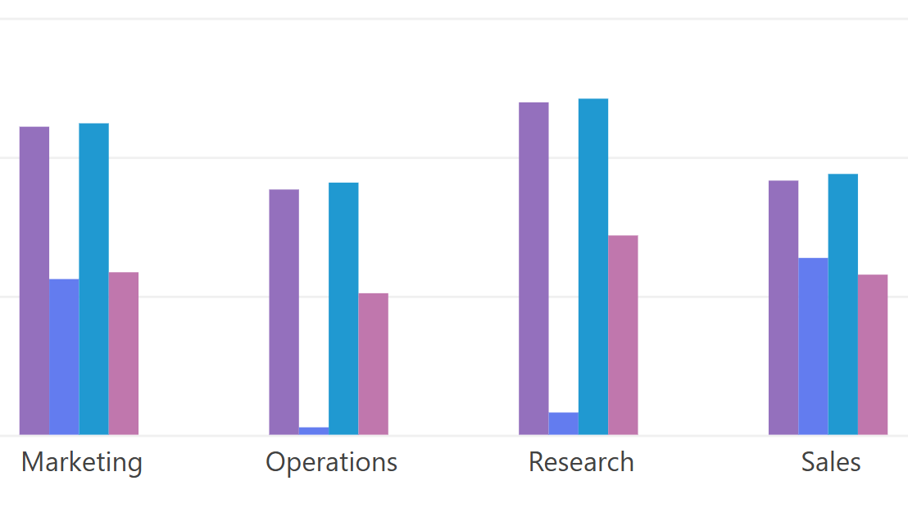
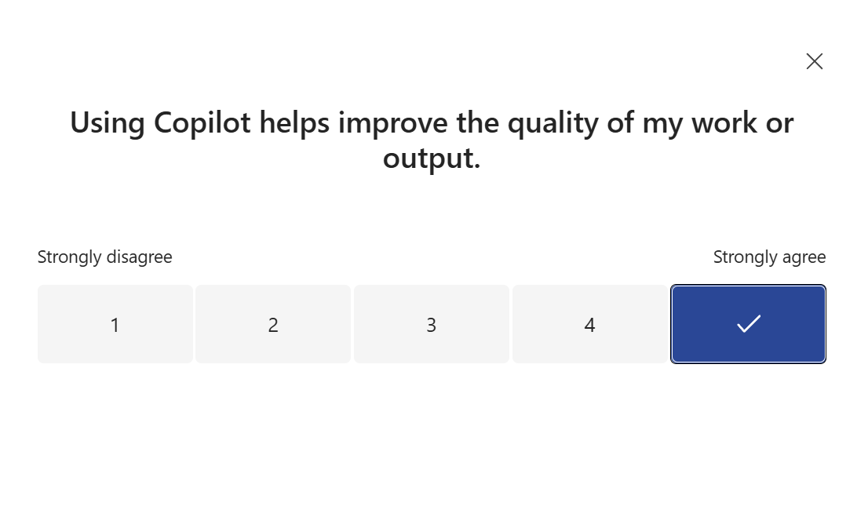
Measure impact, realize AI value
Measurement
2
Plan & monitor your deployment
Measure & analyze
Combine usage & outcome data
Human stories &
real-world impact
Core analysis
Extended analysis
Custom analysis
Gather stories & sentiment
Measure usage
Measure impact
Slice by org structure
Make informed decisions
Pre-built report templates
Enhanced metrics
Deeper org-structure insights
Dynamic date slicing
Build custom ROI analysis dashboards
Integrate with org outcome data e.g. customer service
Gather feedback on the Copilot experience across the org
Collect use cases relevant to your business case
Track feedback & sentiment over time
Microsoft 365 Copilot
Viva Insights Premium
Viva Insights Premium
Viva Glint
Viva Pulse
Available with your Microsoft 365 Copilot license
Available with Microsoft Viva licences

Slide 7
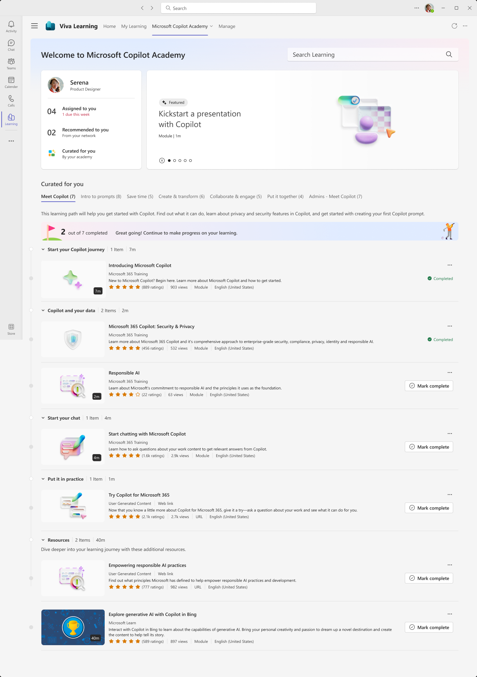
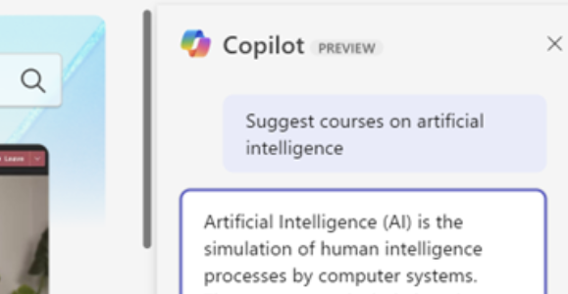
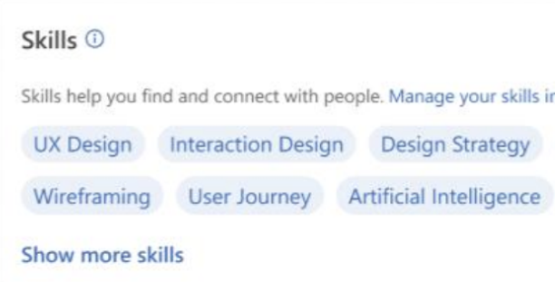
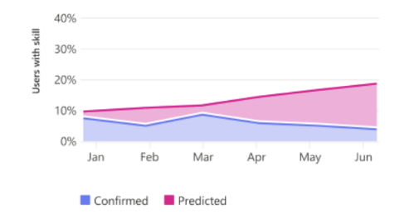
Continually update & improve your AI readiness and skills
Skilling
3
Centralise your core AI learning
Get to the right learning, fast
Skills in the flow
of work
Measure & monitor AI skills
Develop your AI skills
AI powered personalization
AI powered Skills profiles
Talent & skills insights
Curated AI learning paths
Hands-on prompt guidance
Pre-loaded & ready to go
Integrated into Teams
Ask for the training you need
AI powered responses
Create personal learning paths
Get to the right learning, fast
Inferred AI skills suggestions
Personal skills profile
Find people based on skills
Develop skills plans
Visualise org skills insights
Make data-driven decisions
Refocus resources
Identify skills gaps
Microsoft 365 Copilot
Viva Learning Premium
Skills in Viva*
Skills in Viva*
Available with your Microsoft 365 Copilot license
Available with Microsoft Viva licences
*Skills in Viva coming soon

Slide 8








Leverage your existing Viva capabilities or Viva licensed features
Experience areas | Viva apps | Features | Included with Microsoft 365 | Included with Microsoft 365 Copilot | Included with Viva license
Communication | Viva Connections | Viva Connections Dashboard, Feed, Resources, and Teams app | ● |  | ●
 |  | Multi-instance support (up to 10 instances) |  |  | ●
 | Viva Engage | Communities, Conversations, Storyline, Live events | ● |  | ●
 |  | Copilot Communities |  | ● | ●
 |  | Copilot, Leadership Corner, Campaigns, AMAs, Storyline delegate posting, advanced analytics, Multitenant Organization, Answers |  |  | ●
 | Viva Amplify | Campaign management, multi-channel publishing, advanced analytics |  |  | ●
 |  | Copilot Deployment Kit to to onboard Copilot users. |  |  | ●
Skilling | Viva Learning | Viva Learning app in Teams with access to MS Learn and 300+ LinkedIn Learning courses | ● |  | ●
 |  | Copilot Academy to develop the skills to utilize Copilot experiences effectively |  | ● | ●
 |  | LMS and 3P learning provider integration, collections, learning paths, academies, add to calendar, Copilot in Viva Learning |  |  | ●
 |  | Skills in Viva** |  |  | ●
Measurement | Viva Insights | Viva Insights app in Teams with personal insights and experiences | ● |  | ●
 | Viva Insights | Copilot Dashboard to measure Copilot readiness, adoption, and impact |  | ● | ●
 |  | Advanced Copilot reporting capabilities to create to create custom reports and measure business impact* |  | ● | ●
 |  | Analyst workbench to customize and tailor premium organizational reports |  | ● | ●
 | Viva Pulse | Create, distribute, and customize team surveys, review reports & initiate post survey actions |  | Viva Pulse Copilot templates included | ●
 | Viva Glint | Employee engagement surveys, employee lifecycle surveys, customizable dashboards, benchmarks, actionable recommendations |  |  | ●
 | Viva Goals | Creation and management of Objectives and Key Results (OKRs), workflows and dashboard, Project and task integration, data integrations |  |  | ●

Slide 9
Available with your Microsoft 365 Copilot license

Slide 10
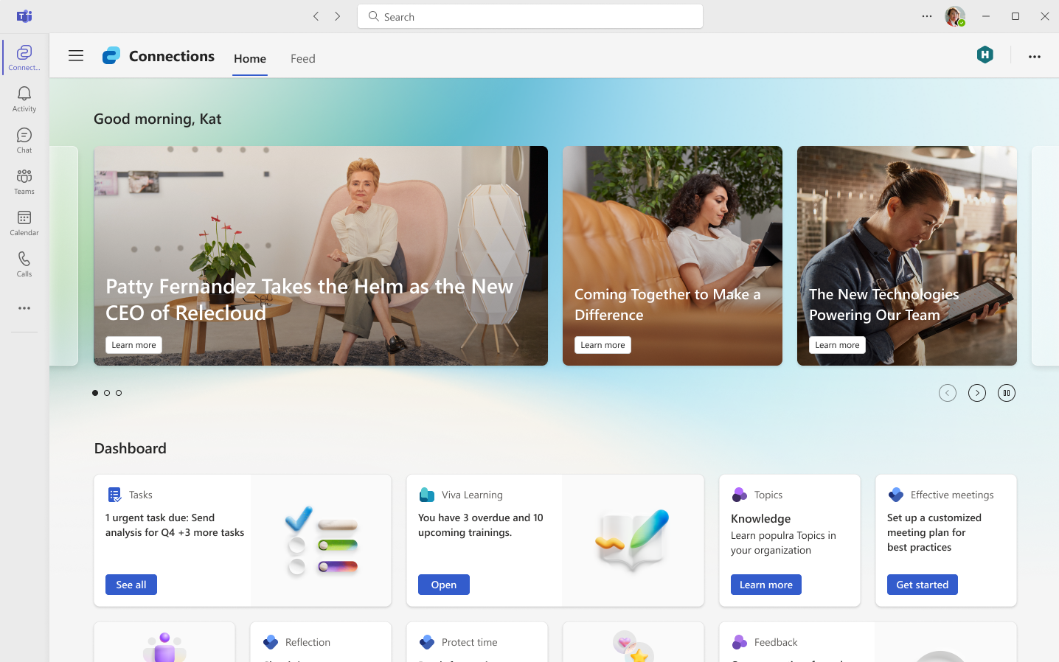
Viva Connections
Communications
Your gateway to Copilot communications
Deploy an employee app that connects your workforce to the information, resources, and tasks that they need to succeed with Copilot.
Tailor the experience to specific employee groups, roles, or geos such as employees licensed with Copilot with targeted news, conversations, and content powered by AI and Microsoft Graph.
Notes:
Viva Connections is your new home for Copilot. It helps everyone stay engaged and informed by delivering a curated employee destination that can be configured for specific roles and needs. Customers can brand and customize it as their own ‘employee app’, which you can then surface to different employee types, like Frontline workers, or information workers, so that everyone has the resources, news, and dashboard content that they need.

Slide 11
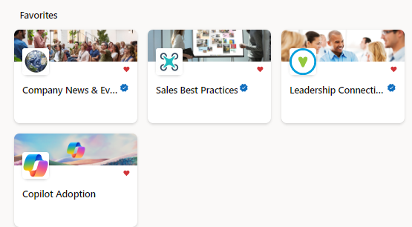
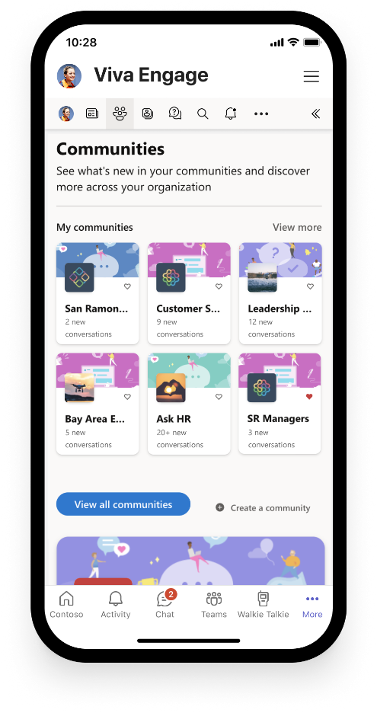
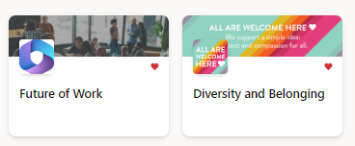
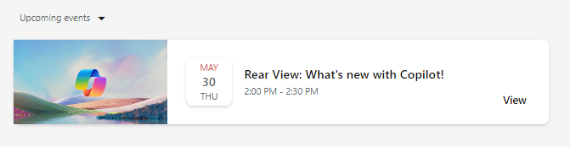

Copilot Communities
Communications
Out-of-the-box Community of Practice to drive Copilot awareness and user enablement
Use the new Copilot community template in Viva Engage to quickly generate excitement, share learning, and support future Copilot Champions and experts.
Give employees a place to:
Share best practices, such as prompts
Share success stories of Copilot saving time and driving productivity
Access company announcements on AI usage, adoption, direction, and mission
Seek support from peers and IT admins
Host virtual townhalls with Q&A in your community
Notes:
NOTE: Viva Engage is recommended for enterprise customers already utilizing Viva Engage in their environment. Small/medium businesses may opt to hold this essential employee engagement in Microsoft Teams or other community chat tools.

Slide 12

Copilot Academy
Skilling
Develop the skills to utilize Copilot experiences effectively
Curated learning paths designed by Microsoft experts to help you learn about, discover, and use Microsoft 365 Copilot
Access directly at aka.ms/CopilotAcademy
Surface free Copilot learning courses in the tools and platforms where users already spend their time
Includes hands-on prompt guidance from Copilot Prompt Gallery to develop prompt engineering skills
Out-of-the-box academy is preloaded in Viva Learning – no admin configuration required
Available in 8 languages

Slide 13
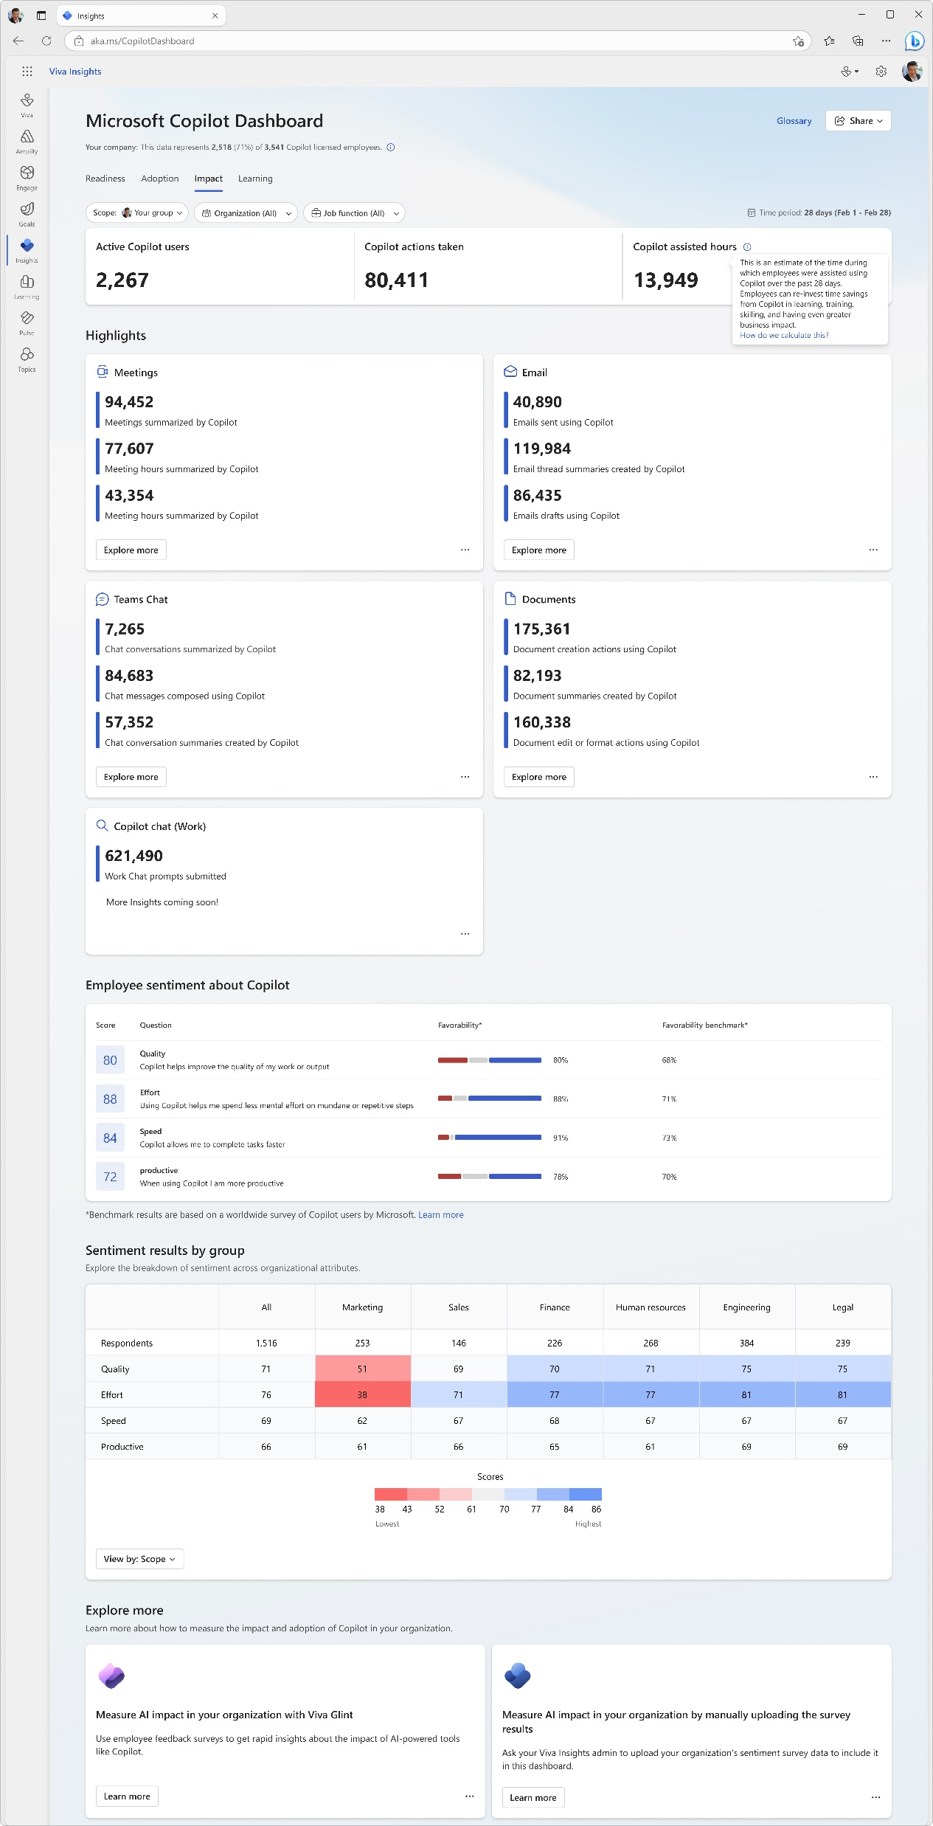
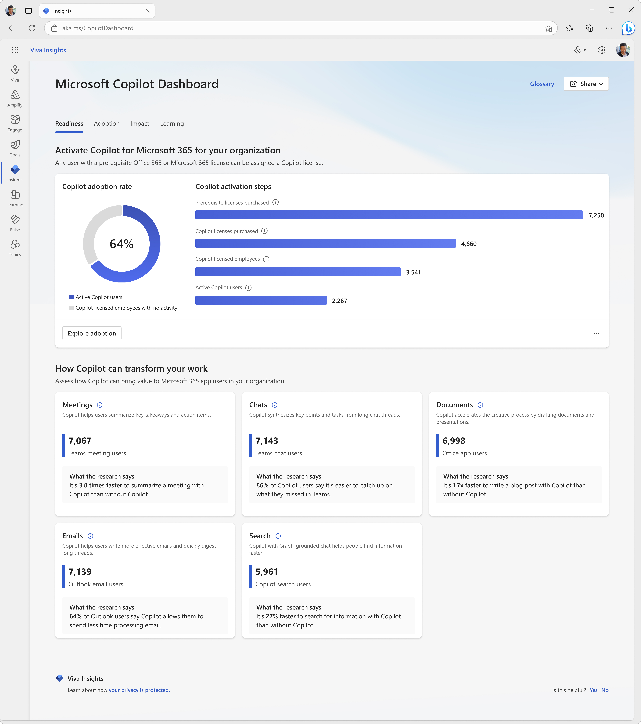

Copilot Dashboard
Measurement
Measure Copilot adoption and impact
Pre-built dashboard for business leaders to prepare for their Copilot rollout, understand and drive usage and adoption, and measure the impact of their investments.
Access directly at aka.ms/CopilotDashboard
Readiness tab to see licensing and copilot activation status across the tenant
Adoption tab to see Copilot trends and usage down to the app feature level, with filters to drill down by group, organization, and job function.
Impact tab to view Copilot actions by productivity categories, Copilot assisted hours and related value calculator and how Copilot usage is correlated with behavioral patterns in your business. Sentiment data from uploaded survey results is also available.
Learning tab for research and best practices to inform your AI journey
Use the Copilot Dashboard metrics eBook to help understand and interpret the data

Slide 14
Available with a
Microsoft Viva license
(All users that would access, experience or be included in these features require an applicable Viva license)

Slide 15
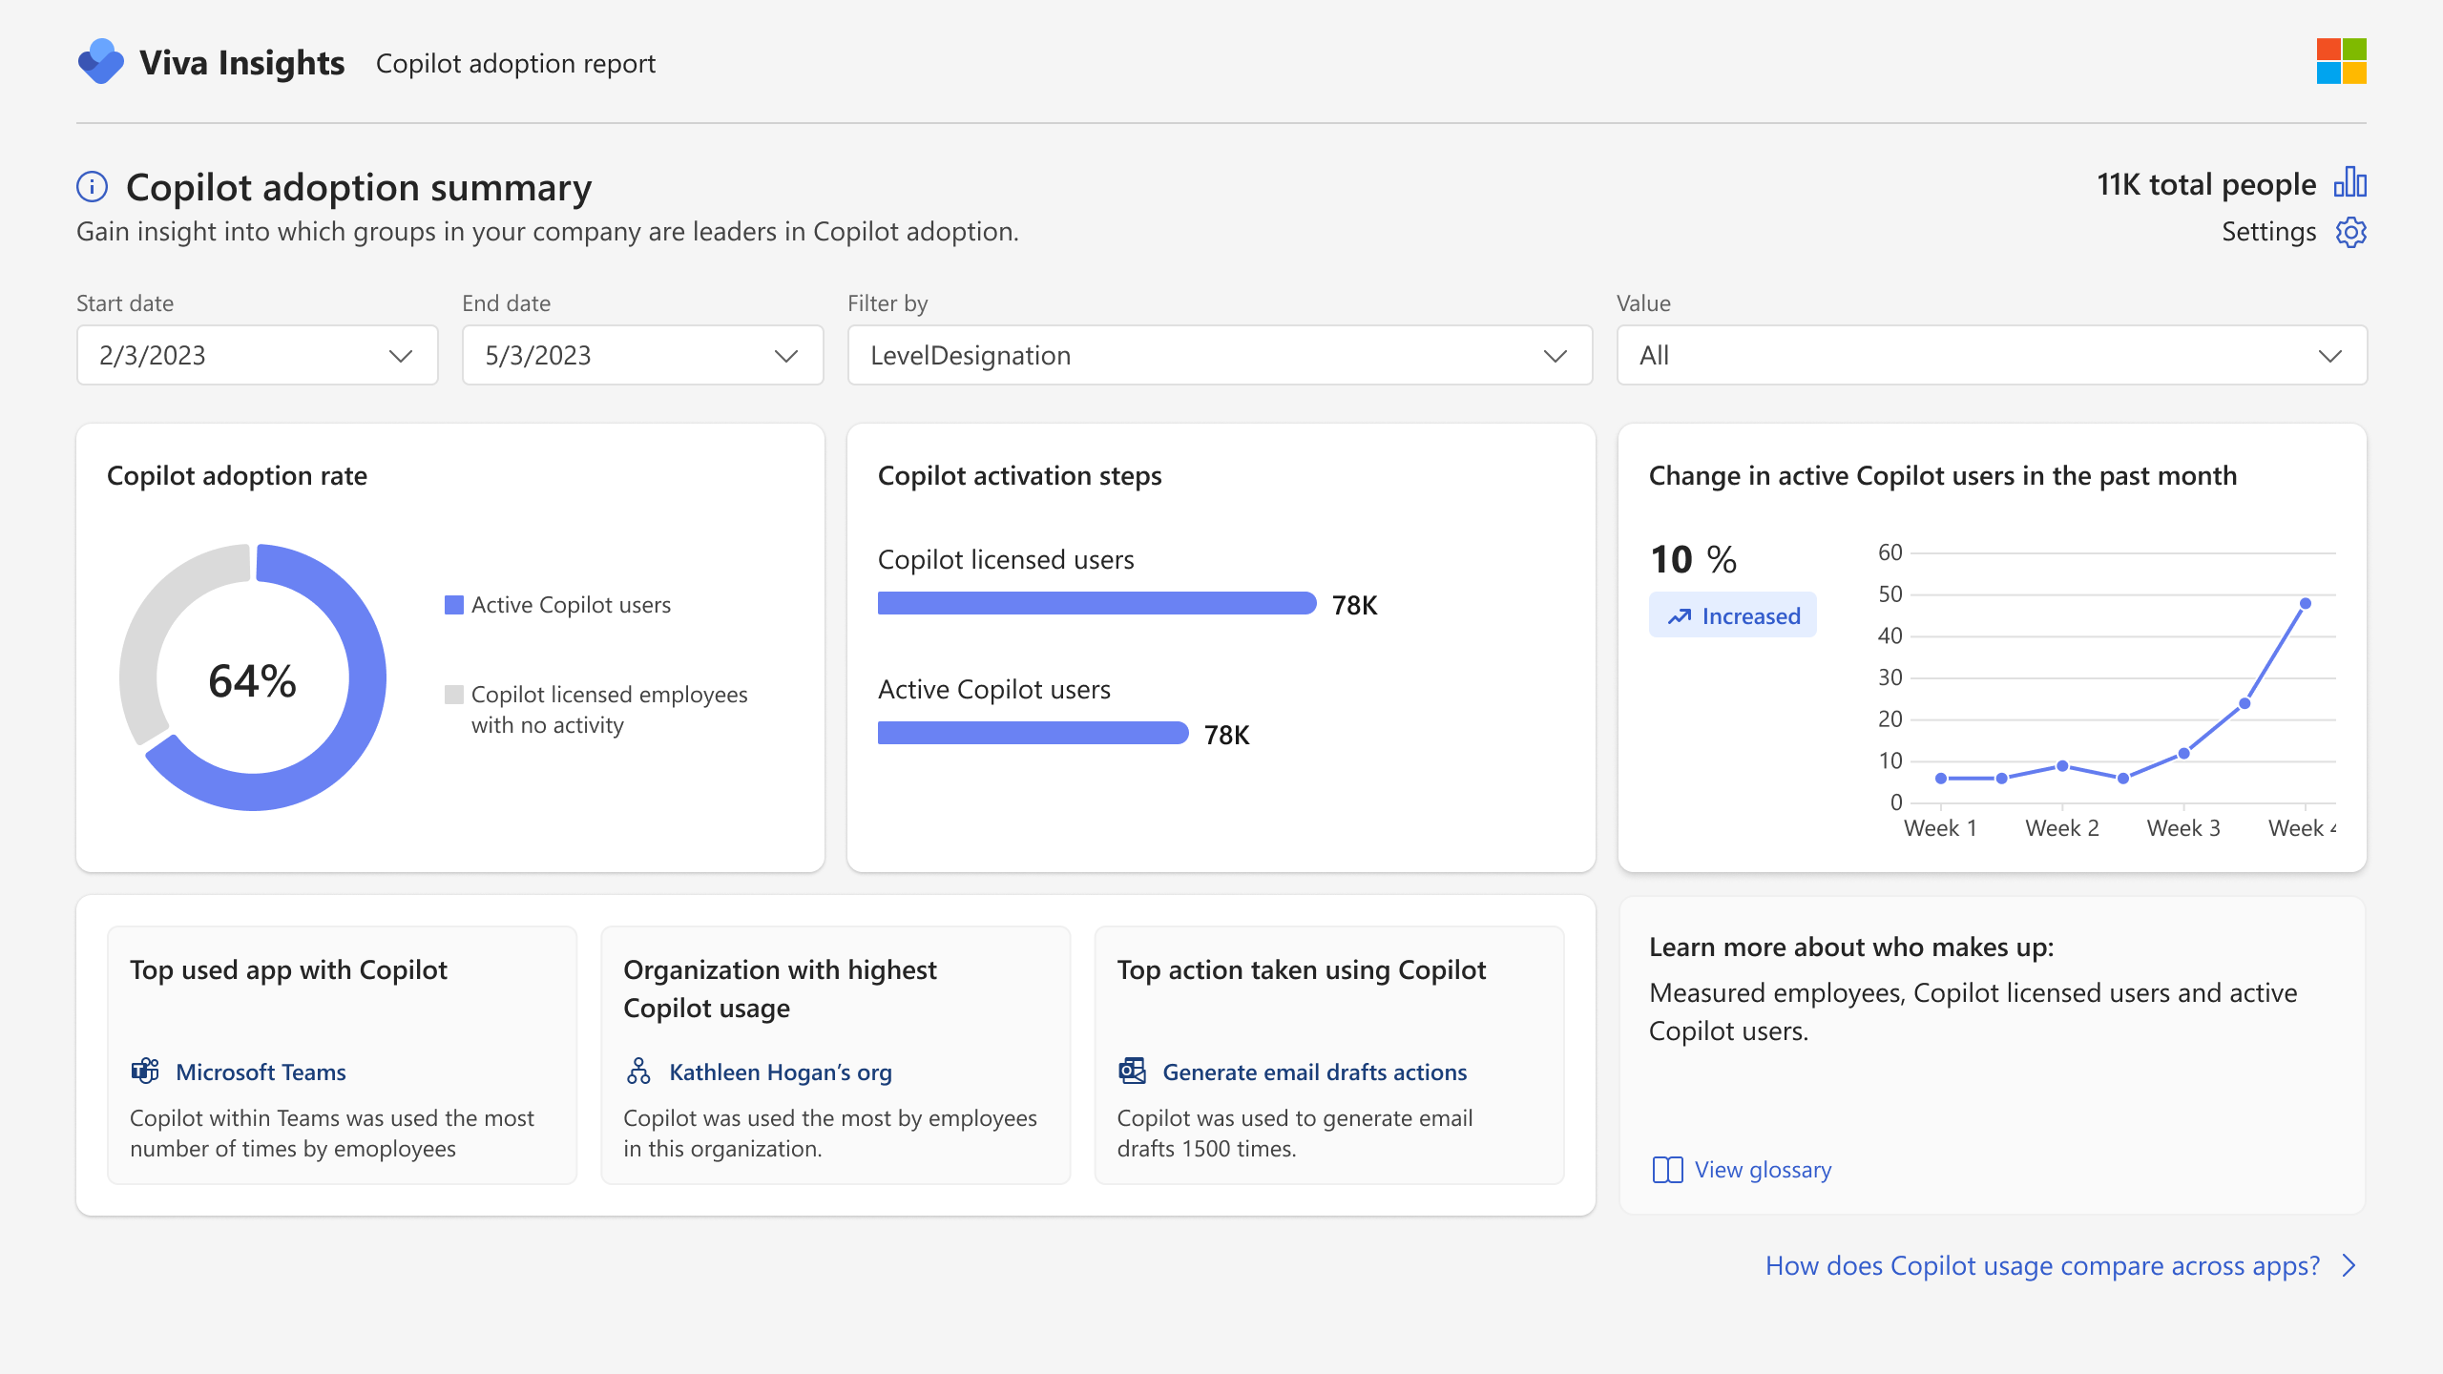
Advanced Copilot reports from Viva Insights
Measurement
Dynamic date slicers
Trendlines
Dive deeper into Copilot adoption and impact reporting with custom analytics
Start with a pre-built report template that can be tailored to include additional collaboration metrics and organizational attributes.
Create a report from scratch for a fully custom view; include additional organizational data, such as CRM or other outcome data.
View usage data older than 28 days with dynamic time ranges and customize metric definitions.
Group and filter by any org. attribute
Learn more at
Microsoft Viva Insights | Employee Engagement
Notes:
Finally, Microsoft Viva delivers powerful, data-driven insights to help you maximize the value of your Microsoft 365 and Copilot investment.
We believe that by delivering the right insights and recommended actions, we can help you drive meaningful changes and we want to deliver these insights in a way that is conveniently accessible to the right people in your organization. So, we’ve recently introduced the new Microsoft Copilot Dashboard, powered by Viva.
The Copilot Dashboard helps you measure the impact of Copilot on employee productivity and sentiment, and get a better understanding of Copilot readiness, usage and adoption.
Here’s how it works: - upon launching the dashboard, you’ll see three sections:
Starting with Readiness, an overview of the technical eligibility requirements for Microsoft 365 Copilot usage, the number of users who are in a position to get the most benefit from Copilot licenses, and the volume of work activities that can be transformed using Copilot.​
Once your organization is onboarded, the Adoption section offers senior leaders visibility into the number of users in your organization that using Copilot, and a breakout by Microsoft 365 app, over a rolling 30-day period. This section also shows the number of active users by key Copilot features, like summarization of enterprise content, or AI-assisted creation of new files or content.​
Next, the dashboard conveys Microsoft 365 Copilot impact by showing the volume of AI-assisted actions per user per week, and the rate at which Copilot-generated content is kept by users.
The Copilot Dashboard is available in preview for select customers and will be generally available worldwide in late Q1 of 2024.

Slide 16
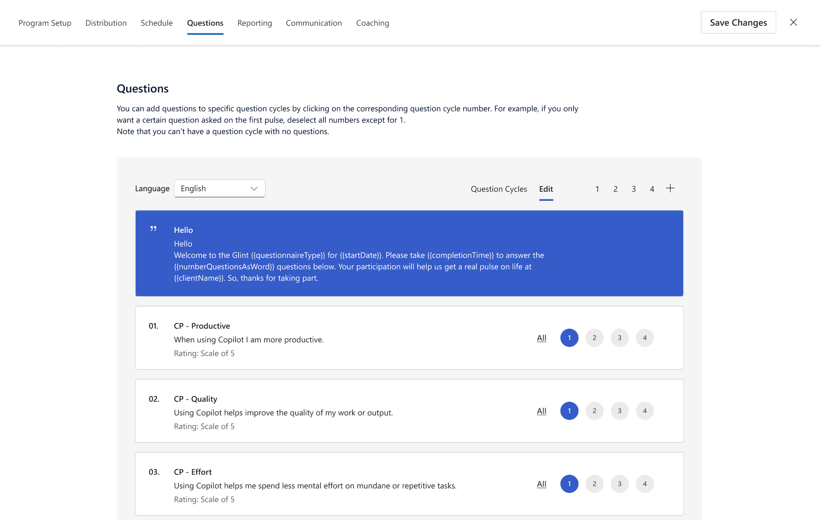
Supporting Microsoft 365 Copilot adoption with Viva Glint
Measurement
Measure engagement and gain insights
  Gather feedback on Copilot impact on the employee experience across the organization
  Gather use cases directly relevant to your organization
  Measure Copilot growth and adoption before, during and after the Copilot roll out
Learn more at
Microsoft Viva Glint | Employee Engagement
Notes:
Viva Glint surveys are meant to be used organization wide and are typically managed by HR leaders

Slide 17
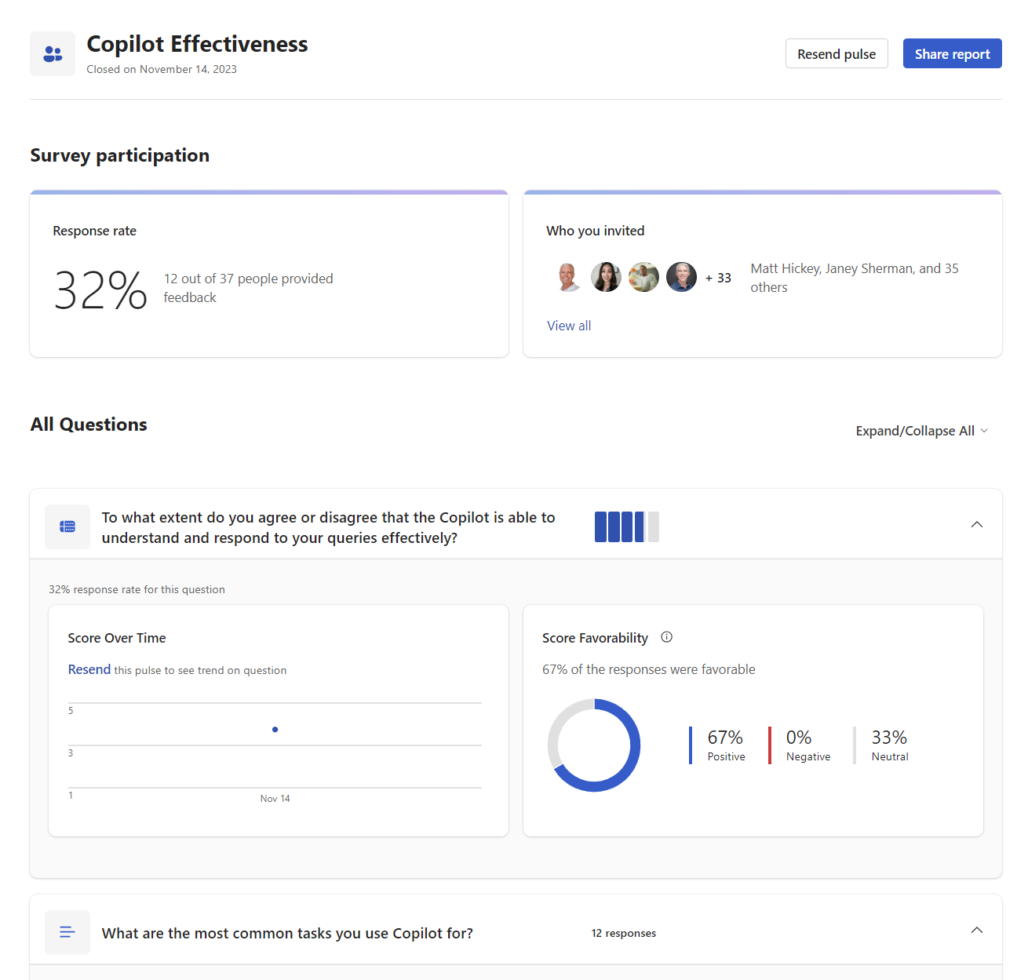

Supporting Microsoft 365 Copilot adoption with Viva Pulse
Measurement
Measure engagement and gain insights
  Capture feedback and insights from pilot users
  Gather use cases directly relevant to your organization
  Sample survey questions:
On a scale of 1-5, how satisfied are you with Copilot's ability to understand and respond to your queries?
How often do you use Copilot in your day-to-day work?
What are the most common tasks you use Copilot for?
How has Copilot helped you in your work?
What improvements or changes would you like to see in Copilot?
How easy or difficult is it to use Copilot?
How has Copilot impacted your productivity?
Would you recommend Copilot to your colleagues?
Learn more at
Microsoft Viva Pulse | Employee Feedback Surveys
Notes:
Viva Pulse pulses are meant to be distributed to smaller team or v-team basis and are typically distributed by a manager or project lead.

Slide 18
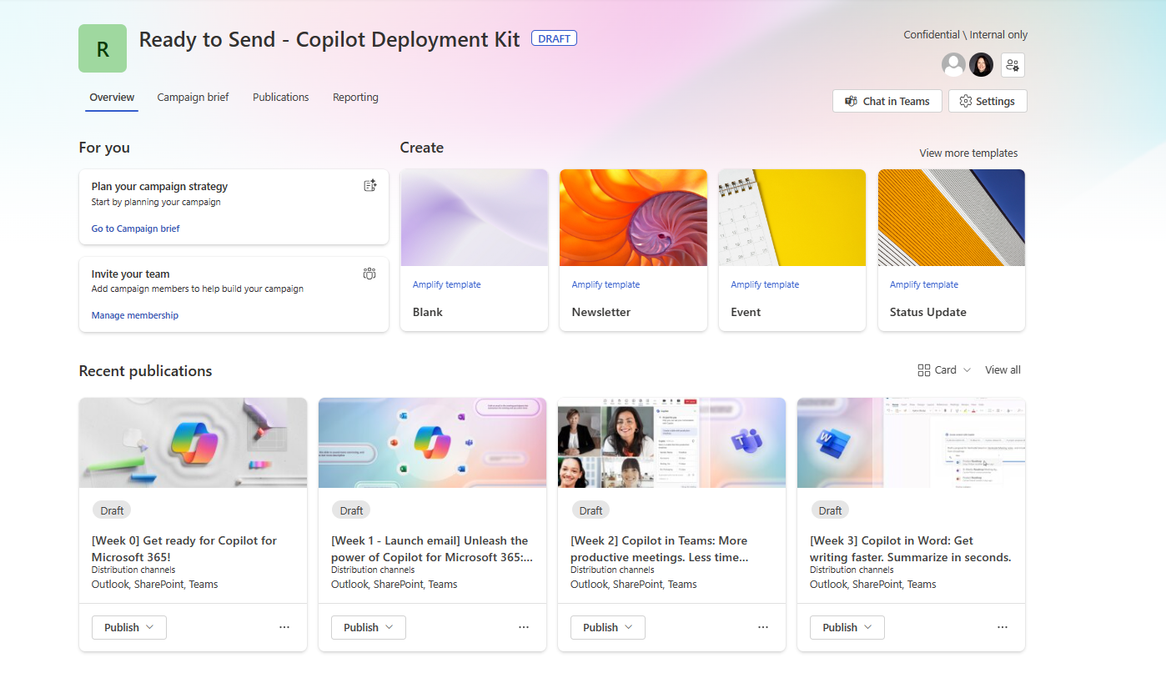

Communicate and build skills with the Viva Amplify Copilot Deployment Kit
Communications
Save time with pre-drafted communications
  Seamlessly onboard users onto
  Microsoft 365 Copilot with pre-built content and customizable communications
  8 Pre-drafted weekly communications focused on how to use Copilot in M365 apps like Outlook, Teams, Word, PowerPoint, and Excel.
  Tailor and target communications to specific
  distribution channels and groups
  Publish once to multiple apps like Outlook and Teams and assess engagement and reach through reports
Learn more at
Microsoft Viva Amplify | Employee Communications Management

Slide 19
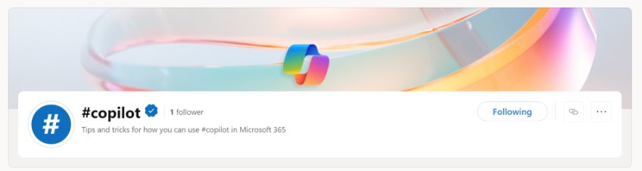
Build a Community of Practice in Viva Engage
Communications
Community of Practice: Leverage an out-of-the-box Copilot community that includes an onboarding checklist, pre-seeded content and conversation starters, and supports dynamic community membership based on Copilot licensing allotment.
Answers: Ask questions and find Copilot knowledge, experts, and resources around the organization. The Intelligent Importer makes it easy to generate and add your own Q&A for any community to support commonly asked questions. Upload your own Q&A from a Word document directly into Answers in Viva.
Leader Announcements: Leaders can use storyline announcements to target their audiences and keep everyone informed and engaged with announcements and notifications across web and mobile apps.
Leadership Corner: What are leaders doing with Microsoft 365 Copilot? Get to know your leaders, stay informed, attend their AMAs (Ask Me Anything), and follow them for updates.
#Campaigns: Corporate communicators or community managers can build campaigns for Copilot based on what people are talking about. As people post comments to the campaign, Copilot can help draft responses and provide detailed analytics around engagement, trending topics, reach, and sentiment.
Learn more at
Microsoft Viva Engage | Employee Communication Platform

Slide 20
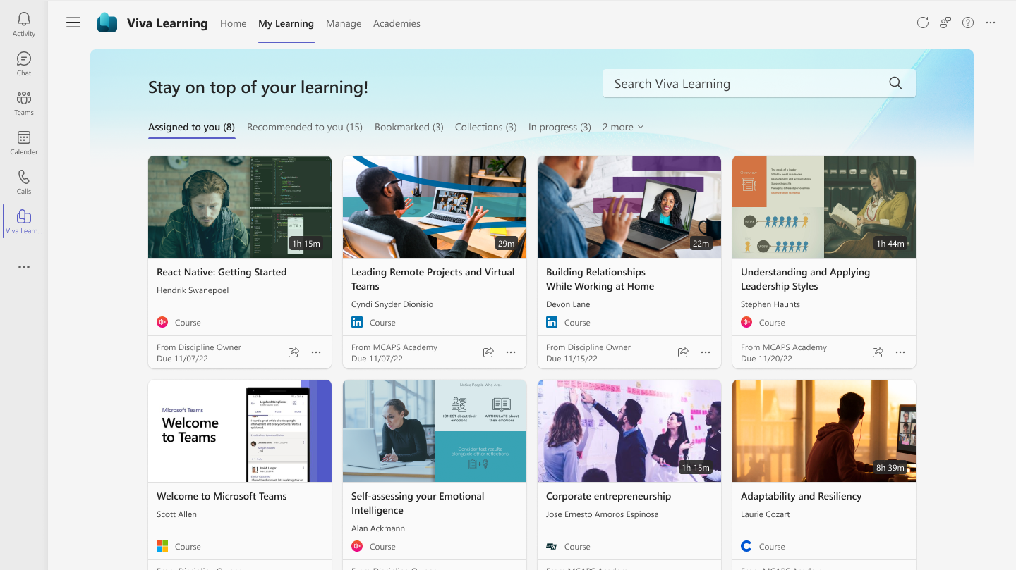

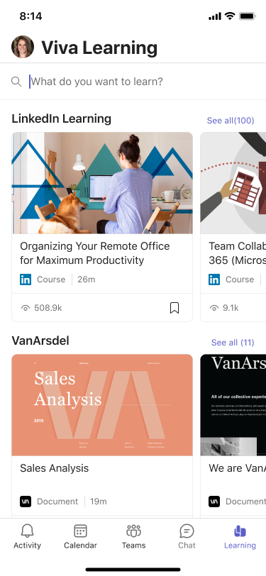
Build a culture of learning with Viva Learning
Skilling
Drive AI and Copilot learning in the flow of work
  Create custom targeted learning experiences with academies, collections, recommendations, and learning paths
  Connect with your LMS and learning content providers for a single learning front door
  View assignments and records from connected LMS’s
  Learn from the apps where you already spend time at work with native integrations in Teams, Outlook, chat, and search
Learn more at
Employee Learning and Training Platform | Microsoft Viva
Notes:
Viva Pulse pulses are meant to be distributed to smaller team or v-team basis and are typically distributed by a manager or project lead.

Slide 21
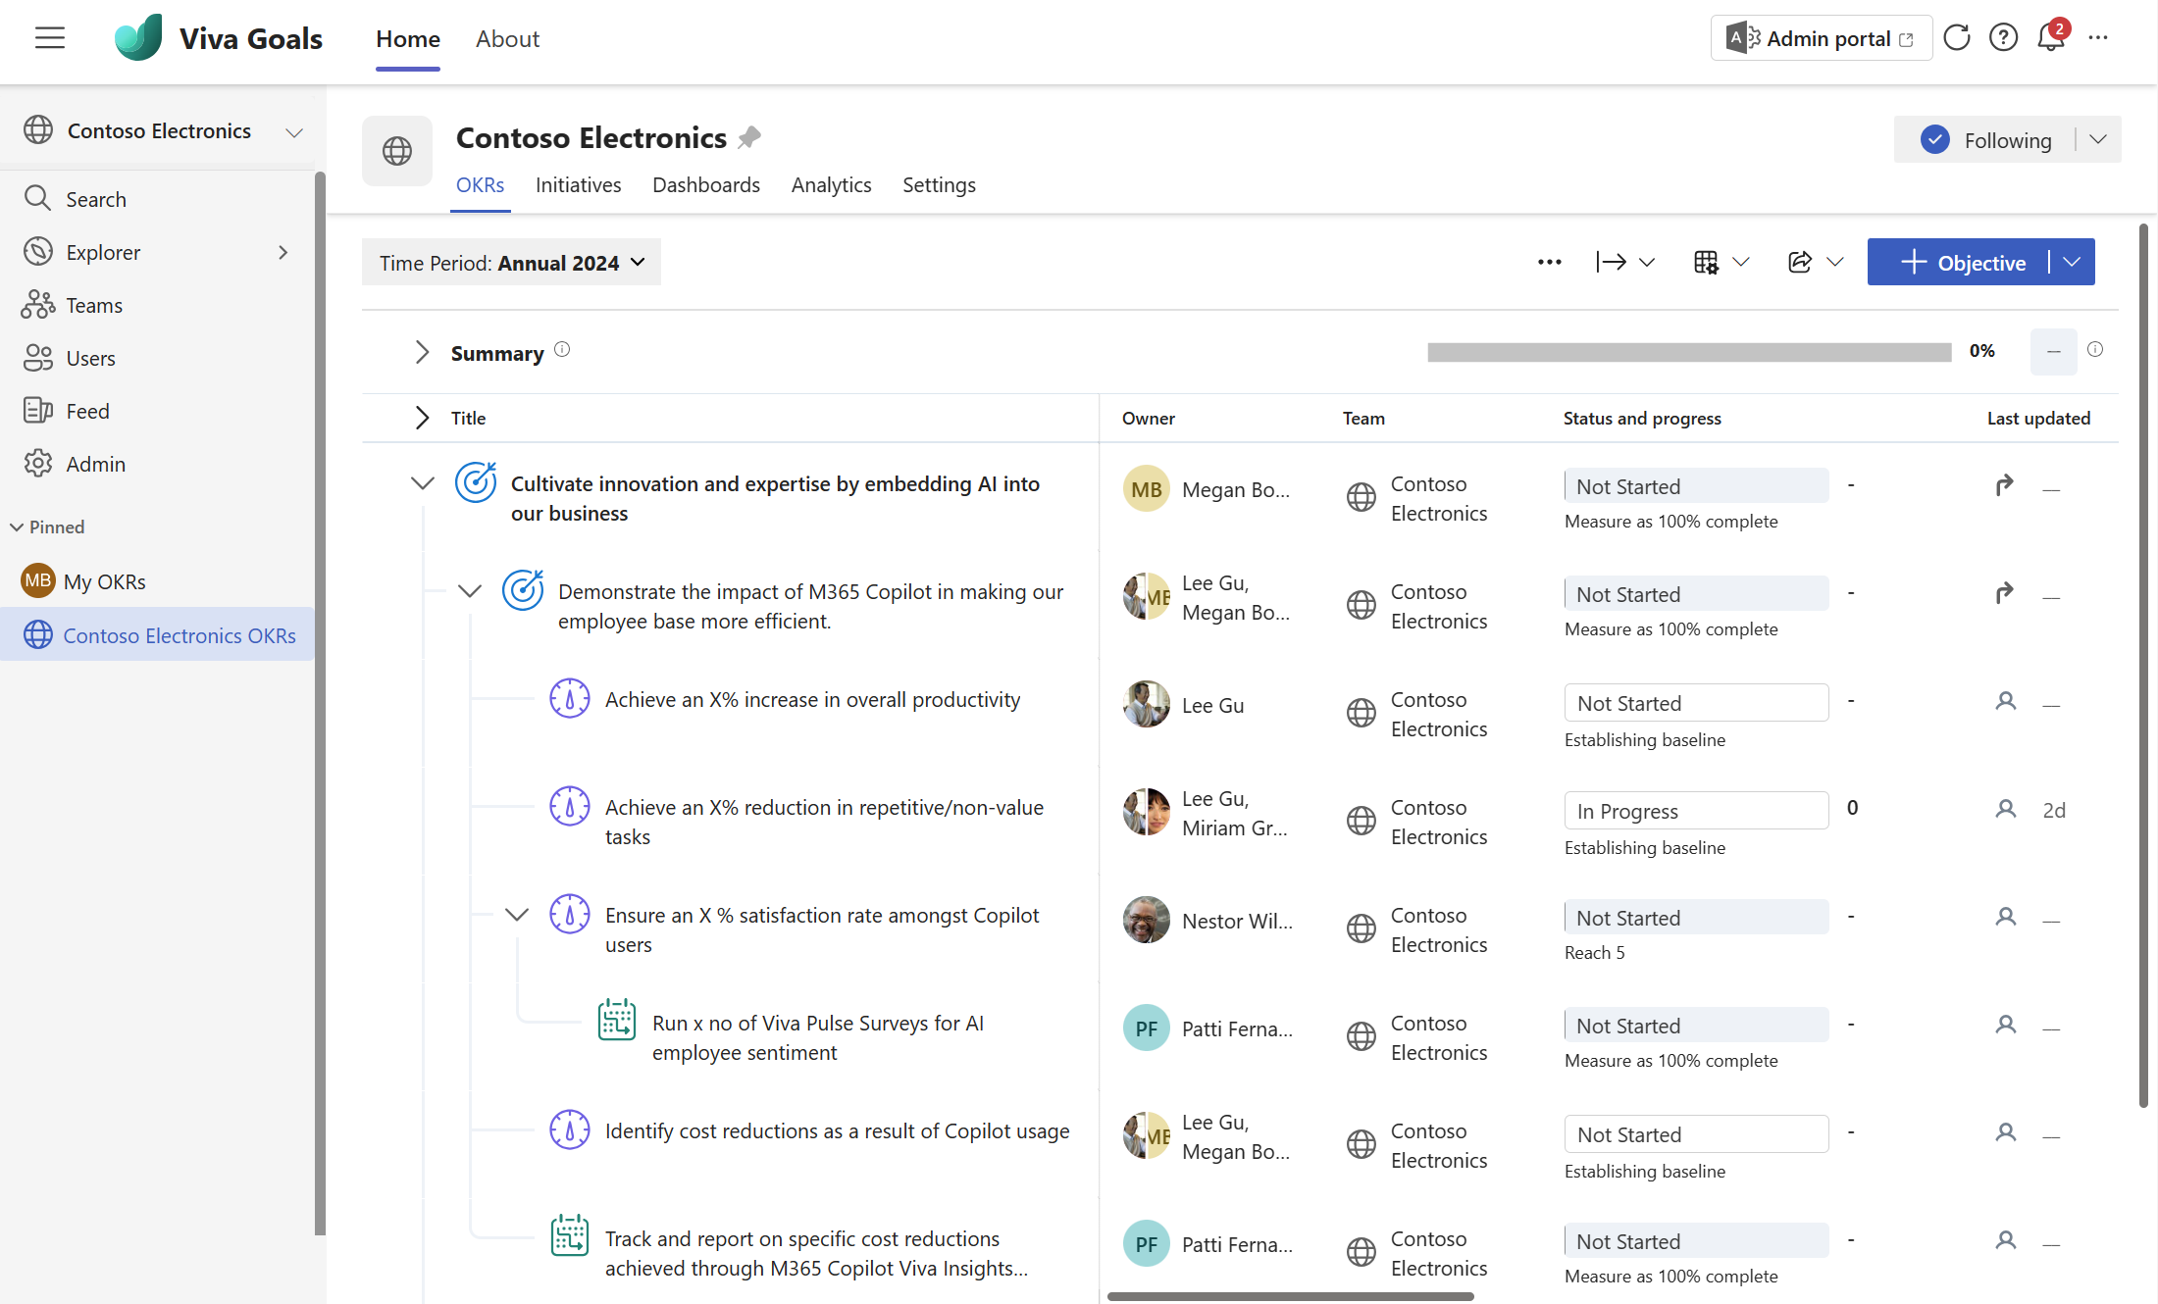

Microsoft 365 Copilot adoption with Viva Goals
Measurement
Drive mission and alignment for Microsoft 365 Copilot
  Create, manage and track Goals for Microsoft 365 Copilot deployment and adoption
  Align employees with Microsoft 365 Copilot goals, enhancing visibility and alignment with organizational AI goals
  Provide a single, secure repository for Microsoft 365 Copilot goals with easy-to-use updates, reporting, and integrations
Learn more at
Microsoft Viva Goals | Set Team and Company Goals

Slide 22
Microsoft investments to accelerate your time to value
Customers that buy more than 150 Copilot
seats are eligible for Microsoft co-investment in partner deployment and adoption services through eligible Microsoft Partners.
Eligible customers can request technical and deployment assistance from Microsoft FastTrack.
Get started on your Copilot journey with
expert-led services through Microsoft Unified.

Slide 23
Links to learn more (1 of 2)
How Copilot works
How Microsoft 365 Copilot works: Microsoft Mechanics video
Semantic Index for Copilot
Microsoft Graph
Microsoft Graph connectors
Additional copilot experiences across the Microsoft Cloud
  Microsoft Dynamics 365 Copilot
  Copilot in Power Platform
  Microsoft Security Copilot
  GitHub Copilot
  Copilot in Microsoft Stream
Privacy
Microsoft’s privacy policy
Microsoft Privacy Statement
Trust Center data protection and privacy
Data, privacy, and security for Microsoft 365 Copilot
Data, privacy, and security for Azure OpenAI Service
Role-based access control
User permissions and permission levels in SharePoint Server
Customer Lockbox requests
Microsoft 365 isolation controls
Data Protection Addendum
Copilot Readiness Hub
What is Copilot?
Introducing Microsoft 365 Copilot
The Copilot System
ChatGPT vs. Microsoft 365 Copilot: What's the difference?
What is Microsoft Viva?
Microsoft Viva overview
Get started with Viva: plans and pricing
Learn more about Microsoft Copilot Dashboard
Learn more about Microsoft Copilot Academy
Learn more about Copilot Deployment Kit
Learn more about Copilot communities
Viva customer success stories

Slide 24
Links to learn more (2 of 2)
Data residency and storage
EU Data Boundary
  Website
  Blog
  Documentation
Compliance
Microsoft Compliance
Service Trust Portal
Compliance offering definitions
General Dat Protection Regulation (GDPR)
  Full summary
  Short summary
Security
Configure usage rights for Azure Information Protection (AIP)
Universal Licensing Terms for Online Services
Data Protection Addendum
Isolation and Access Control in Microsoft 365
How to prepare for Microsoft 365 Copilot
Learn about Microsoft feedback for your organization
Manage Microsoft feedback for your organization
How to manage Microsoft Search
Microsoft 365 Product Terms
Content management and security in SharePoint, OneDrive, and Teams
Transcription Management in Microsoft 365 Copilot
Responsible AI
Responsible AI core principles
  Videos
  Documentation
Microsoft Responsible AI Standard
Governing AI: A Blueprint for the Future

