Slide 1
Build cutting edge Viva Connections cards with virtually any platform

Slide 2
Table of contents
Extensibility options
Card designer
SharePoint Framework ACEs
Next steps

Slide 3
Extensibility

Slide 4
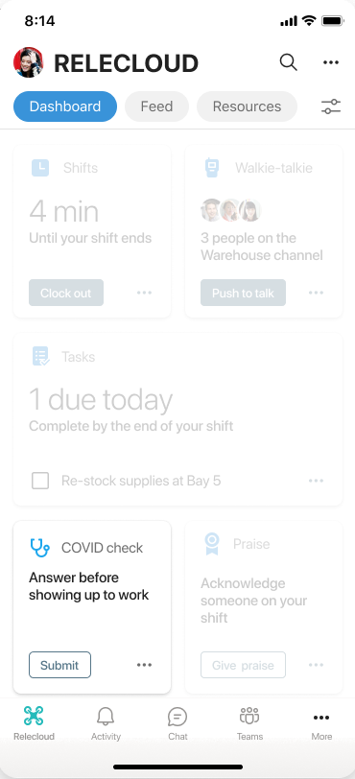
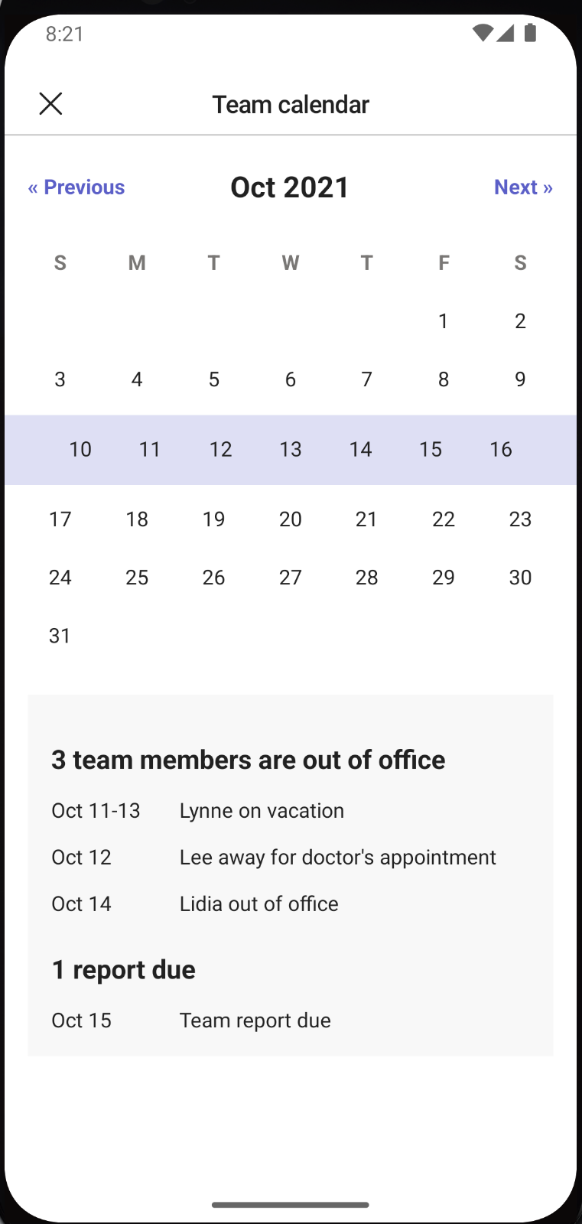
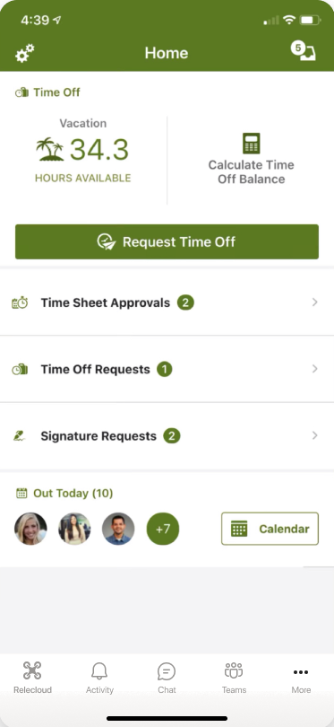
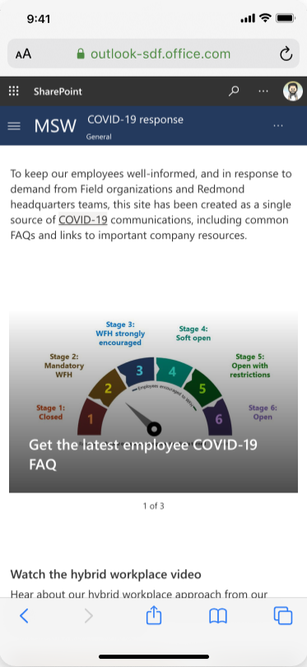
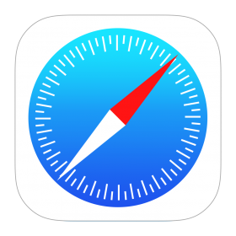
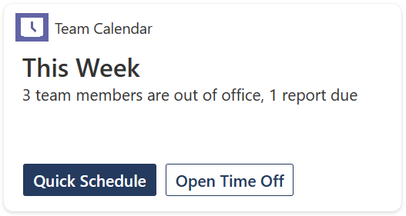

So, how do the adaptive cards work on Viva Connections?
Card
Quick view
App
Web
App
Notes:
The cards are designed to enable quick task completion by interacting with a card directly or by opening a quick view. In this example you can select Quick Schedule or Open Time Off within a Viva Connections card. You can explore adaptive cards on the web or via the Teams app.

Slide 5
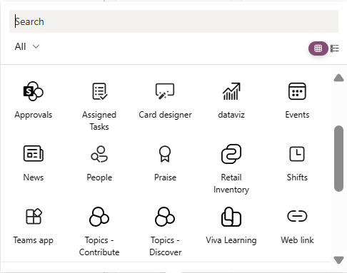
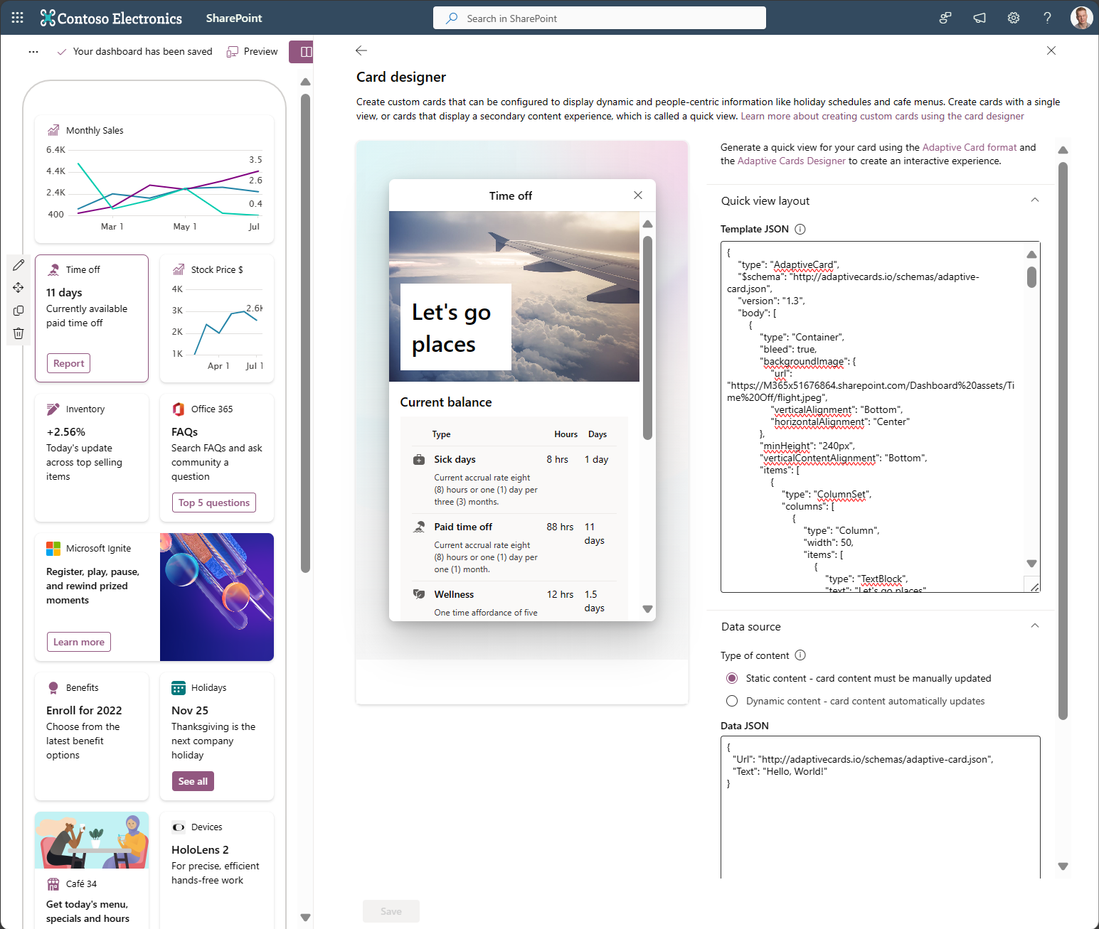
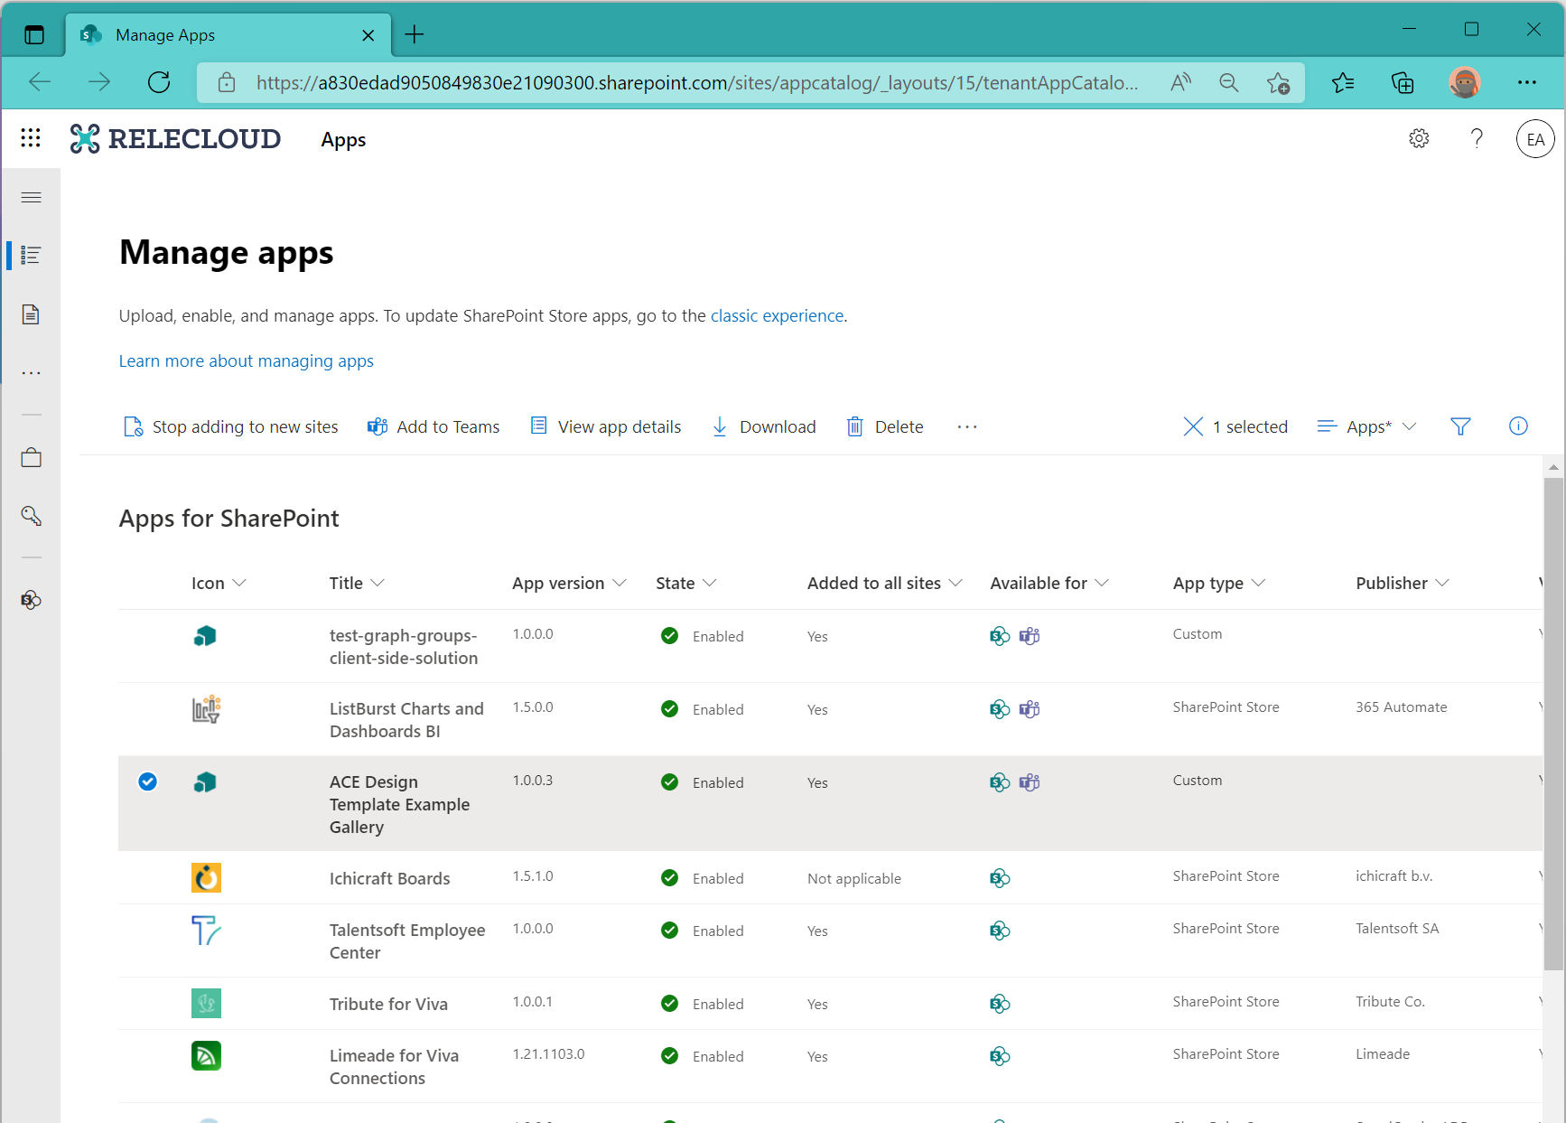
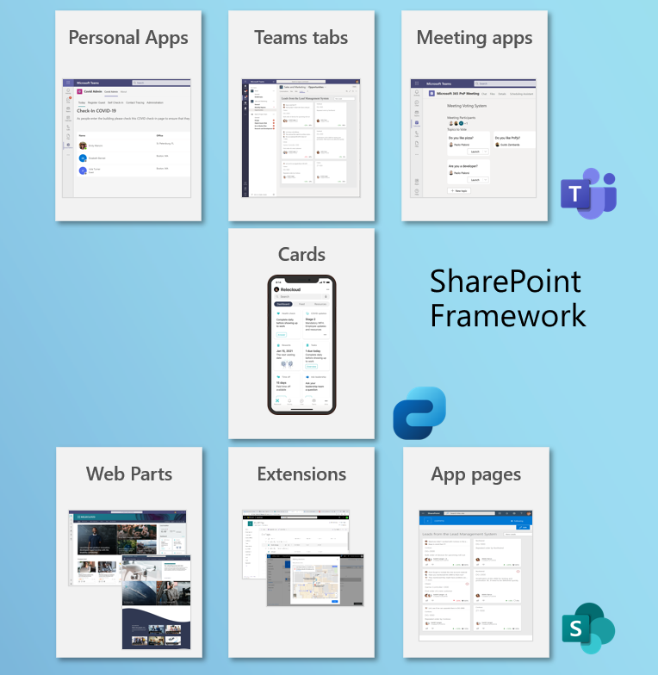
3 models of card implementation
No code
Low code
Pro Dev
Includes cards acquired from the store.
Notes:
You can implement 3 models of card implementation – including no code, low code, and pro dev. No code includes cards acquired from the store.

Slide 6
Viva Connections provides a powerful and extensible platform
Adaptive Cards Extension (ACEs) (Card views + quick views)
ACEs are SharePoint Framework component that enables developers to build rich, native extensions to Viva Connections' Dashboards
Deep linking to Teams
Existing Microsoft Teams partners can deeplink Viva Connections solution to their existing Teams app to connect users with more features and information
Bot framework powered ACEs
Existing Microsoft Teams partners and developers can use their existing Microsoft Teams bot investments to power Viva Connections experiences
Graph API
Create rich, personalized scenarios using data and functionality from the Microsoft Graph API
Distribute and Manage your solution
ISV Partners Publish to the SharePoint Store and Microsoft App Source
Enterprise Developers Upload the solution to the organizations SharePoint app catalog (LOB Apps)
Administrator Assign policy for apps over the employees/ end users
Operator Create and edit dashboard content, e.g., add a card and apply audience targeting
Capabilities

Slide 7
UX & low-code experience
Viva Connections platform capabilities in action

Slide 8
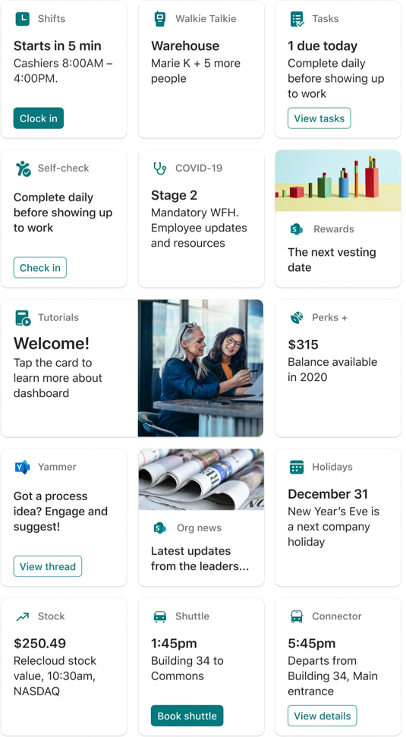
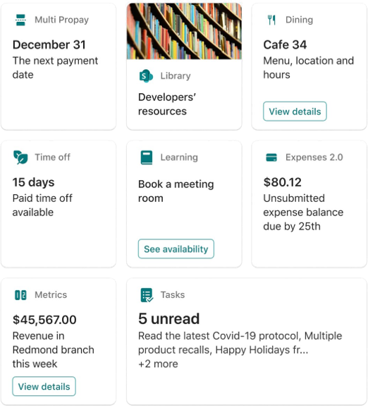
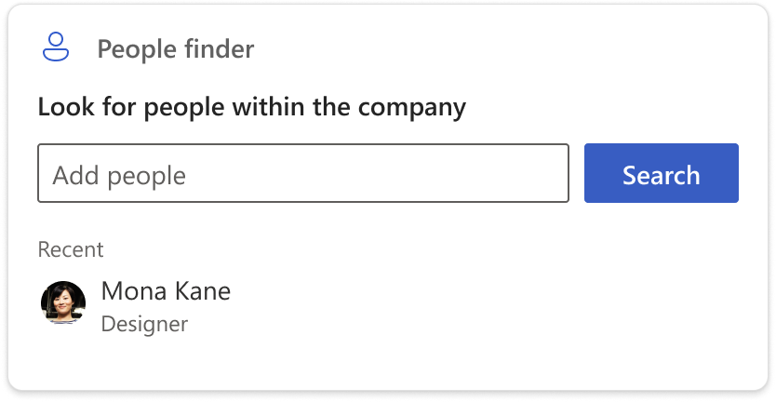
Card templates: layout, size and default
Flexible and customizable dashboard cards (ACEs)
Card templates
General purpose - Heading, Image and Title
Scenario focused - Search
Card sizes
Medium and Large
Extra features
Entire card is clickable
Primary and Secondary Buttons
aka.ms/Viva/Connections/DesignGuidelines

Slide 9
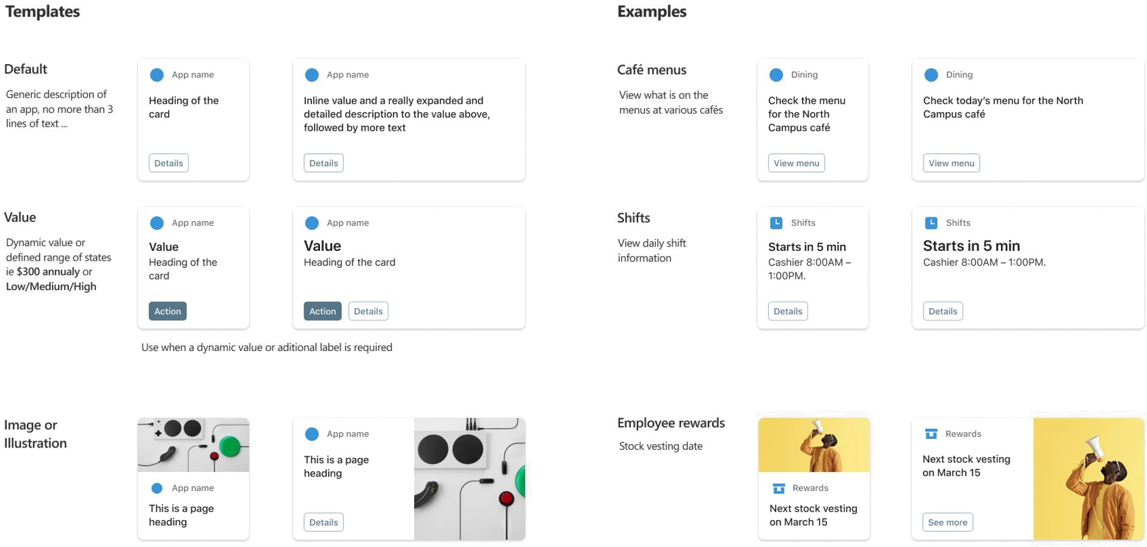
Make a great impression
Templates
Examples
Notes:
You can make a great impression with various templates – including default, value, image, or illustration. Some examples include café menus for dining, shifts, and employee awards.

Slide 10
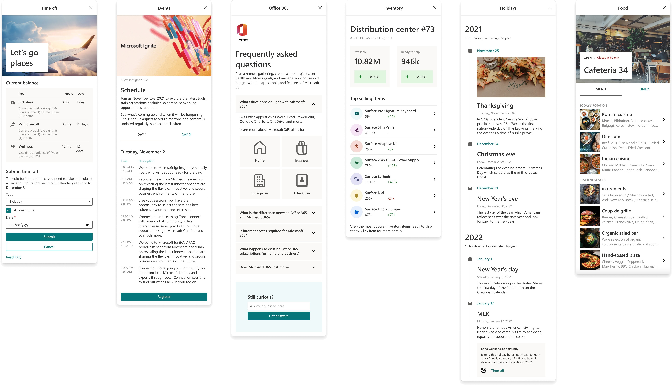

Quick views
Notes:
Quick views within Viva Connections include examples such as Time off, Events, Office 365, Inventory, Holidays, and Food.

Slide 11
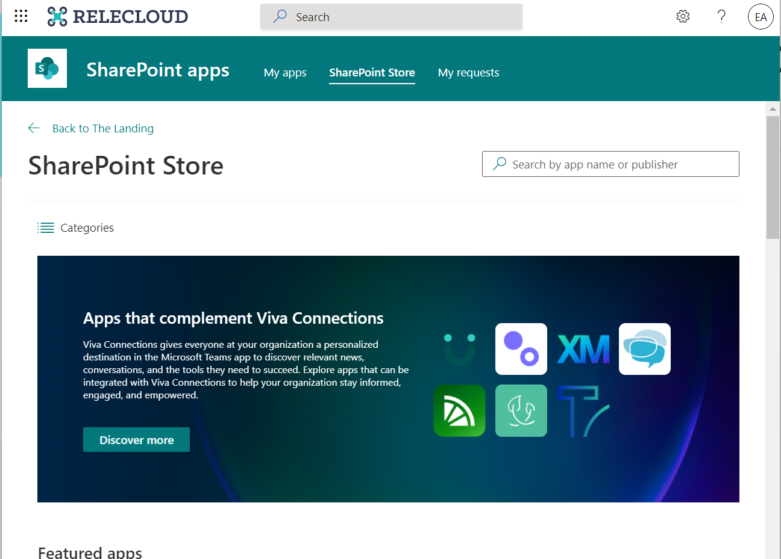
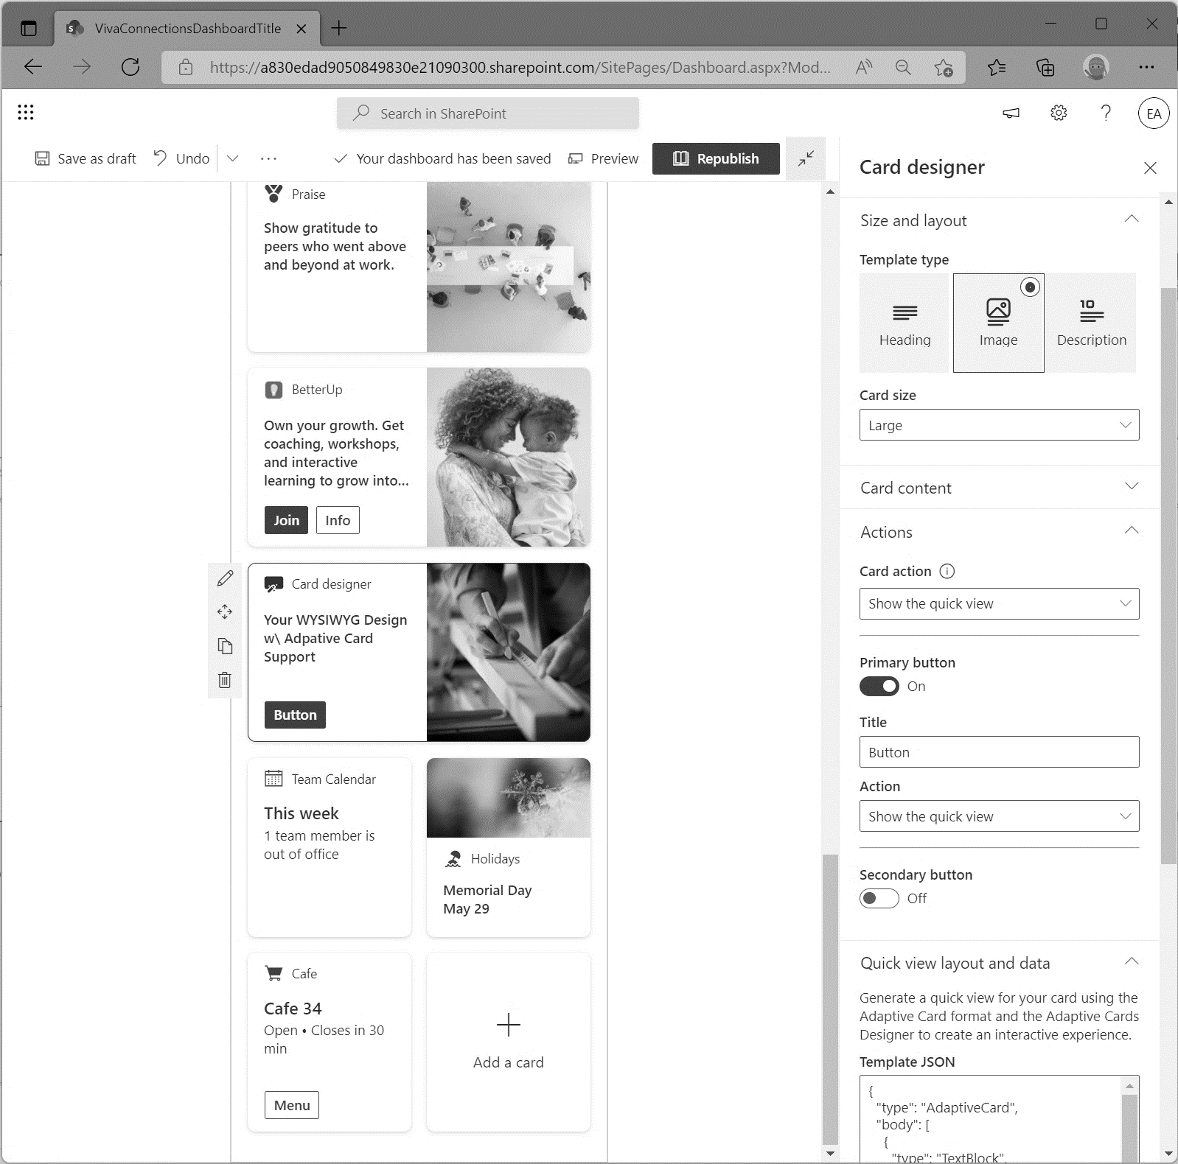
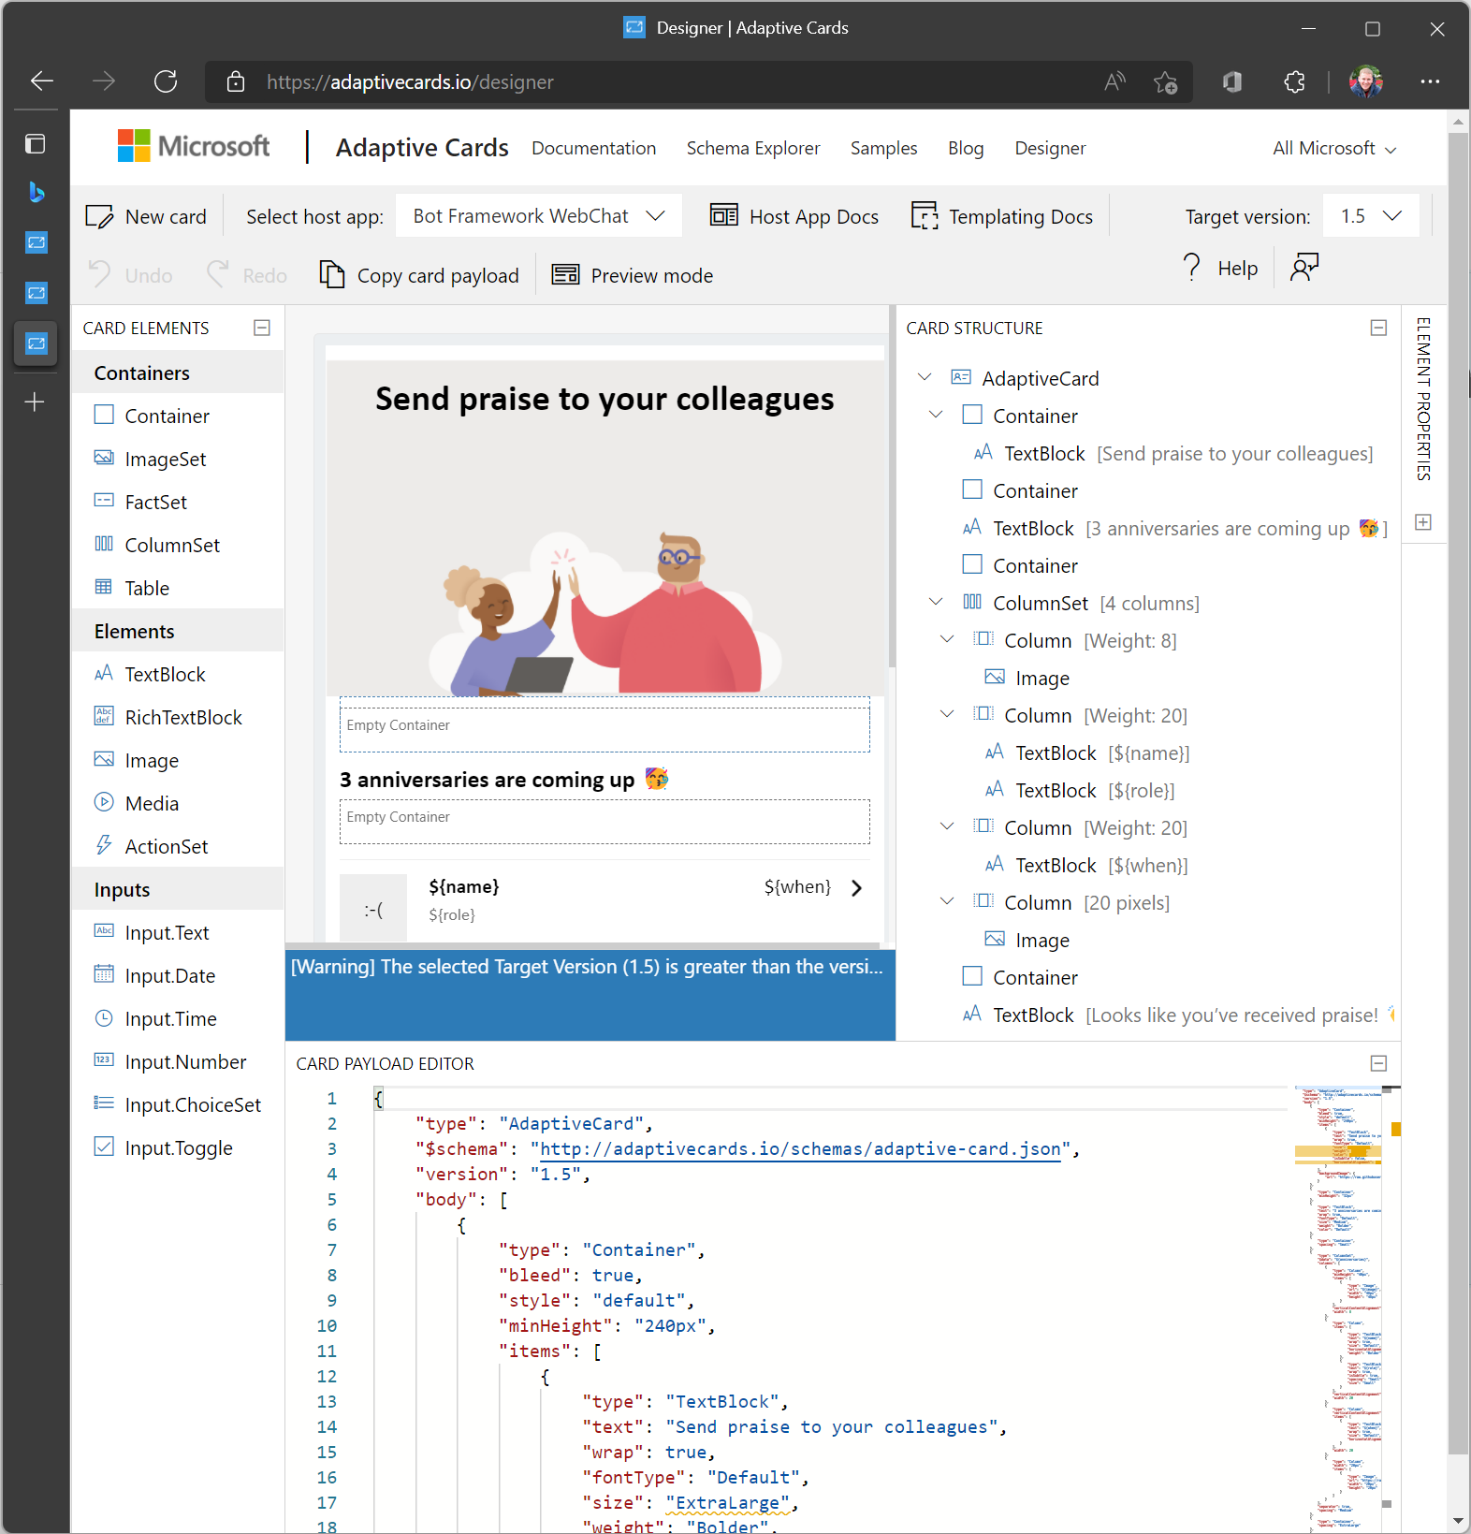
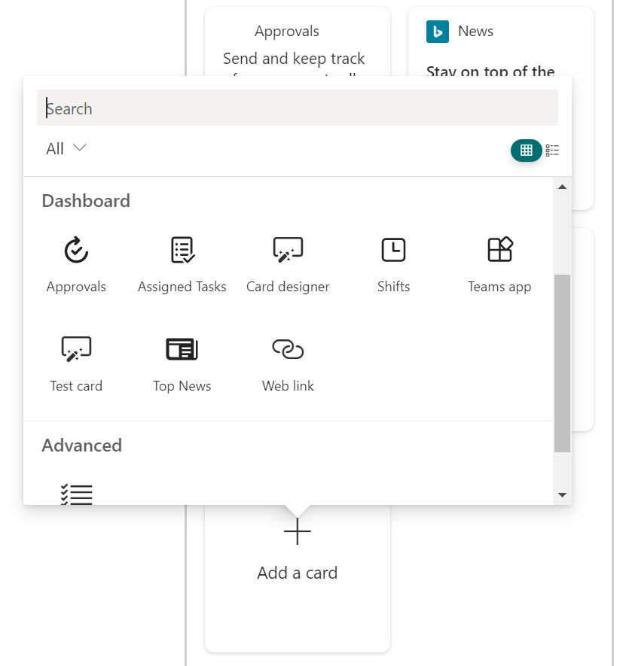
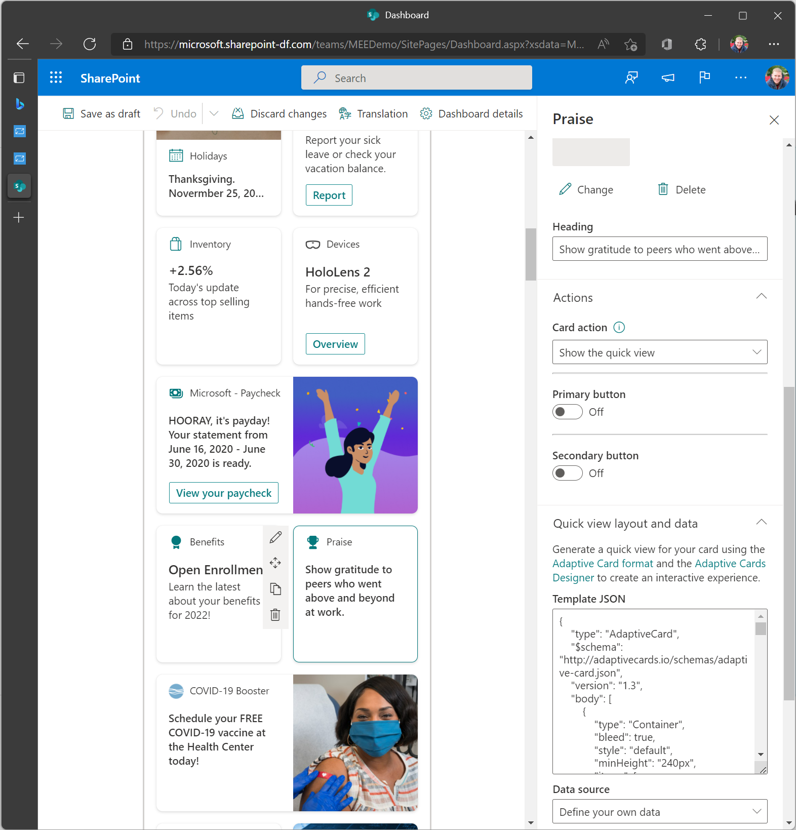
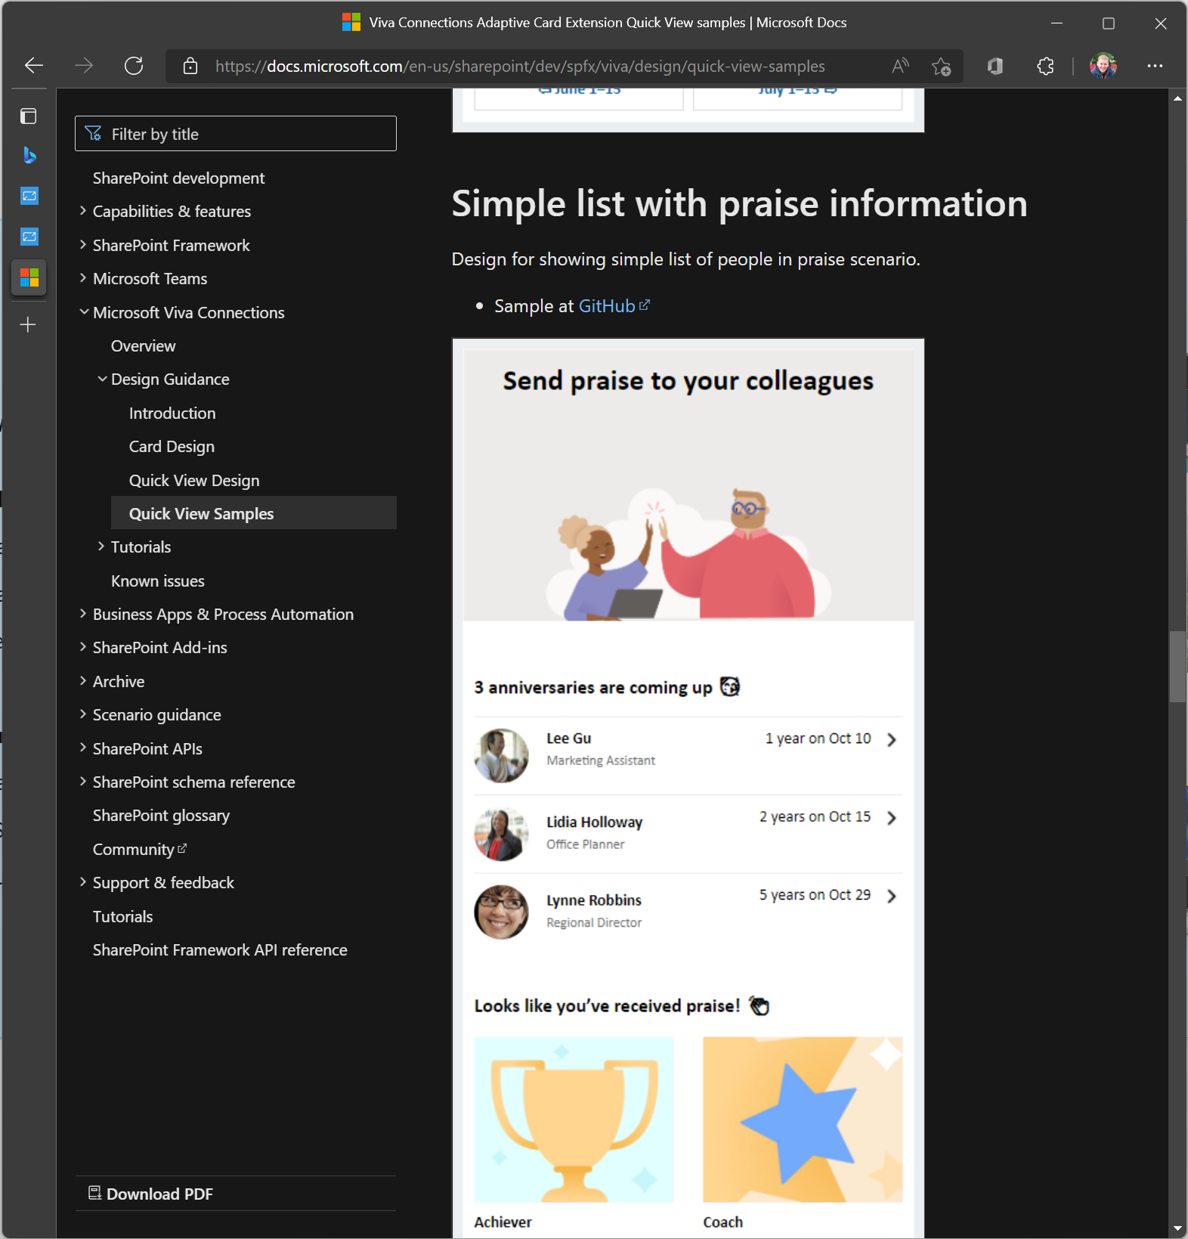
Guidance + card designer
UX Guidance
Customize
Try it!
Design Guidelines
aka.ms/Viva/Connections/DesignGuidelines
Adaptive Cards Designer
www.Adaptivecards.io/Designer/
Card Designer
aka.ms/Viva/Connections/CardDesigner
Notes:
You can explore these clickable links to learn more about design guidelines for UX guidance, adaptive cards designer for customization, and card designer for designing.

Slide 12




































Building low-code cards with card designer v2
Targets citizen developers / power users
Powered by SharePoint data
Powered by Microsoft Graph
Supports full admin governance
Enhanced authoring experience
Foundation for future integrations
Notes:
Targets citizen developers / power users
Powered by SharePoint data
Powered by Microsoft Graph
Supports full admin governance
Enhanced authoring experience
Foundation for future integrations

Slide 13




Bot-powered Adaptive Card Extensions (ACEs)
Brings existing bots in Viva Connections
Leverages Teams manifest and package
One solution, multiple canvases
Supports SSO and 3rd party IdPs
Available in desktop, mobile, web
Powered by Microsoft Bot Framework
Notes:
Brings existing bots in Viva Connections
Leverages Teams manifest and package
One solution, multiple canvases
Supports SSO and 3rd party IdPs
Available in desktop, mobile, web
Powered by Microsoft Bot Framework

Slide 14
SharePoint Framework ACEs
Viva Connections platform capabilities in action

Slide 15

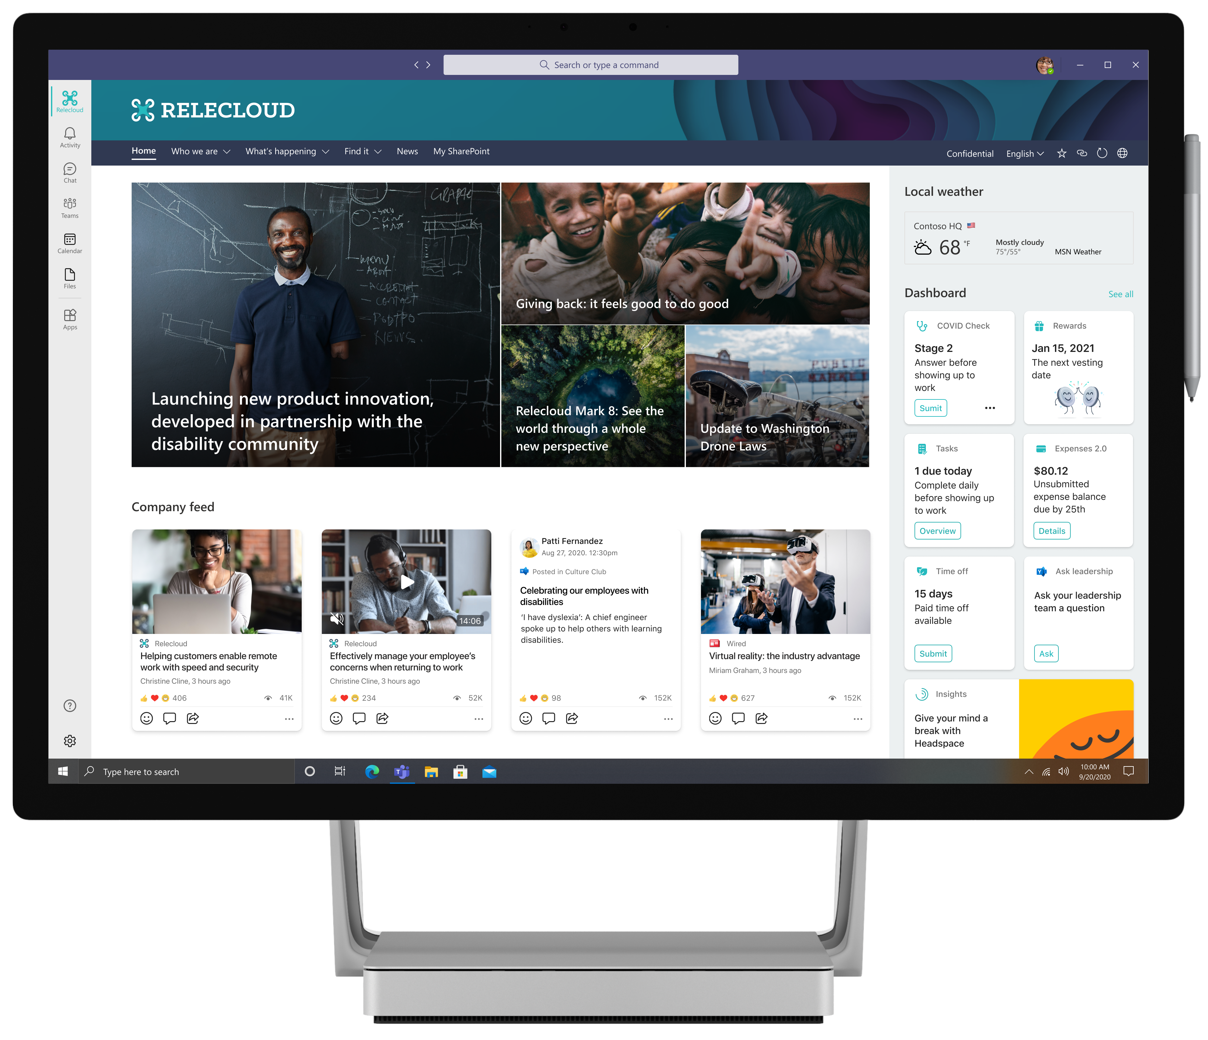
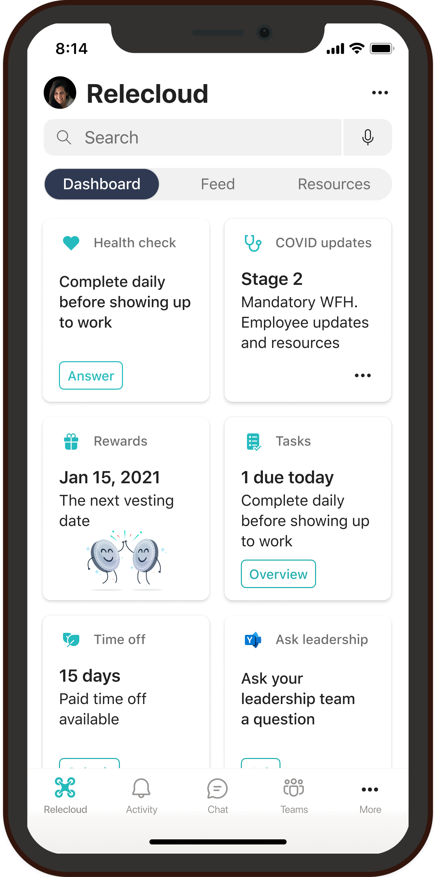
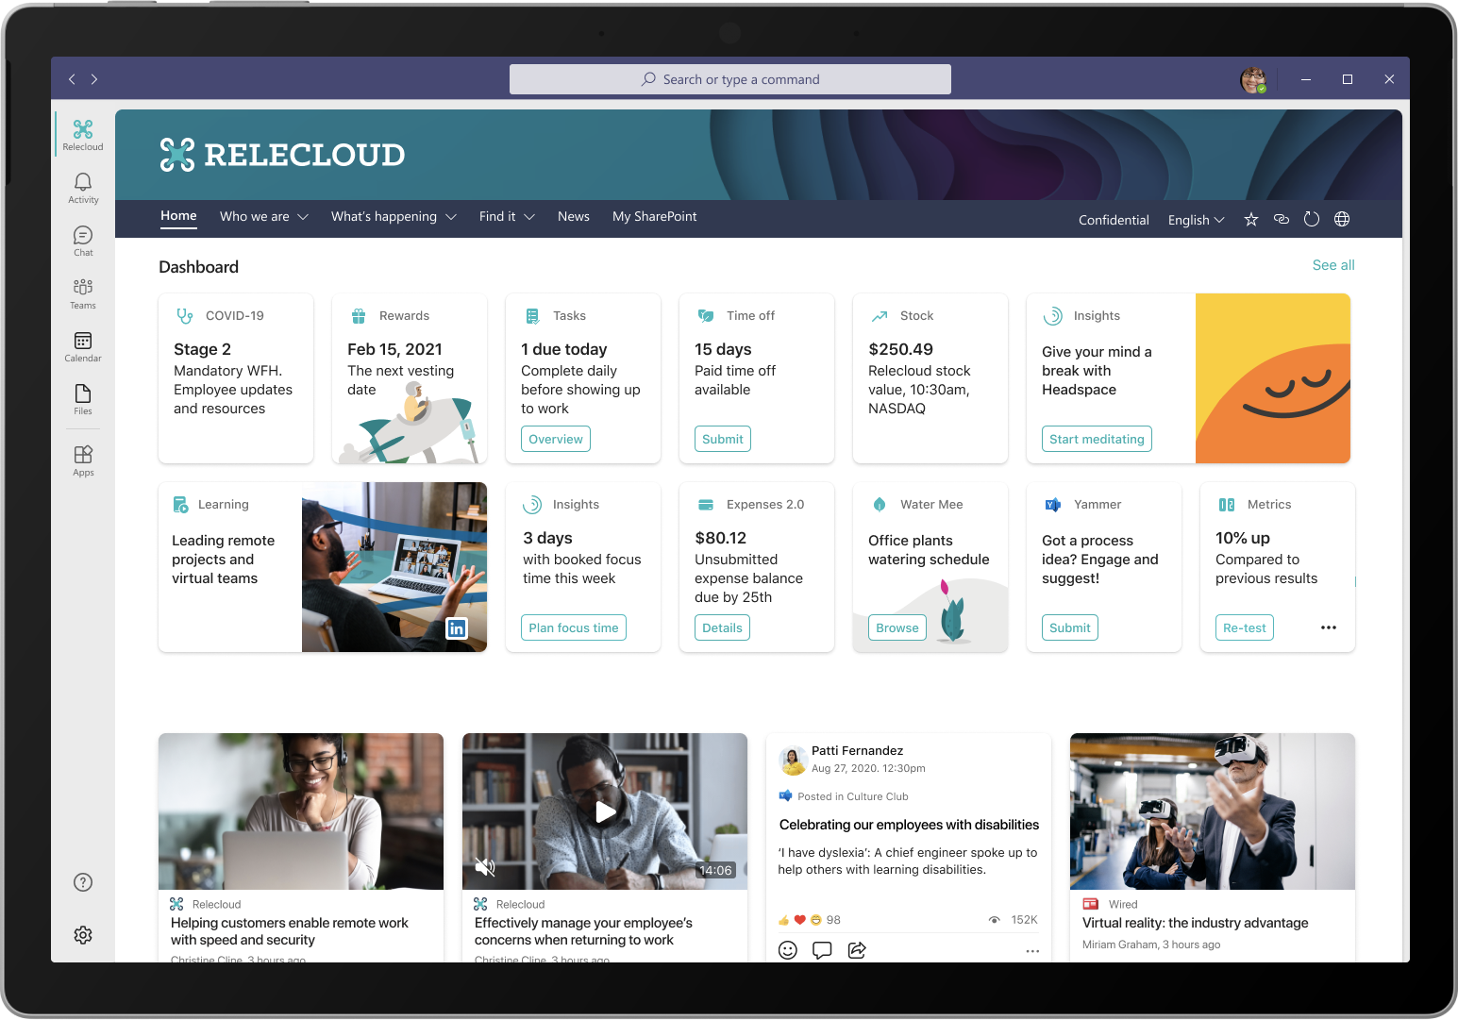
SharePoint Framework
The easiest way to build your enterprise solutions for Microsoft 365
Automatic Single Sign On
Automatic hosting
Consistent dev experience
Industry standard tooling
Notes:
SharePoint Framework The easiest way to build your enterprise solutions for Microsoft 365
Automatic Single Sign On
Automatic hosting
Consistent dev experience
Industry standard tooling

Slide 16



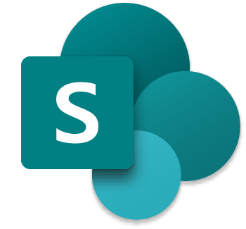
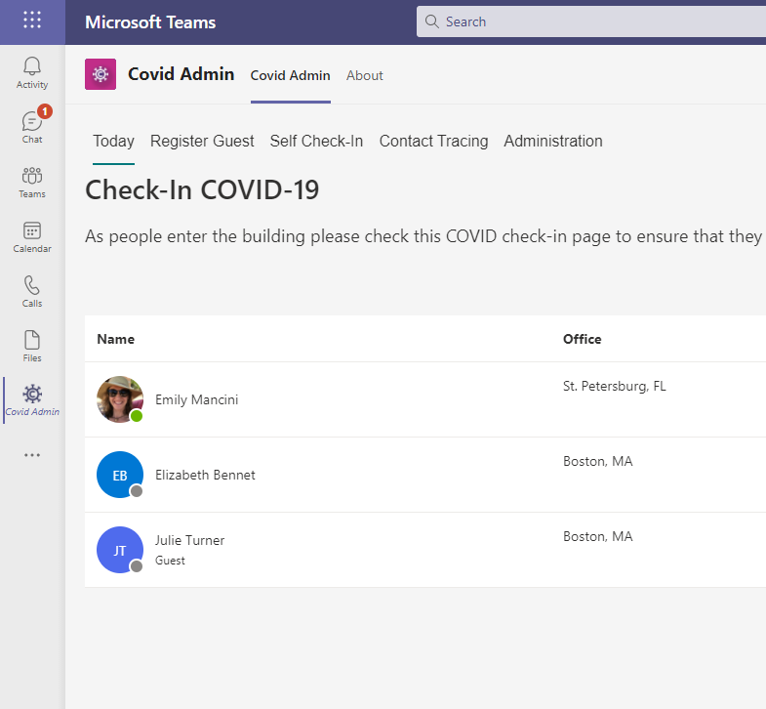
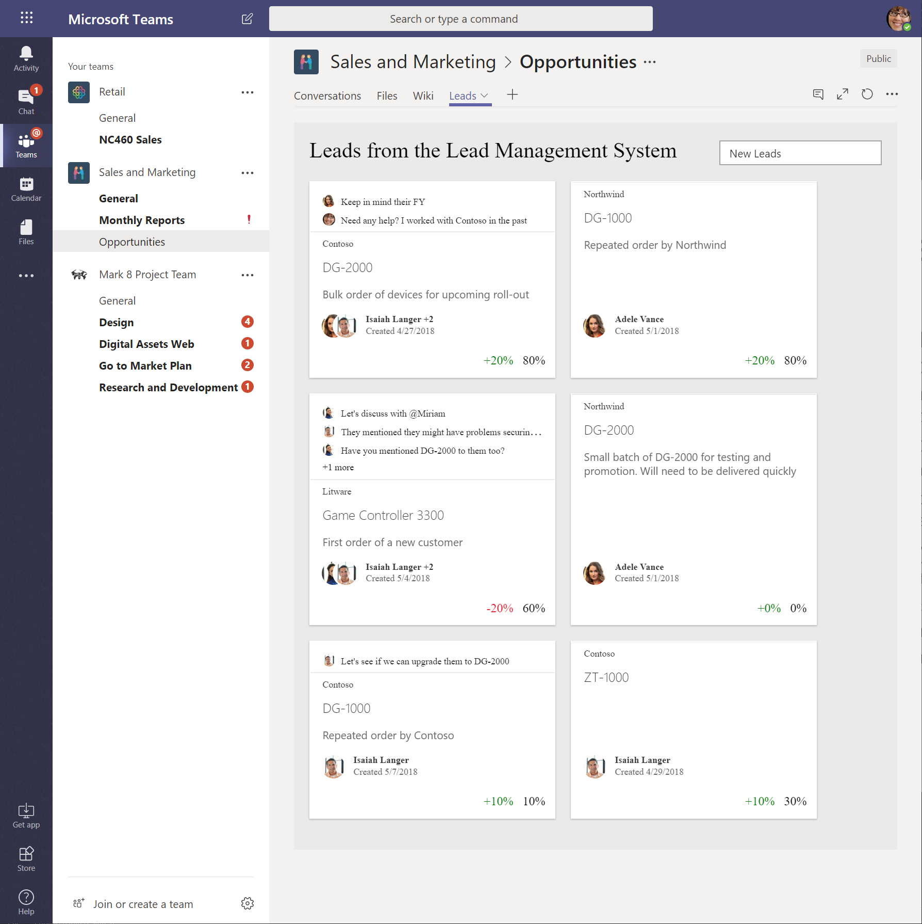
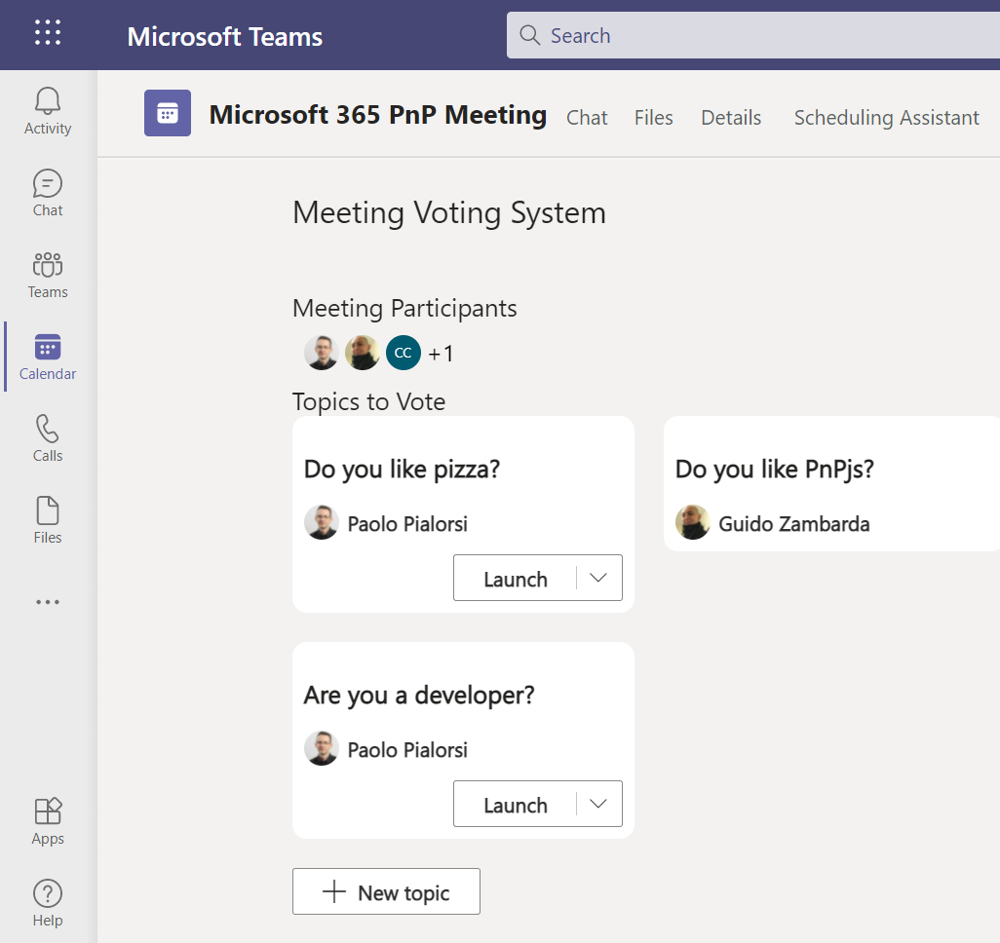
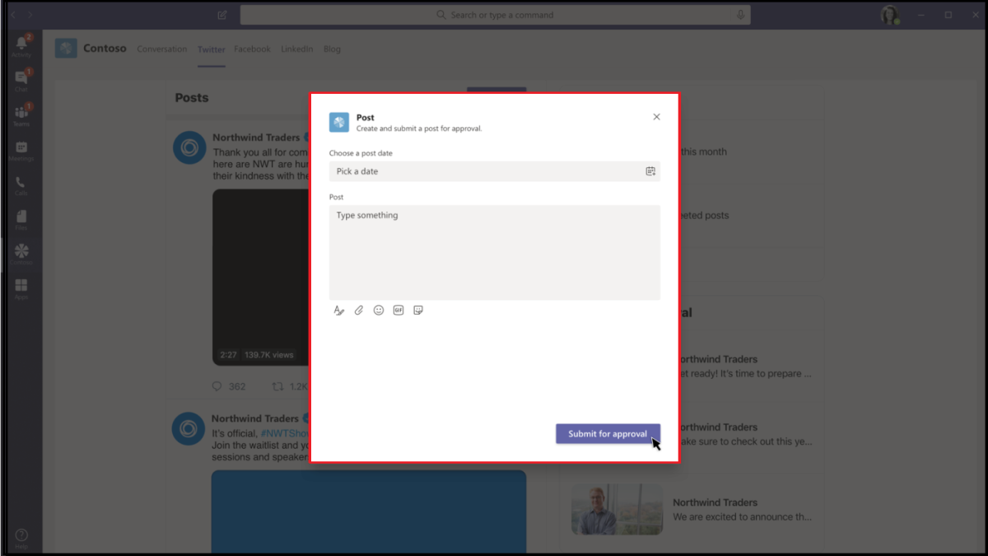
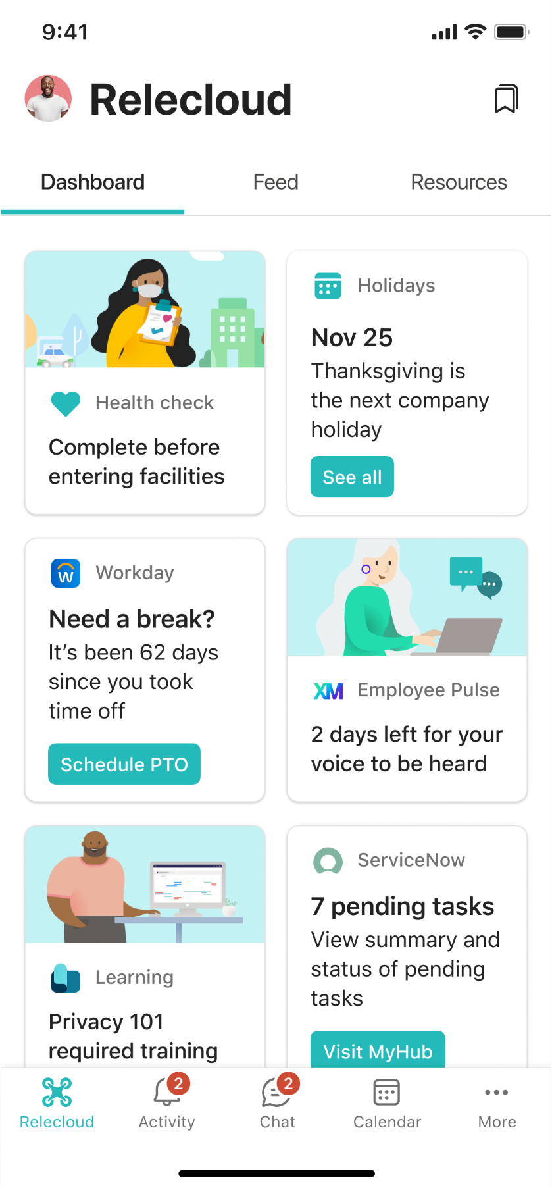
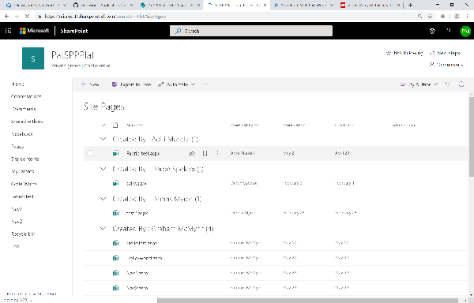
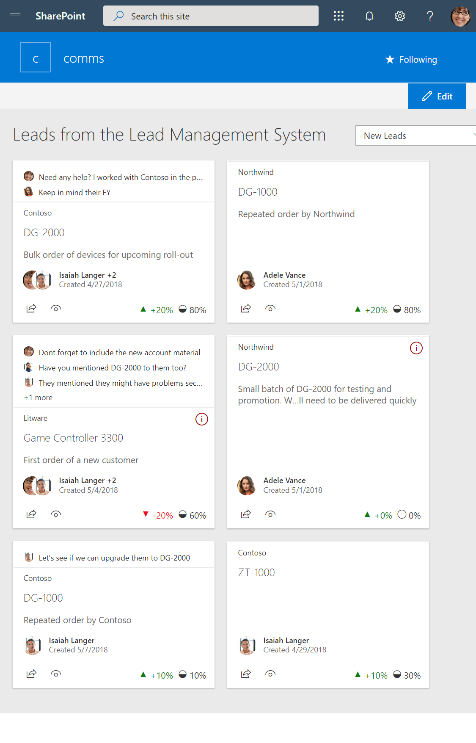
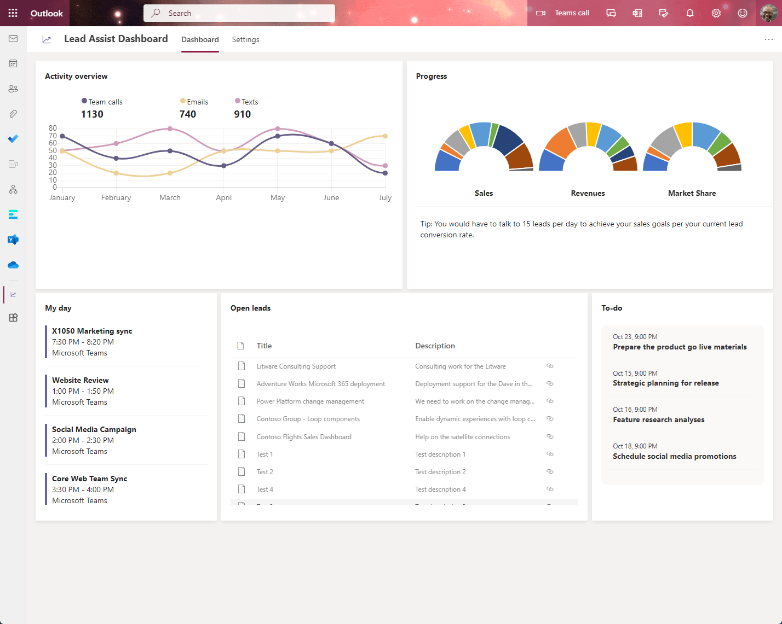
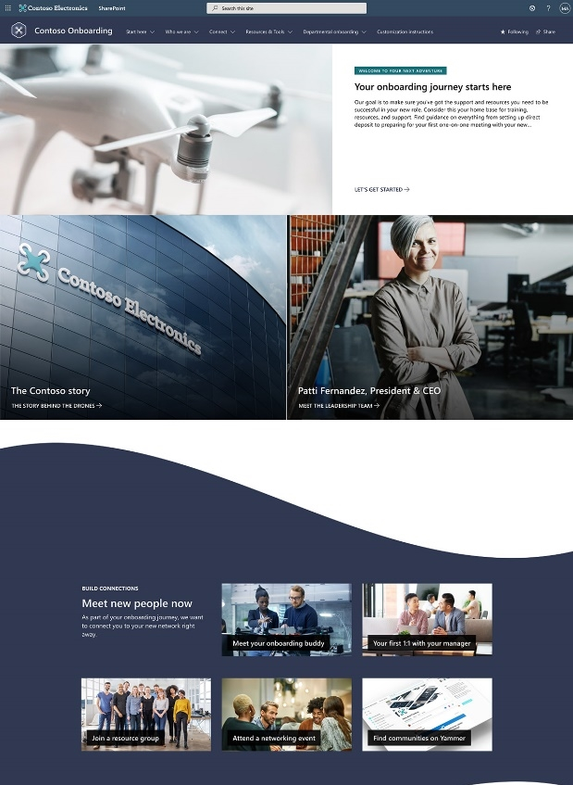
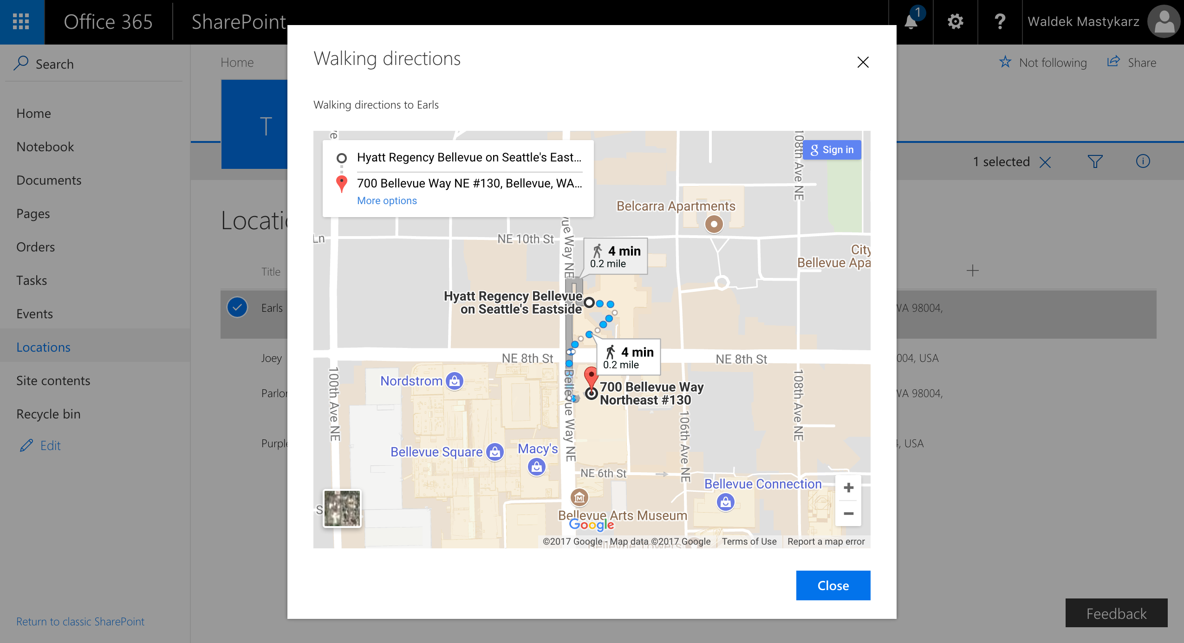


SharePoint Framework across Microsoft 365
Microsoft Viva
Microsoft Teams
SharePoint
Personal Apps
Teams tabs
Meeting apps
Messaging extensions
Cards
Web parts
Extensions
App pages
Outlook and Microsoft 365 app (Office)
Content driven applications | SSO | Automatic code hosting | Industry standard tooling
Notes:
Here is a modern toolkit for creating responsive and engaging components and user experiences for SharePoint, Teams, Viva Connections, Office Apps, and third-party apps and services. Microsoft Teams includes personal apps, Teams tabs, Meeting apps, Messaging extensions, and Cards. Outlook and Micrososft 365 includes personal apps. Microsoft Viva includes Cards, Web parts, and extensions. SharePoint includes web parts, extensions, and app pages.

Slide 17
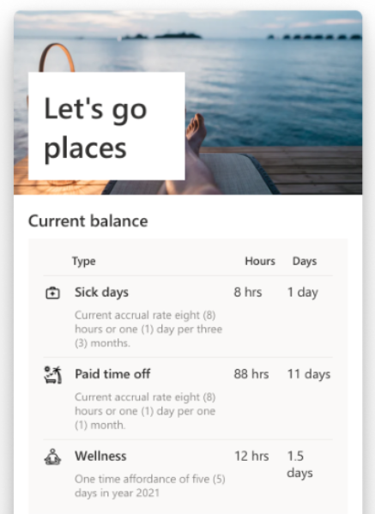
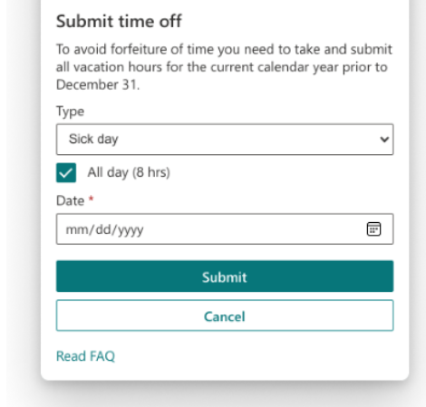
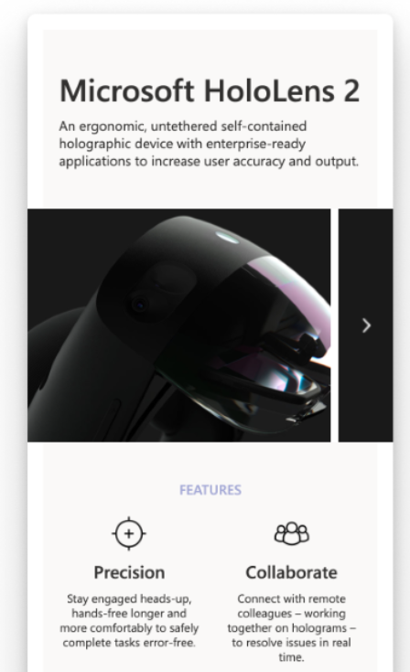
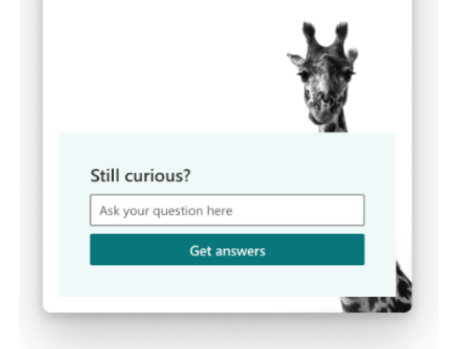
Viva Connections adaptive card extension architecture
Adaptive card markup
SharePoint Framework
Orchestration between Adaptive Cards and APIs
Microsoft Graph
Notes:
The adaptive card markup comprises of synergies between Microsoft Graph and SharePoint Framework. The SharePoint Framework is an orchestration between adaptive cards and APIs.

Slide 18
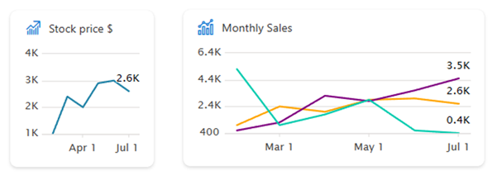
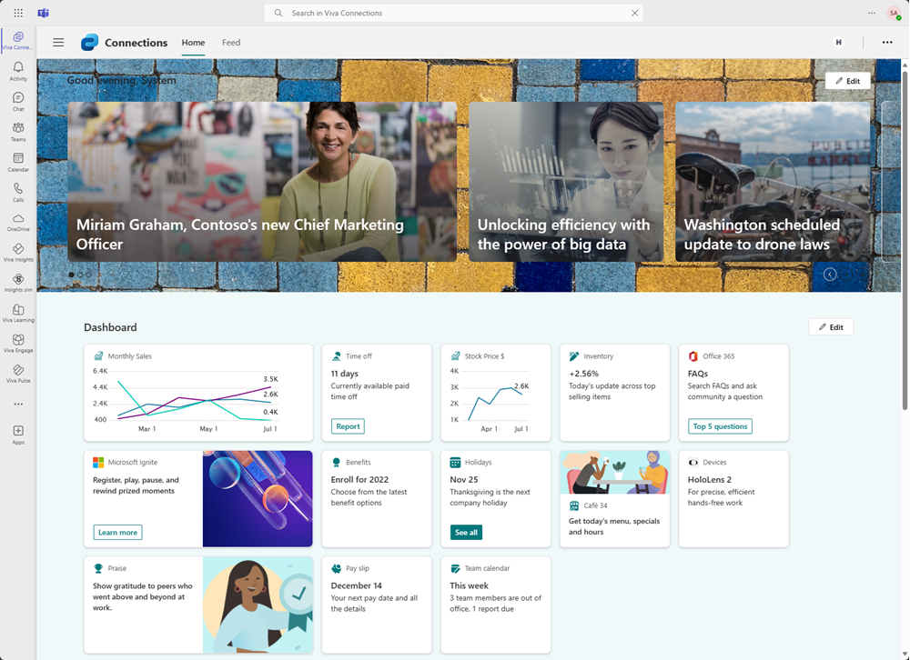
New chart card option in the SPFx 1.19
Chart card option will be introduced with the SPFx 1.19 release – Available this week
Beta version already available to start testing the chart card in your solutions
Provides an option to render 1 to 3 charts directly in the card
Up to three lines shown when the card is in larger rendering mode
One line shown when rendered in small mode
You can control the chart metrics, colors and details
More charting options for Viva Connections in the roadmap

Slide 19
Contoso Retail sample showcasing the art of possible with SPFx in Microsoft 365

Slide 20
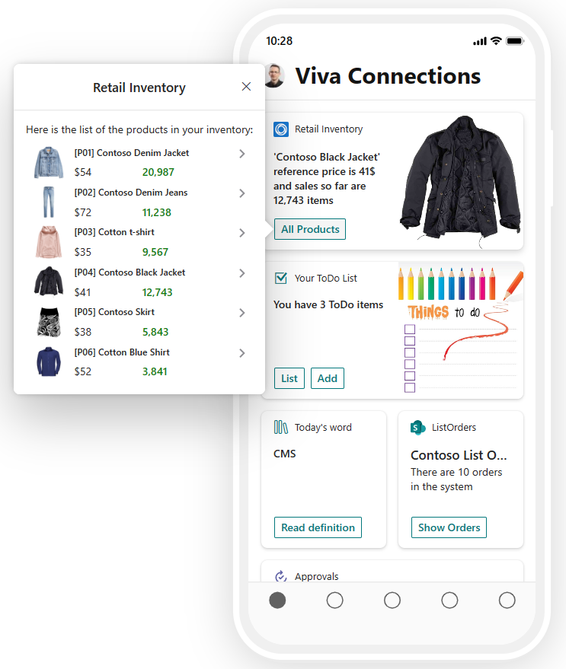
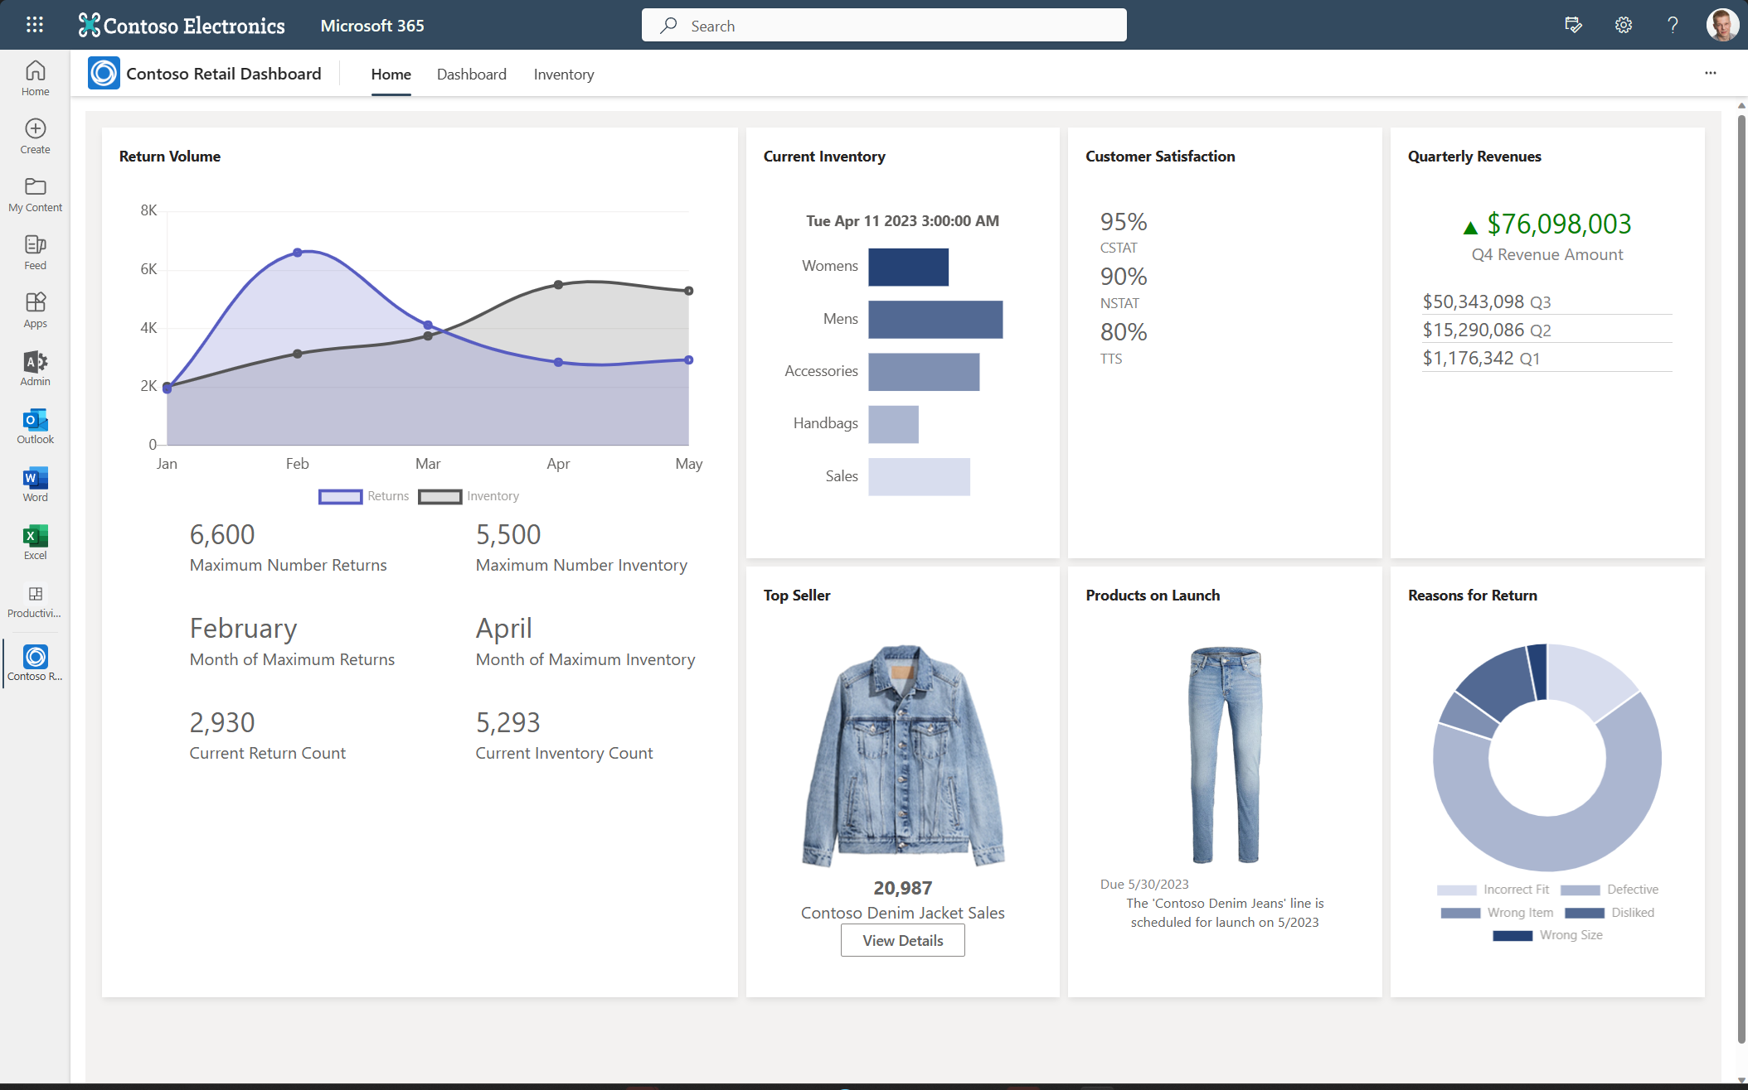
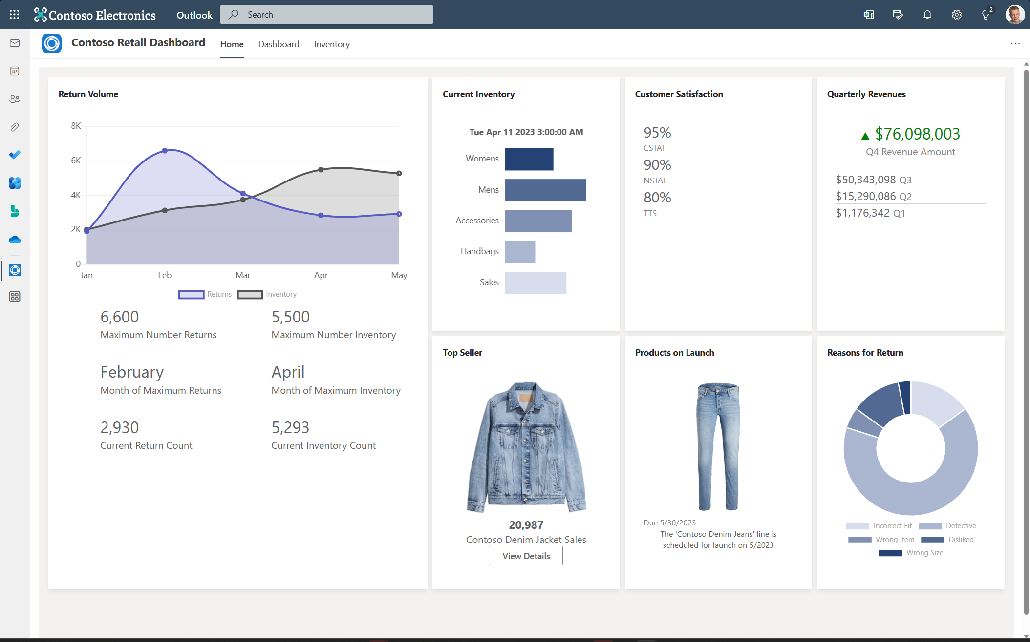
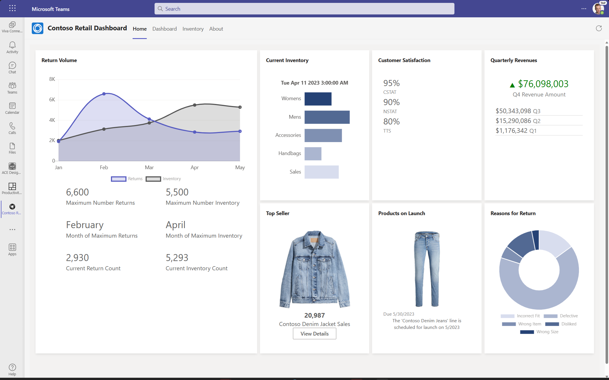
Contoso Retail – fully polished example
https://aka.ms/sample/contoso/retail
Notes:
This is a sample end-to-end application, based on demo sample data, that shows you how to create a Microsoft Teams personal app with SharePoint Framework, hosting the solution also in Outlook.com and in the Office portal as a Microsoft 365 app. The solution also provides a sample Adaptive Card Extension (ACE) for Microsoft Viva Connection, still built with SharePoint Framework. The sample illustrates how to connect the ACE with the Teams personal app, providing custom arguments to the Teams personal app via deep links defined in the ACE. Last but not least, the solution illustrates how to create a Teams Message Extension for Search using Microsoft Teams Toolkit. Explore more here: https://aka.ms/sample/contoso/retail

Slide 21

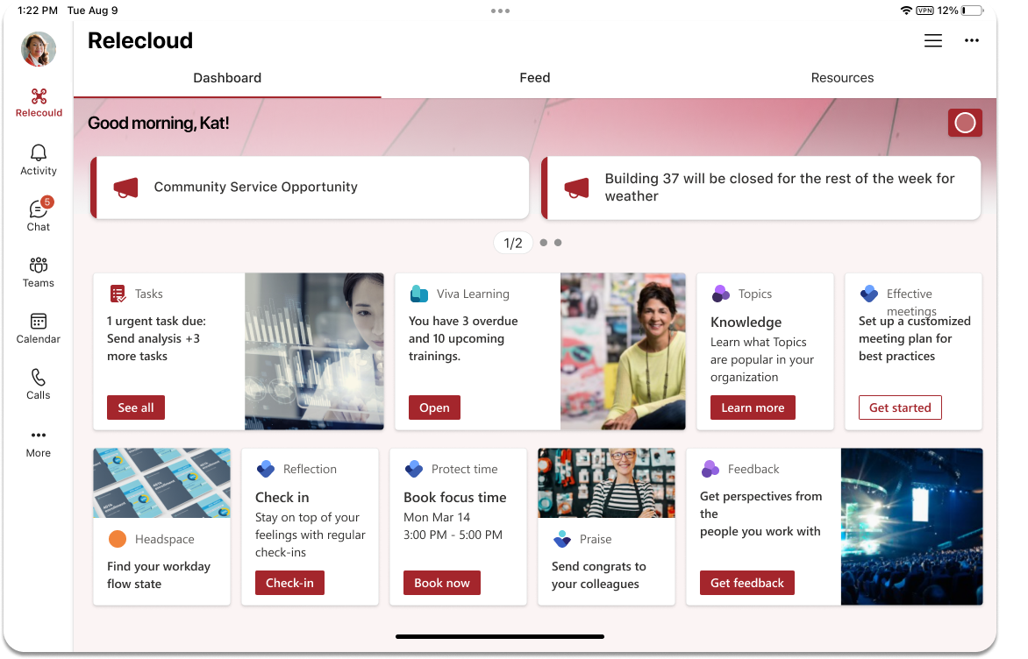
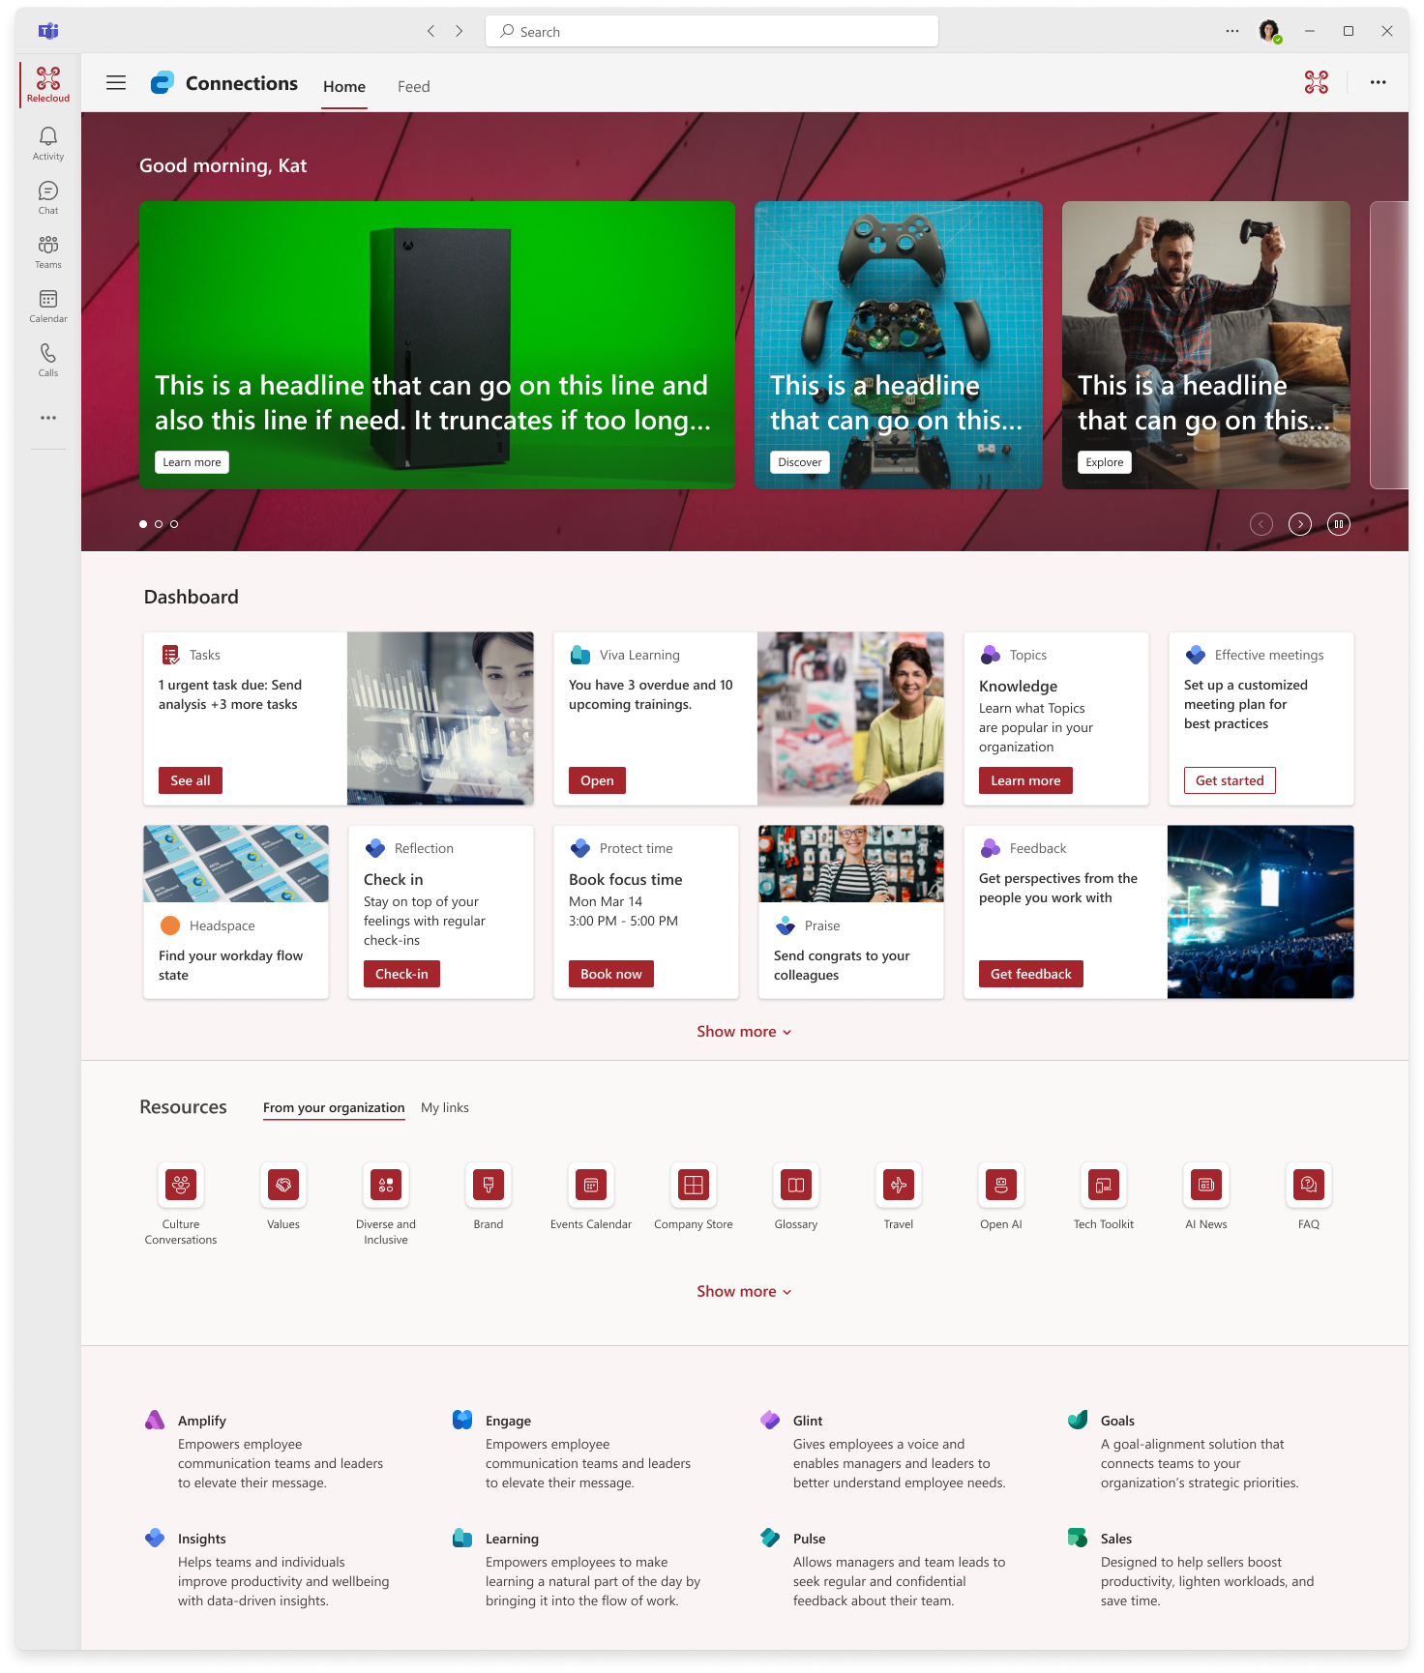
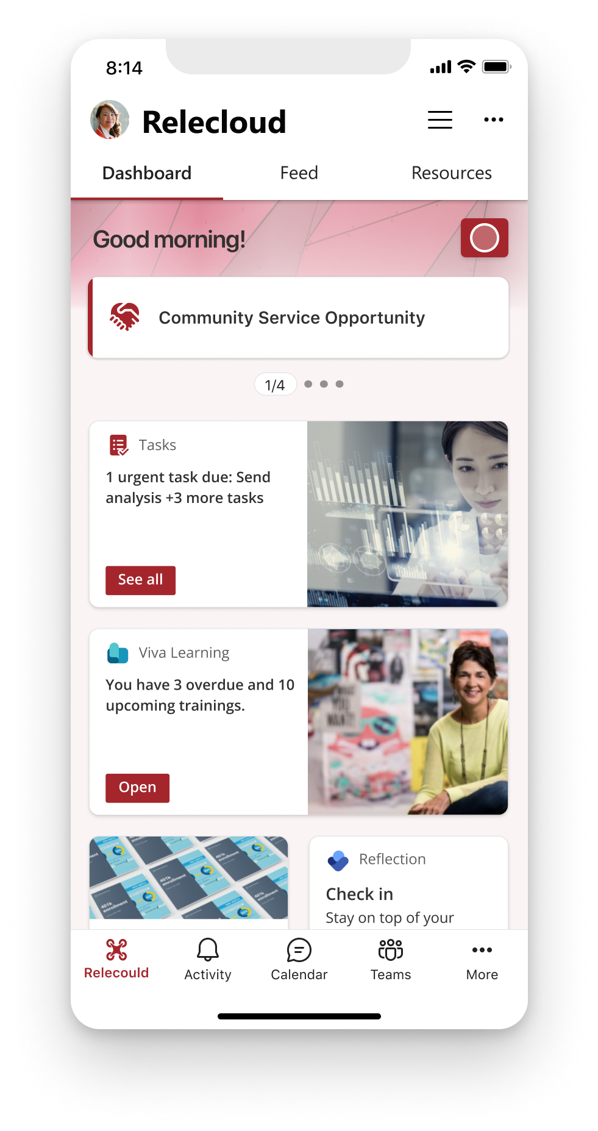
Next steps
All developers
Start using Viva Connections aka.ms/Viva/Connections/GettingStarted
Start a solution aka.ms/Viva/Connections/Platform
Design guidelines aka.ms/Viva/Connections/DesignGuidelines
Teams developers
Enable deep linking aka.ms/Viva/Connections/Teams/DeepLinks
Enable SSO for your Teams App aka.ms/Viva/Connections/Teams/SSO
Consider Message Extensions: aka.ms/Viva/Connections/Teams/MessagingExtensions
Consider Stage View: aka.ms/Viva/Connections/Teams/StageView
Jump Start Development
Training aka.ms/Viva/Connections/Platform/Training
OSS Samples aka.ms/Viva/Connections/Samples
Plug into Community aka.ms/community/home
Microsoft Viva Adoption Hub

Slide 22
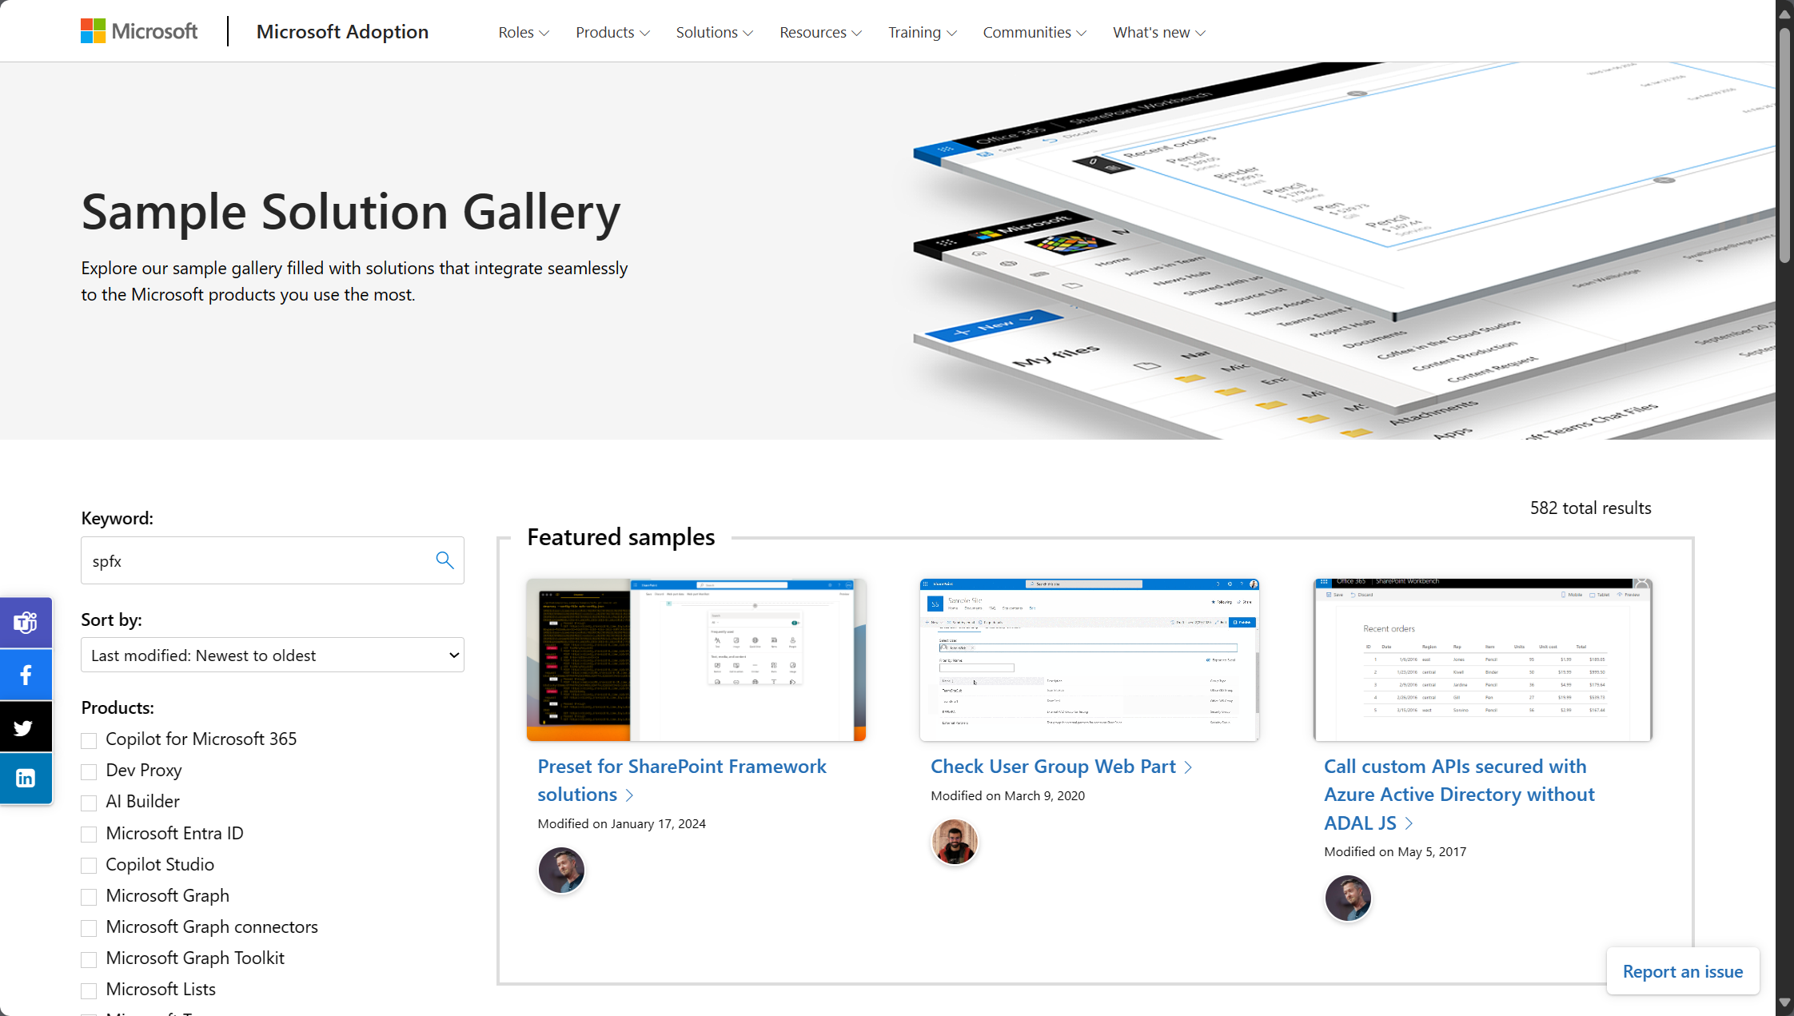
https://aka.ms/community/samples
1900+ samples from Microsoft and community
Notes:
Explore the Sample Solution Gallery here: https://aka.ms/community/samples

Slide 23
Microsoft Viva

