Slide 1
Nonparametric Scene Parsing: Label Transfer via Dense Scene Alignment
Ce Liu Jenny Yuen Antonio Torralba
{celiu, jenny, torralba}@csail.mit.edu
CSAIL MIT

Slide 2
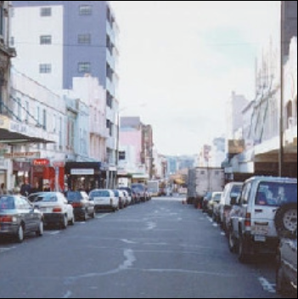
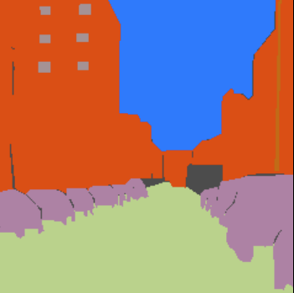
The task of object recognition and scene parsing
window
tree
sky
road
field
car
building
unlabeled
Input
Output
Notes:
One important task of computer vision is to recognize objects and parse the scene for a given image. For the input image on the left, one desirable output is shown on the right where the image is parsed into regions and an object category is associated with each region, such as sky, building, car, road and windows. Obviously, it is nontrivial for computers to do this task automatically.

Slide 3
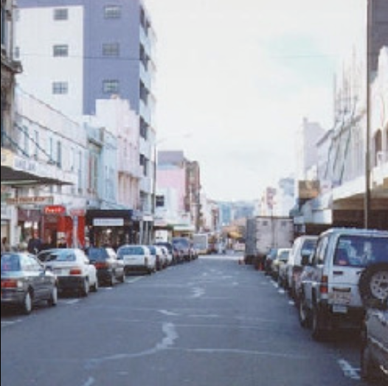
Training-based object recognition and scene parsing systems
Sliding window method
Train a classifier for a fixed-size window (e.g., car vs. non-car)
Try all possible scales and locations, run the classifier
Merge multiple detections
Notes:
One popular approach to object recognition and scene parsing is the sliding window method. Using an annotated database, we can train a classifier for a fixed-size window and run this classifiers at all possible locations and scales for an input image.

Slide 4
Training-based object recognition and scene parsing systems
Sliding window method
Train a classifier for a fixed-size window (e.g., car vs. non-car)
Try all possible scales and locations, run the classifier
Merge multiple detections
Texton method
Extract pixel-wise high-dimensional feature vectors
Train a multi-class classifier
Spatial regularity: neighboring pixels should agree
Is it possible to build a recognition system without training classifiers?
Notes:
Another typical approach is called the texton method, where we extract a high-dimensional feature vector for every pixel, train a multi-class classifier, and impose spatial regularity to generate pixel-wise scene parsing. These two methods both require training classifiers. So is it possible to build a recognition system without training classifiers?

Slide 5
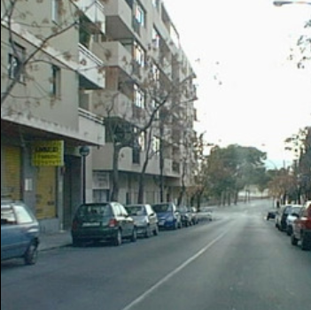
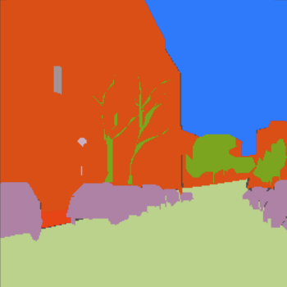
Label transfer: a correspondence-based approach to scene parsing
Given an image
Find another annotated image with similar scene
Find correspondence between these two images
Warp the annotation according to the correspondence
Two key components:
A large, annotated database
Good correspondence for label transfer
Input
Support
window
tree
sky
road
field
car
building
unlabeled
Warped annotation
User annotation
Notes:
Here is an idea. Given an input image, we can find one support image that shares similar scene characteristics as the input. By scene characteristics we mean not only the object classes but also the context of the scene. Importantly, this support image is also annotated. Next, we can establish correspondence between these two images, cars to cars, buildings to buildings, sky to sky and road to road. Lastly, we simply warp the annotation of the support image back to the input according to this correspondence, and we should be able to obtain a reasonable parsing of the input! So now we have reduced the scene parsing problem to the correspondence problem. We call this correspondence-based scene parsing approach label transfer, in parallel to the sliding window and texton methods.

Slide 6
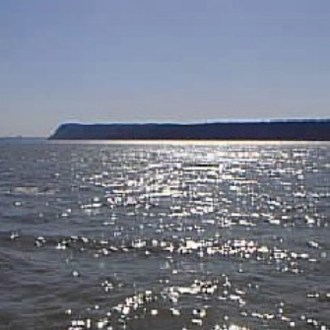
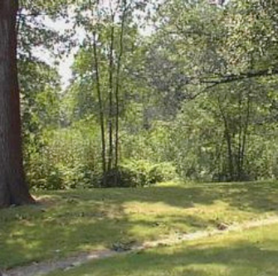
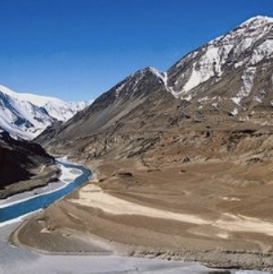
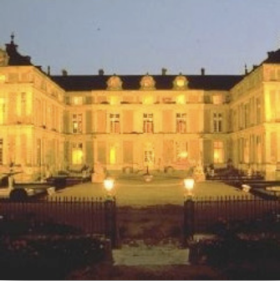
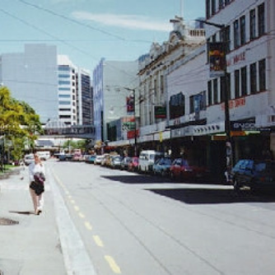
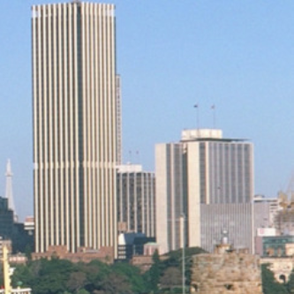
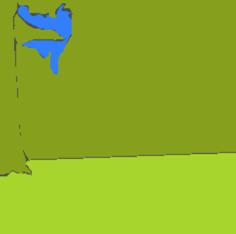
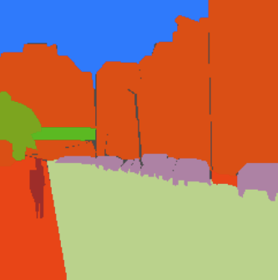
The database
A subset of LabelMe database (outdoor scenes)
2688 in total, 2488 for training, 200 for test
33 object categories + “unlabeled”
B. Russell et al. LabelMe: a database and web-based tool for image annotation. IJCV 2008.
Notes:
We use a subset of the LabelMe database. This subset contains mostly outdoor scenes. …. On bottom-left we di

Slide 7
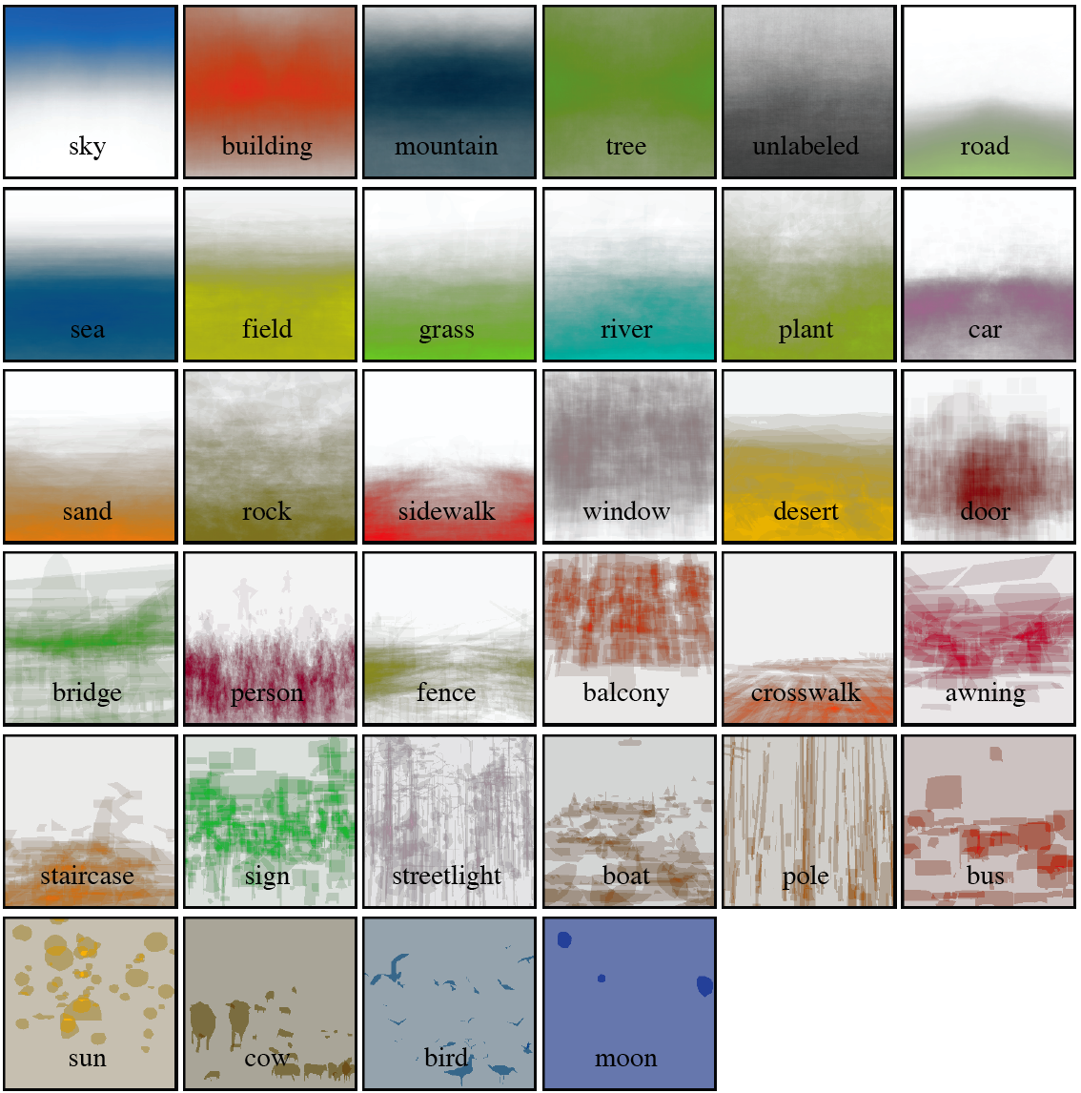
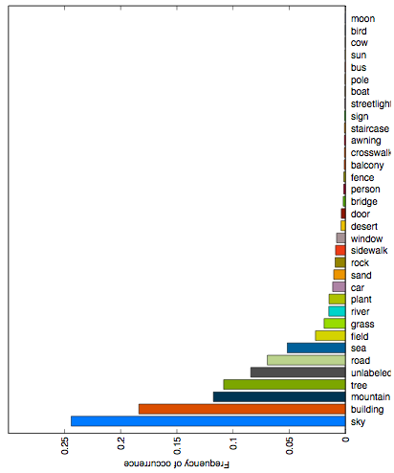
Statistics of the database
Pixel-wise frequency count of each class
Pixel-wise prior distribution of each class (more saturated more probable)
Notes:
Here are the statistics of the database. On the left we plot the pixel-wise frequency count of each object class. This distribution is heavily biased: there are a lot more pixels for stuff-like objects, sky, building, mountains, than the pixels for small, discrete objects such as pole, sun, bus, cow, bird. This bias is very important to understand the performance of the system later. On the right we plot the pixel-wise prior distribution of each class. More saturated color means more probable. For example, the sky pixels tend to appear at the upper part of images, and sea, field and grass pixels tend to appear at the lower part of images.

Slide 8
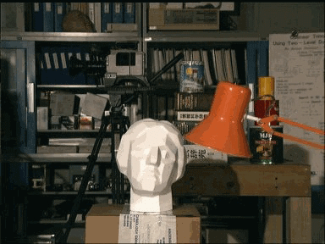
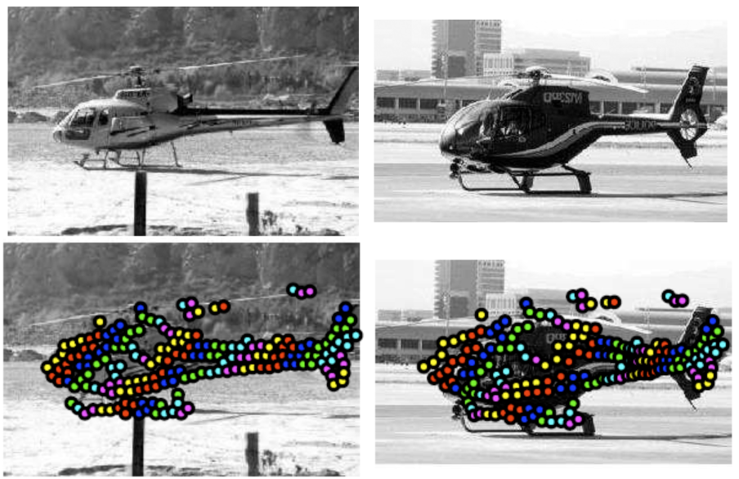
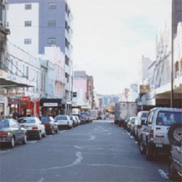
Image correspondence
Correspondence at pixel level
Correspondence at object level
[Scharstein et al. IJCV’02]
[Berg et al. CVPR’05]
Correspondence at scene level
Dense correspondence; Scene context preserved
Notes:
Image correspondence has been studied for decades in computer vision. We can establish correspondence between two images coming from the same 3D scene, such as stereo and optical flow. These are still hard problems to solve. People moved on to study the correspondence at the object level. For most cases, the correspondence is only established between the salient objects in the images, for example, the helicopters. The background pixels are treated as outliers. But for scene parsing, naturally we need correspondence at the scene level, where we want to build a dense correspondence for every pixel so that we can transfer pixel-wise annotations. Notice that this full correspondence also carries scene context: the context regularity of the support image is respected during the label transfer process.

Slide 9
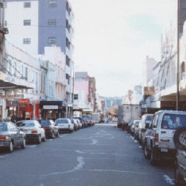
How to establish dense scene correspondence?
Input
Support
Before alignment
Notes:
So how to establish dense scene correspondence? Maybe these two images are already aligned. So we flip back and forth these two images. Hmm, not really. But this is a useful technique to inspect a correspondence between two images.

Slide 10
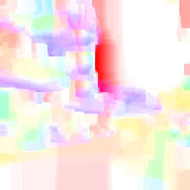
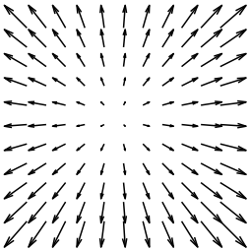
How to establish dense scene correspondence?
Input
Support
Optical flow
Flow visualization code
Notes:
You may say why not try optical flow, and here is the result. We use a popular visualization code from the optical flow community to display the flow field.

Slide 11
How to establish dense scene correspondence?
Input
Support
Warping of optical flow
Notes:
But you don’t need to understand it, just look at the warping from the second image to the first according to the estimated flow field, and you can easily tell whether they are aligned. Well, not really. Of course, we do not expect the brightness to be constant across the images in scene alignment. In fact, researchers have discovered that SIFT is a good feature to represent objects under different views and even for different instances.

Slide 12
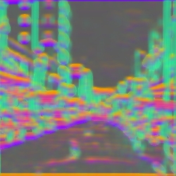
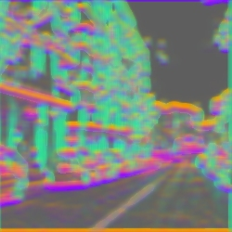
How to establish dense scene correspondence?
Input
Support
SIFT flow
Dense SIFT image (RGB = first 3 components of 128D SIFT)
C. Liu et al. 2008
Notes:
So last year at ECCV, we introduced a technique called SIFT flow to align images across scenes. Instead of matching RGBs, we try to match dense, pixel-wise SIFT descriptors. Here is the estimated SIFT flow field

Slide 13
How to establish dense scene correspondence?
Warping of SIFTflow
Dense SIFT image (RGB = first 3 components of 128D SIFT)
C. Liu et al. 2008
Notes:
and the warping of the SIFT flow. Clearly, a big portion of the two images are aligned using SIFT flow, buildings match to buildings, sky to sky, road to road, and the cars are partially aligned as well. Now that we have SIFT flow to establish dense scene correspondence, we can also use SIFT flow to build a label transfer system.

Slide 14
Nonparametric scene parsing: label transfer via dense scene alignment
How to find a good support image?
SIFT flow to build dense correspondence with every image in the database? Too slow!
Scene retrieval using GIST matching [Oliva & Torralba 2001] to obtain nearest neighbors
One support image is not enough?
Integrate multiple support images under a Markov random field (MRF) framework [Shotton et al 2006]
Better matches → higher weight
A practical system?
Need an efficient SIFT flow algorithm
Notes:
There are still a few issues to address before building such a system. We use GIST matching to retrieve images with similar scene characteristic in a large, annotated database to find good support images. As you can see from the previous example, one support image may not be enough. So we will use multiple support images, and integrate them under a conditional random field framework. Intuitively, the support image with better matches have higher weight in label transfer. In order to build a practical system, we need an efficient SIFT flow algorithm for large-size images. From now on I will talk about some technical highlights of our system. More details can be found in our paper.

Slide 15
Objective function of SIFT flow
The energy function is similar to that of optical flow:
p, q: grid coordinate, w: flow vector, u, v: x- and y-components, s₁, s₂: SIFT descriptors
Data term (reconstruction)
Small displacement bias
Smoothness term
C. Liu et al. SIFT flow: dense correspondence across different scenes. ECCV 2008

Slide 16
Coarse to fine matching
The time complexity of SIFT flow is O(n²) (n: number of pixels)
Reduced to O(nlogn) using a coarse-to-fine scheme
Matching 256×256 images: 30 seconds using coarse-to-fine, 2 hours without coarse-to-fine
[R. Battiti et al. 1991]
p₁
p₂
p₃
c₃
c₂
c₁

Slide 17
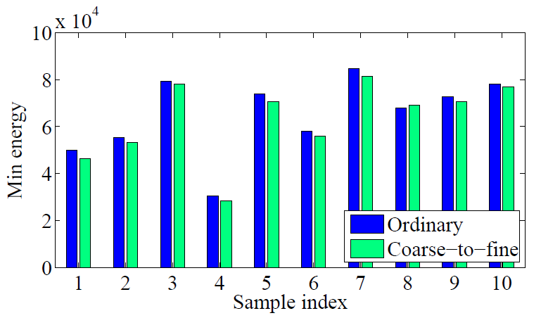
Coarse-to-fine is not just faster, but achieves lower energy
Coarse-to-fine SIFT flow algorithm is able to obtain lower energy than the ordinary algorithm most of the time

Slide 18
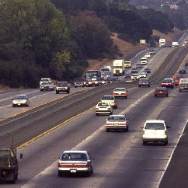
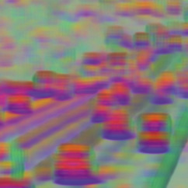
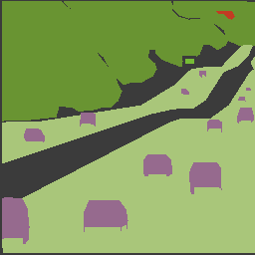
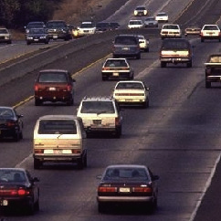
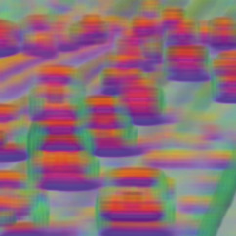
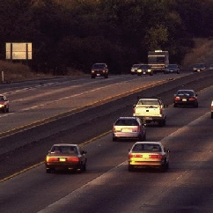
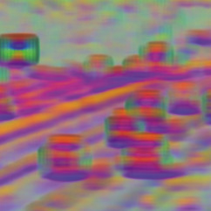
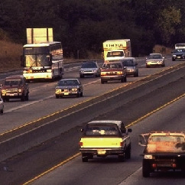
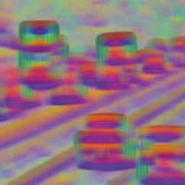
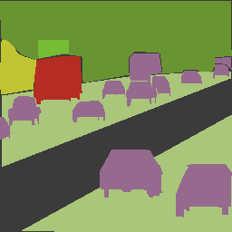
Label transfer system overview
RGB
SIFT
Query
tree
SIFT flow
RGB
SIFT
Annotation
sky
Nearest neighbors
road
field
car
unlabeled

Slide 19
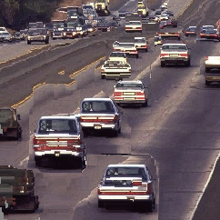
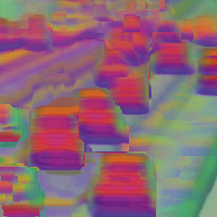
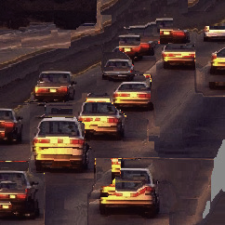
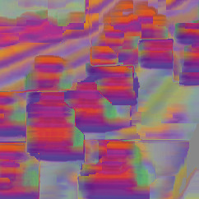
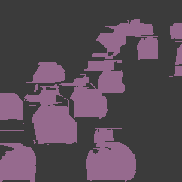
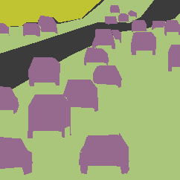
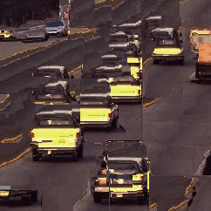
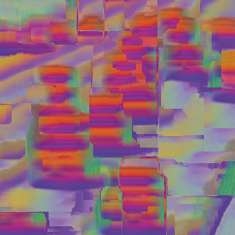
Label transfer system overview
RGB
SIFT
Parsing
Ground truth
Query
Good matches → higher weight; CRF
tree
SIFT flow
RGB
SIFT
Annotation
sky
Warped nearest neighbors
road
field
car
unlabeled

Slide 20
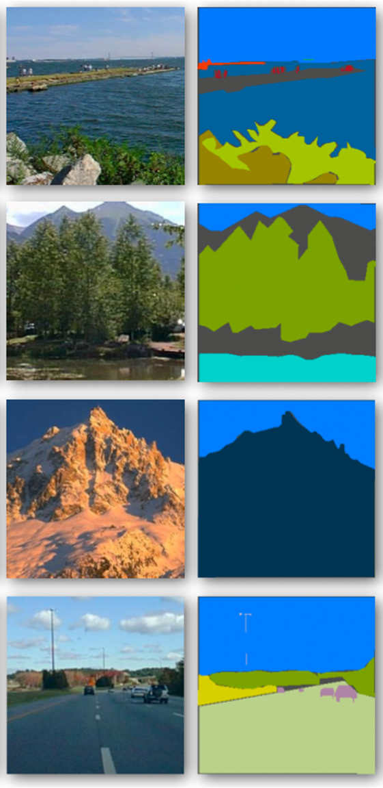
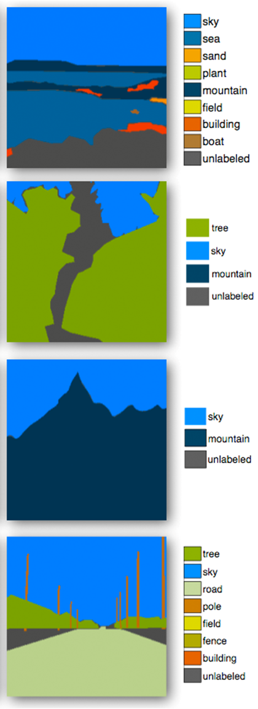
Scene parsing results (1)
Query
Best match
Annotation of best match
Warped best match to query
Parsing result of label transfer
Ground truth

Slide 21
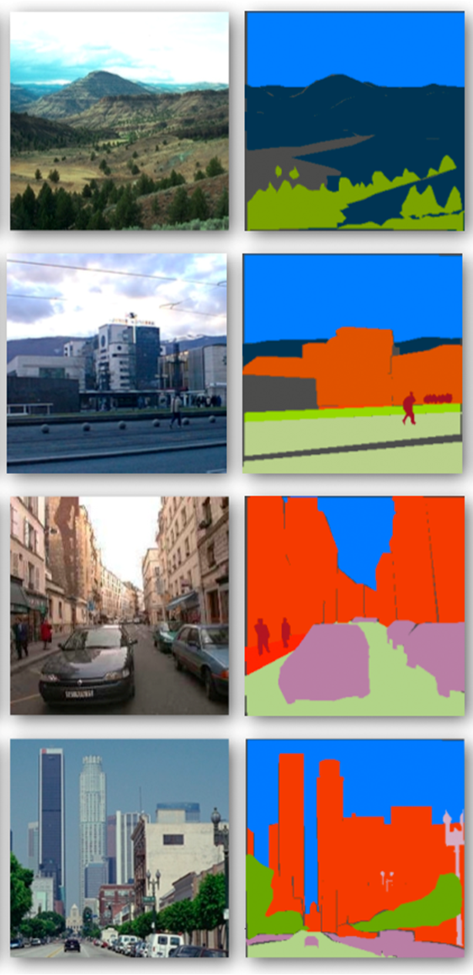
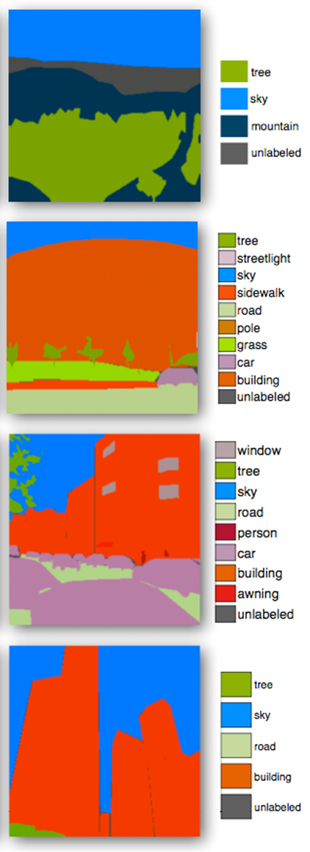
Scene parsing results (2)
Query
Best match
Annotation of best match
Warped best match to query
Parsing result
Ground truth

Slide 22
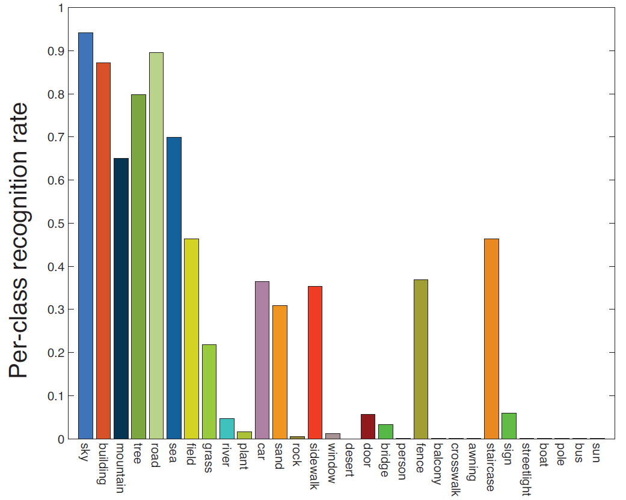
Pixel-wise performance
Our system
optimized parameters
Per-pixel rate 74.75%
Pixel-wise frequency count of each class
Stuff
Small, discrete objects

Slide 23
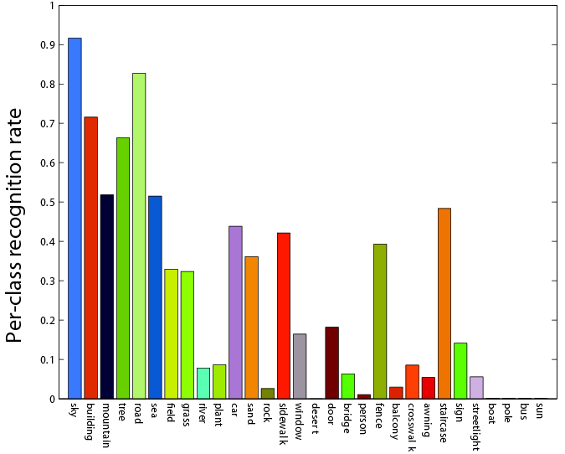
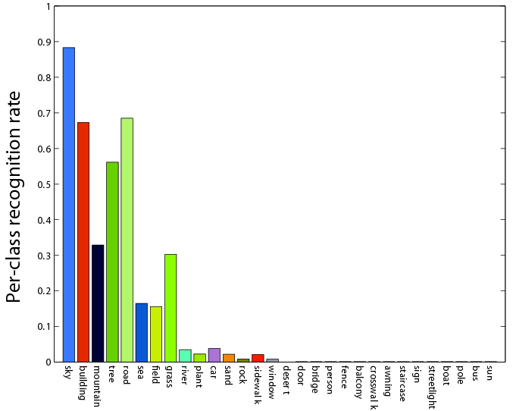
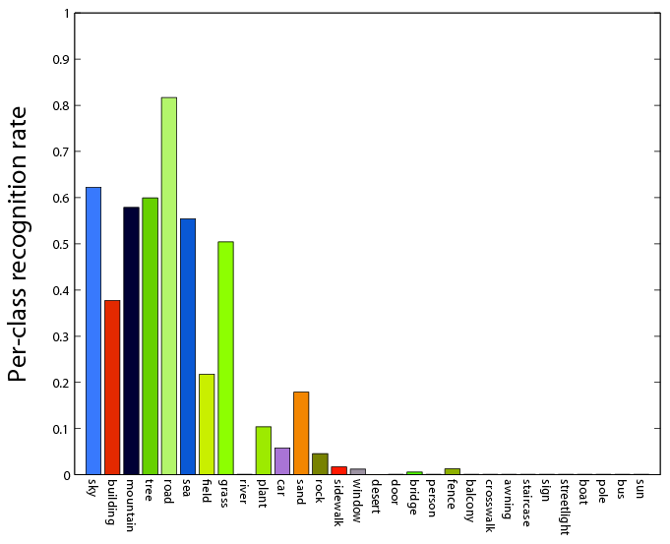
The relative importance of different components of our system
(a) Label transfer (SIFT flow)
With MRF
74.75%
(b) Label transfer (SIFT flow)
Without MRF
66.24%
(c) Texton (Shotton et al.)
Without MRF
51.67%
(d) Label transfer (optical flow)
With MRF
49.68%
J. Shotton et al. Textonboost: Joint appearance, shape and context modeling for multi-class object recognition and segmentation. ECCV, 2006

Slide 24
Comparison with sliding window detectors
We convert our system to a binary detector for each class and compare it with [Dalal & Triggs. CVPR 2005]
In ROC, our system (red) outperforms theirs (blue) for most of the classes

Slide 25
Summary: label transfer using SIFT flow
Scene parsing and object recognition can be implemented in a brand new way
Label transfer: the annotations are transferred from support images to parse the query based on scene correspondence
SIFT flow: coarse-to-fine algorithm to efficiently establish dense scene correspondence
Easy to implement, no training of classifiers, has a few parameters and embeds contextual information
Code will be online soon!

Slide 26
Thank you!
Ce Liu Jenny Yuen Antonio Torralba
CSAIL MIT

